Slide 1
Are Community Indices for Wealth and Poverty Associated with Food Insecurity and Child Hunger?
Bethany A. Bell, Angela D. Liese, & Sonya Jones
University of South Carolina
March 21, 2014

Slide 2
Midlands Family Study (MFS): Background
Funded by University of Kentucky Center for Poverty Research /USDA
Project period: 06/16/2011 -12/15/2013
Investigative team: Sonya Jones (PI), Co-I’s: Bethany Bell, Christine Blake, Darcy Freedman, Angela Liese, Jan Probst
Project Coordinator: Carrie L. Draper, MSW
Many wonderful GAs and other project staff

Slide 3
MFS Overall Research Objectives
Identify the household conditions that distinguish among households experiencing:
Very low food security in children (VLFS)
Food insecurity but not VLFS
Food secure households
Identify the community conditions that distinguish among the three groups of households

Slide 4
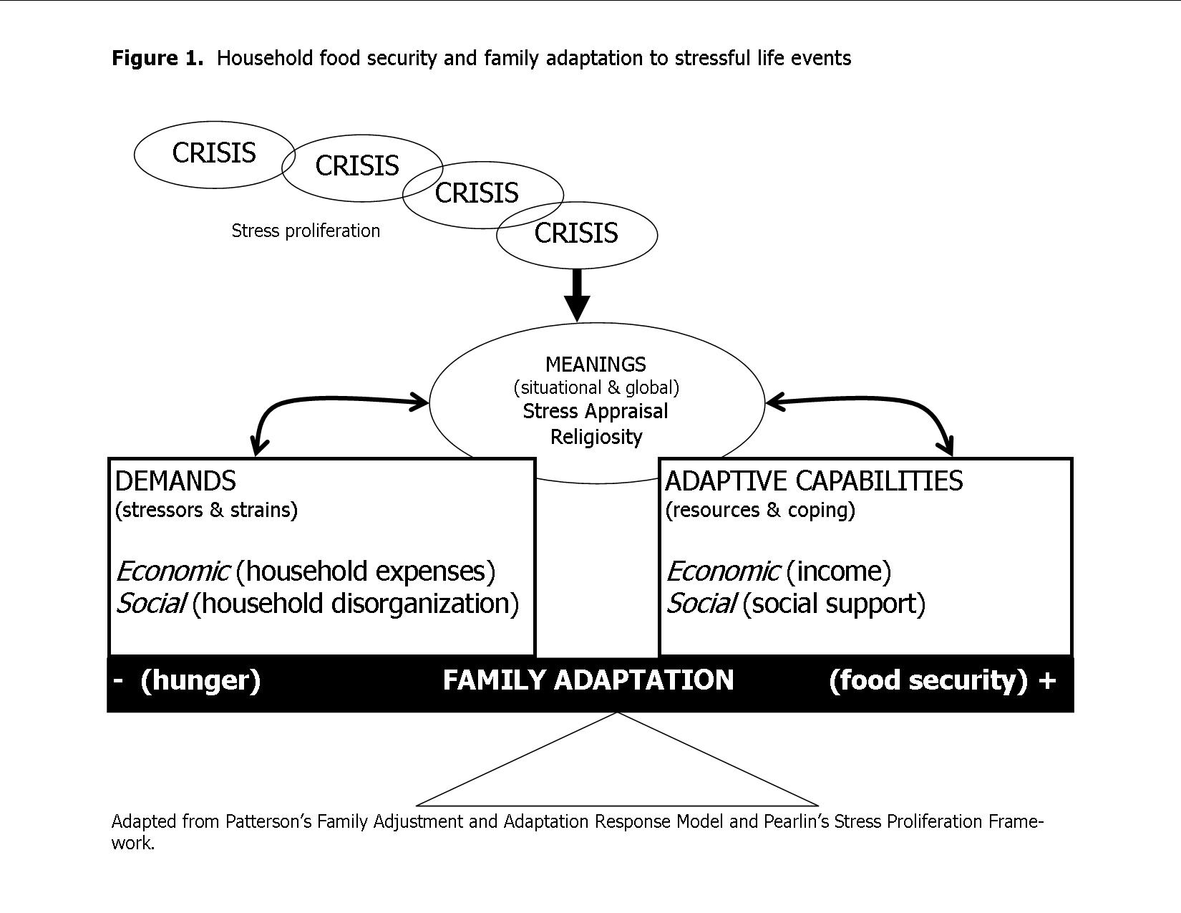
Family Adaptation Framework

Slide 5
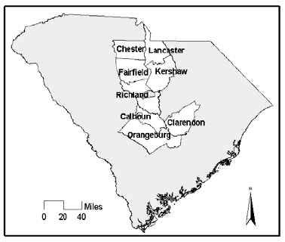
Study Population
Eight counties in midlands region of South Carolina
470 block groups
80,600 households
Notes:
Primary data collection from over 500 families across 8 midland counties
We conducted this study in the Midlands region of South Carolina. The urban region of our study is Columbia, SC and includes 132,000 and the seven surrounding counties and rural areas in the same county have about 590,000 people. The population of the region is roughly ½ African American and ½ White.

Slide 6
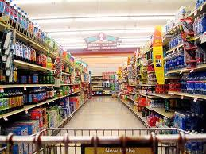
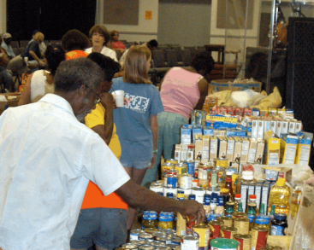
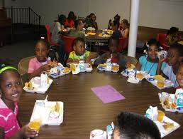
Recruitment
Grocers Restaurants Emergency food Food assistance
Randomly selected
recruitment sites
(249 urban/ 178 rural)
Key informant interviews
Purposively selected
Clients, customers, visitors, participants recruited from site
Final sample (n = 544):
179 VLFS, 207 Food insecure, 158 food secure
Respondents allowed to invite up to 4 others (25% of sample)
Notes:
To recruit participants, we constructed a sampling framework guided by food systems stakeholders. Food systems stakeholders included traditional (e.g., grocery stores, convenience stores, farmers markets, daycare providers) and emergency(e.g., food pantries and backpack programs that targeted families and children. We generated a list of 1,646 potential recruitment sites through online searches or by contacting the appropriate agency or organization overseeing relevant programming (e.g., obtaining lists of summer feeding sites from the South Carolina Department of Education and the Department of Social Services).
We stratified these by urban (n=776) and non-urban location (n=870). We randomly selected an initial 40 urban and 40 rural sites for recruitment. When we exhausted those sites, we randomly selected new sites at which to identify and recruit families. Often selected sites were out-of-business, otherwise unreachable, refused to participate in recruitment, or did not yield participants. We continued to replace sites as necessary. By the end of the study, we had contacted 249 urban sites and 178 non-urban sites.
Aimed for 200 per group but did not quite get that many.

Slide 7
Today’s Research Question
Can composite indices of community poverty and affluence help identify areas where households with VLFS are likely to be found?
Notes:
Previous research has shown that a variety neighborhood characteristics such as affluent neighbors, low-income neighbors, and residential instability are related to many child outcomes (e.g., cognitive functioning, low-birth-weight-rates, and child maltreatment). However, little is known about the relationship between where children live and child hunger.

Slide 8
Community Poverty
Low SES (Duncan & Aber, 1997)
% of families with children headed by females
% of non-Latino individuals who are black
% of non-Latino individuals who are white
% of nonelderly individuals who are poor
% of families with children living as subfamilies
Ratio of children to families with children
Ratio of two-parent families to children
Notes:
(representing poor, black, female-headed families)
^{b}Duncan & Aber, 1997

Slide 9
Community Affluence
Neighborhood Wealth Score (Diez Roux et al., 2001)
Log of the median household income
Log of the median value of housing units
% of households receiving interest, dividend, or net rental income
% of adults 25 years of age or older who had completed high school
% of adults 25 years of age or older who had completed college
% of employed persons 16 years of age or older in executive, managerial, or professional specialty occupations
Notes:
(representing dimensions of wealth and income, education, and occupation)
ªDiez Roux et al., 2001

Slide 10
Data Analysis
Multinominal logistic regression was used to estimate the relative risk of experiencing food insecurity or child hunger in comparison to food secure families, as a function of community poverty and affluence
Models controlled for all the caregiver and family level variables (i.e., constructs from family adaptation framework)
crisis, economic demands, economic capabilities, social demands, social capabilities, world view, and demographics

Slide 11
Study Sample Characteristics (n=477)
Demographics
Race
Black | 0.79 | 0.69 | 0.78 | 0.89
Urbanicity
Urban | 0.57 | 0.57 | 0.48 | 0.68
Number of Children in House
1 | 0.35 | 0.34 | 0.38 | 0.34
2 | 0.36 | 0.36 | 0.38 | 0.33
3 | 0.29 | 0.30 | 0.24 | 0.33
Number of Adults in House
1 | 0.45 | 0.39 | 0.48 | 0.48
2 | 0.41 | 0.49 | 0.35 | 0.41
3 | 0.14 | 0.12 | 0.17 | 0.11
Education
% College Degree or more | 0.25 | 0.39 | 0.22 | 0.16

Slide 12
Results
Multinomial regression (with robust SEs) results examining community wealth and poverty and food security status (n = 477)
 | Food secure vs. food insecure RRR (95% CI) | Food secure vs. VLFS RRR (95% CI)
Neighborhood Wealth Score | 0.97 (0.88, 1.06) | 0.90 (0.79, 1.02)
Low SES | 1.00 (0.99, 1.00) | 1.00 (0.99, 1.00)
Notes:
Results: Neither neighborhood wealth nor low SES were significantly related to FSS. For example,VLFS families have lower odds of living in communities with an average level of neighborhood wealth compared to FS families. Likewise, VLFS families have lower odds of living in communities with average levels of low SES compared to FS families However, these relationships were not statistically significant.

Slide 13
Discussion
Using widely available data to target efforts to end child hunger is appealing because of potential cost savings
Unfortunately, no evidence to suggest that families experiencing child hunger in this study lived in neighborhoods with more or less wealth or poverty than families not experiencing child hunger
Notes:
Discussion: Using widely available data to target efforts to end child hunger is appealing because of potential cost savings. Unfortunately, families experiencing child hunger in this study did not easily follow geographic patterns that could be used for targeting interventions. Future research should examine other data sources, and possibly other community indices, that could be used for targeting.

Slide 14
Discussion (cont)
Do these results mean that hungry children reside in all types of neighborhoods?
If so, what might that mean from a policy or intervention perspective?
Might there be other neighborhood characteristics that might better identify areas where families experiencing child hunger live?
If so, what might those characteristics be?

