Slide 1
Building a systems map of childhood food security in the US: A qualitative map to inform quantitative modeling
Nancy L. Fleischer^{1,2}, Ross Hammond³, Xiaoguang Ma², Sonya Jones^{2,4}, Edward A. Frongillo⁴, Craig Gundersen⁵, Jay Hirschman⁶, Alisha Coleman-Jensen⁷, Neil Mehta⁸, Angela D. Liese^{1,2}
¹Department of Epidemiology and Biostatistics, Arnold School of Public Health, University of South Carolina. ²Center for Research in Nutrition and Health Disparities, ASPH, USC. ³Center on Social Dynamics and Policy, the Brookings Institute. ⁴Department of Health Promotion, Education, and Behavior, ASPH, USC. ⁵Department of Agricultural and Consumer Economics, University of Illinois. ⁶Special Nutrition Research and Analysis Division, Food and Nutrition Service, ⁷Food Assistance Branch, Economic Research Service, U.S. Department of Agriculture. ⁸Hubert Department of Global Health, Rollins School of Public Health, Emory University.

Slide 2
Acknowledgements
This study was funded by Advanced Support Program for Integration of Research Excellence-II (ASPIRE-II) from the Office of the Vice President for Research at University of South Carolina.
The views expressed are those of the authors and should not be attributed to the Food and Nutrition Service, the Economic Research Service or USDA.

Slide 3
What do we know about childhood food security in the US?
In 2012, one in every five American households with children lacked food security at some time during the year
Despite considerable increases in federal food assistance spending over the past decade, the lack of food security is at its highest since measurement began in the mid-1990s
Project goal: develop a systems map to improve our understanding of childhood food security in US

Slide 4
What is a systems map?
Visual model of important elements that impact childhood food security
Qualitative method used in systems science to inform what parts of a system are important to consider in quantitative modeling

Slide 5
How did we create a systems map?
Two-day workshop in December 2013 of experts with backgrounds in demography, economics, epidemiology, health behavior, nutrition, sociology, and systems science
Discussion of key actors, pathways and processes that impact the childhood food security system
Identified several key elements for the map

Slide 6
How did we create a systems map?
A draft map was generated by end of second day
Following workshop, we created a digitized version of the map for panel to consider and provide comments
Map refined following series of conference calls in February 2014

Slide 7
Map elements
Sectors
Actors
Program/policy levers
Flows

Slide 8
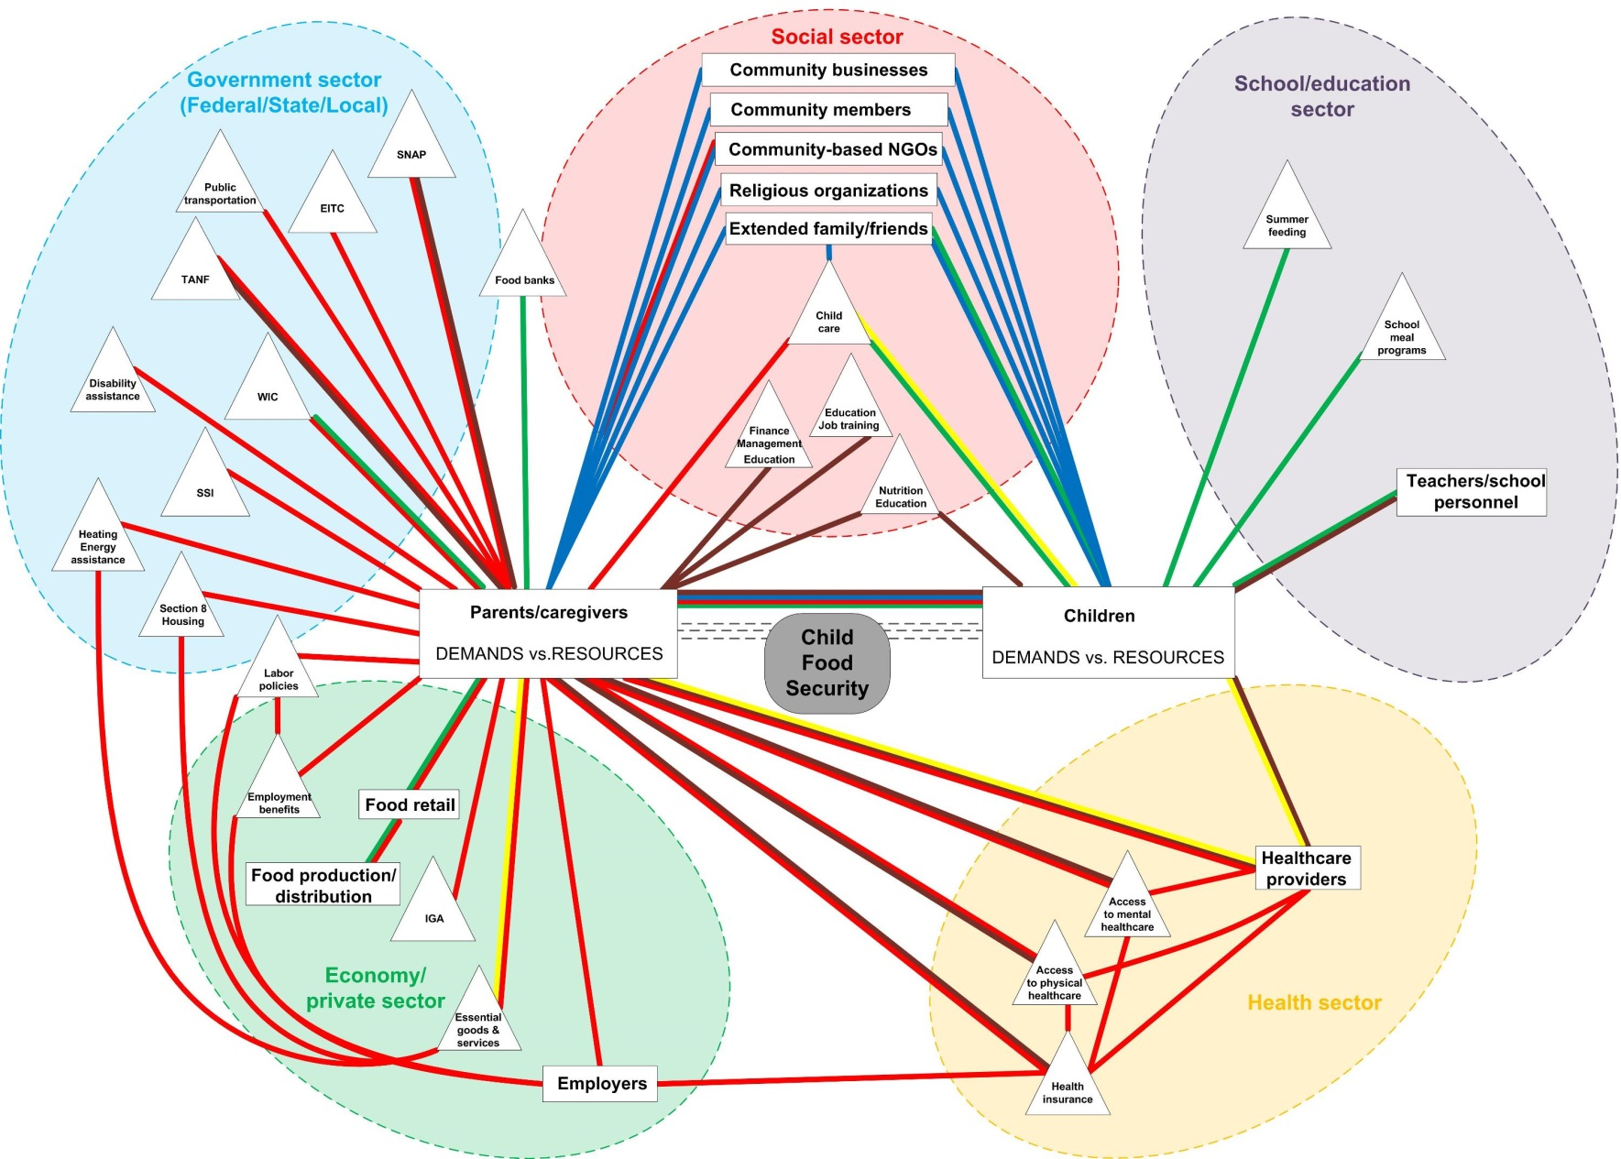
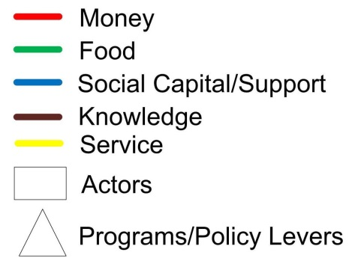
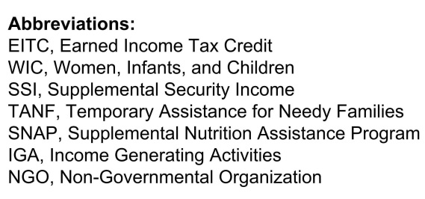
Systems map for child food security in US

Slide 9
Next steps for systems map project
Refinement of map is ongoing
Map will be used as the basis for a subsequent system dynamics model
Goal is to identify key intervention points to improve childhood food security

Slide 10
Thank you! Questions?

