Slide 1
Neighborhood Food Access and Food Security Status among Households with Children
www.deviantart.com/art/Fast-Food-168232056
Xiaoguang Ma
Postdoctoral Fellow
Center for Research in Nutrition and Health Disparities
Arnold School of Public Health, University of South Carolina
4th Nutrition Center Symposium
March 18, 2014

Slide 2
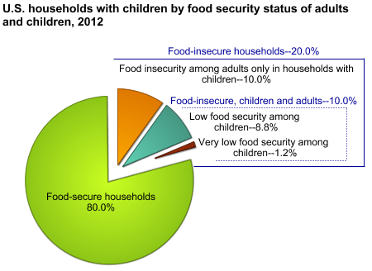
Introduction
Food security status of US children:
Food insecure households with children: 20.0%
Very low food secure households with children: 1.2%
Neighborhood food access relates to:
Dietary intake, e.g. fruit and vegetable intake
Nutrition status
Health outcomes, e.g. obesity
Few studies have examined neighborhood food access and food security status.

Slide 3
Objectives
To identify associations between perceptions of neighborhood food access and food security status among households with children
To identify associations between geographic access to food stores and food security status among households with children

Slide 4
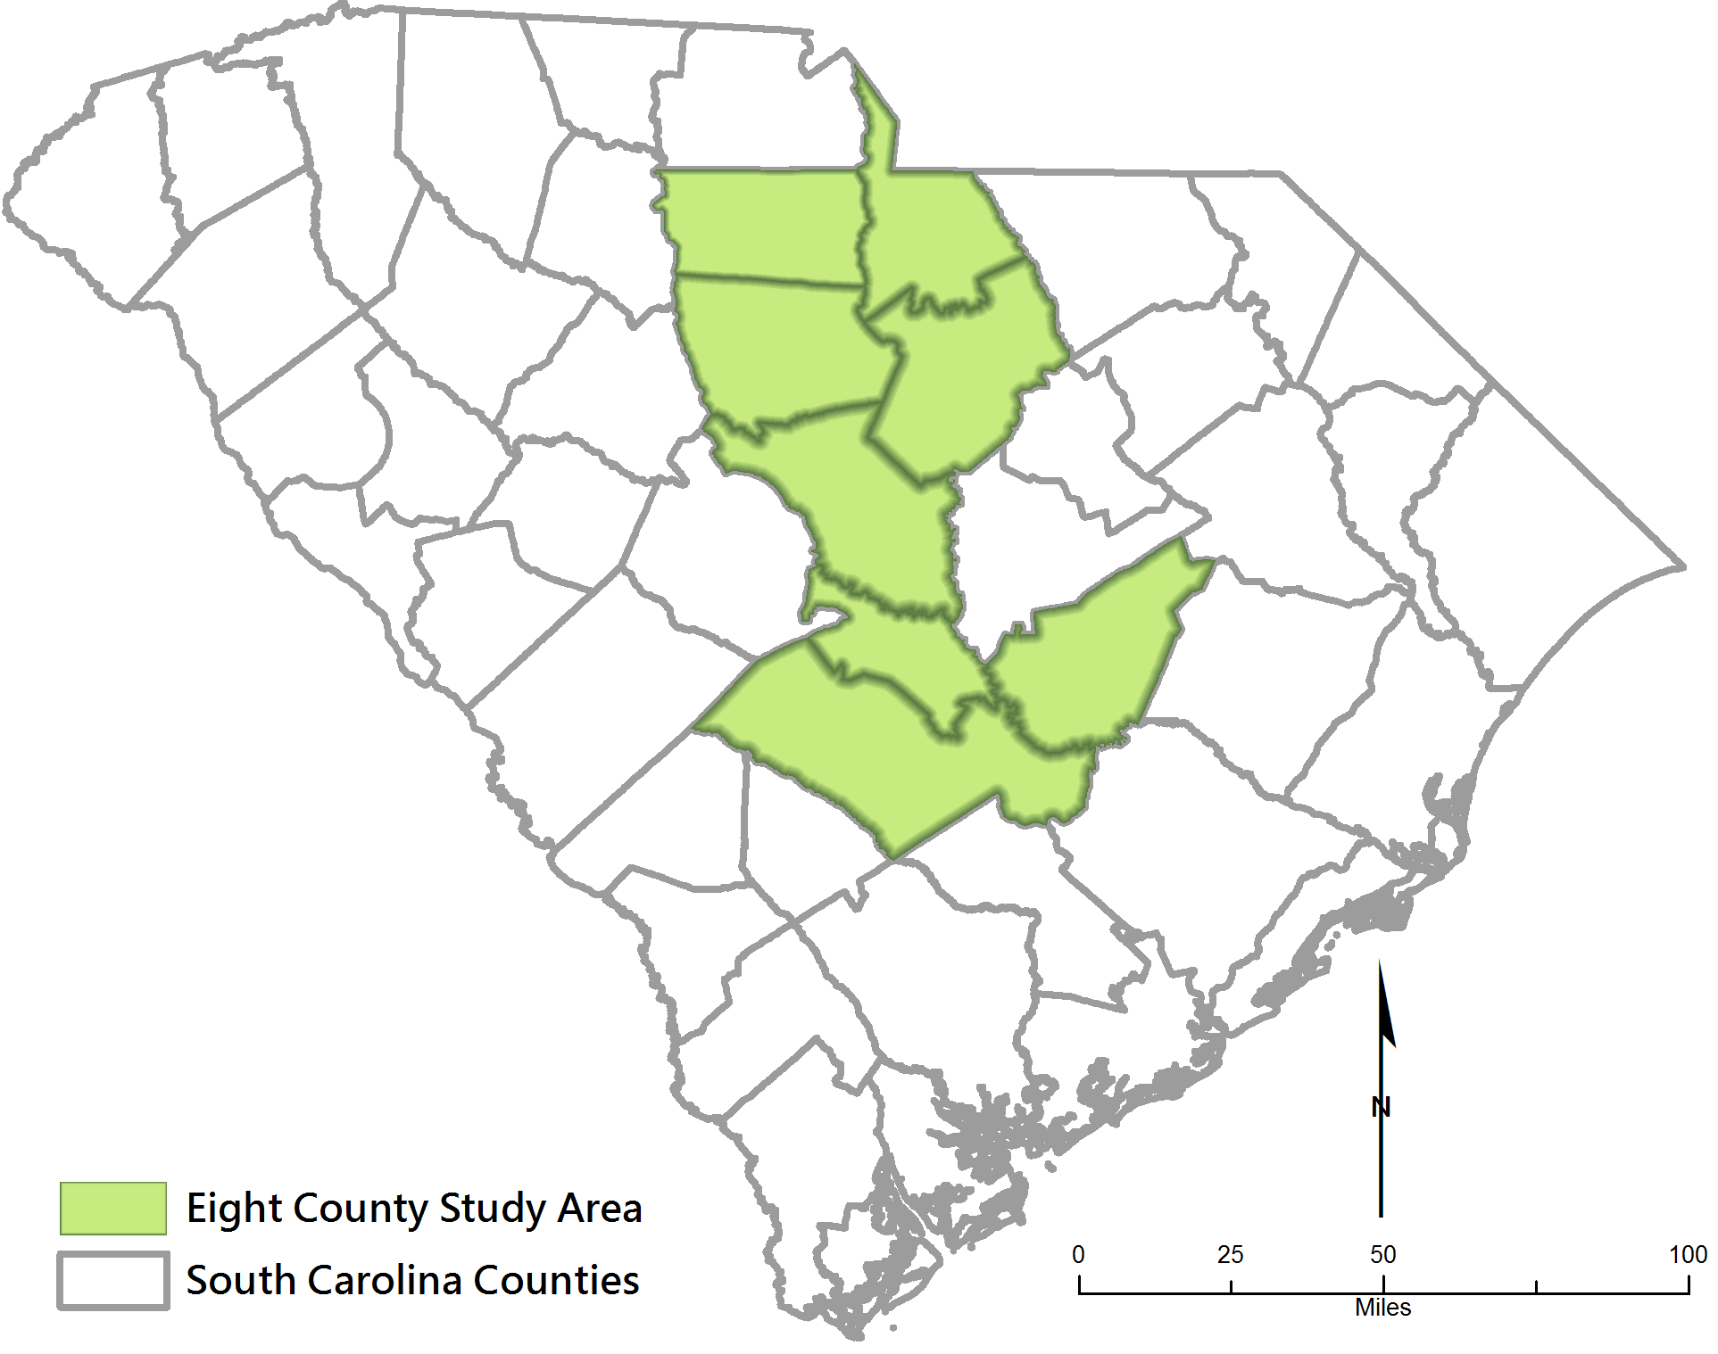
Study Population and Area
The Midlands Family Study: to understand the household and community conditions associated with very low food security in children
544 households with children in Midlands of South Carolina

Slide 5
Measures
Food security status among children (Household Food Security Survey Module)
Very low food security: 5+ affirmations of 8 children items (N=179)
Food insecurity: 3+ affirmations of 18 items but not VLFS-C (N=207)
Food security: 0-2 affirmations of 18 items (N=158)
Perceptions of neighborhood food access (Multi-Ethnic Study of Atherosclerosis Food Access Measures)
Availability of fruits and vegetables (1.strongly disagree – 6.strongly agree)
Quality of fruits and vegetables (1.strongly disagree – 6.strongly agree)
Fruits and vegetables are affordable (1.strongly disagree – 6.strongly agree)
Availability of low fat products (1.strongly disagree – 6.strongly agree)
Opportunities to purchase fast foods (1.strongly disagree – 6.strongly agree)
Food access is a problem (1.very serious problem – 4.not really a problem)
Access to food stores (Geographic Information System, GIS)
Network distance to the nearest supermarket and grocery store in miles
Residence within 1 mile from the nearest supermarket and grocery store
Residence over 4 miles from the nearest supermarket and grocery store

Slide 6
Statistical Analysis
GIS analysis
Census 2010 geographic boundaries
ArcGIS 10.0
Multinomial logistic regression models
Food security group as reference group
Covariates: race, urban, number of children in household, number of adults in household, homelessness, monthly mortgage/rent, monthly transportation, monthly utilities, health care expenses $2,000+, monthly household wages, CHAOS Scale, social support, negative life events, perceived stress, intrinsic religiosity
Robust standard error estimate for cluster sampling data
Robust standard errors were calculated in STATA 10
Census tract as the cluster variable (544 participants in 119 tracts)
Notes:
Do these results control for clustering? If not, they should in order to prevent standard errors from being too small.

Slide 7
Results - Descriptive
Neighborhood Food Access Measures | Food Security N=158 | Food Insecurity N=207 | VLFS N=179
 | Mean (SD) or Percentage
Perceptions of neighborhood food access
Availability of fruit and vegetable‡ | 4.0±0.2 | 3.8±0.1 | 3.5±0.2
Quality of fruit and vegetable‡ | 4.0±0.2 | 3.7±0.1 | 3.4±0.1
Fruits and vegetables are affordable‡ | 4.1±0.1 | 3.8±0.1 | 3.3±0.1*
Availability of low fat product‡ | 4.0±0.1 | 3.8±0.1 | 3.4±0.1
Opportunities to purchase fast food‡ | 4.2±0.2 | 4.5±0.1 | 4.5±0.1
Food access is a problem† | 3.2±0.1 | 3.0±0.1 | 2.6±0.1*
Geographic access to supermarkets and grocery stores
Distance to nearest supermarket, miles | 2.0±2.0 | 2.3±2.4 | 1.7±1.7*
Residence within 1 mile from supermarket | 29.6% | 29.3% | 36.3%
Residence over 4 miles from supermarket | 12.0% | 17.3% | 11.7%

Slide 8
Results – Multinomial Models
Neighborhood Food Access Measures | FI vs FS | VLFS vs FS
 | Relative Risk Ratios (95% CI)
Perceptions of neighborhood food access
Availability of fruit and vegetable | 0.95 (0.81, 1.12) | 0.80 (0.66, 0.96)
Quality of fruit and vegetable | 0.91 (0.77, 1.08) | 0.77 (0.63, 0.93)
Fruits and vegetables are affordable | 0.92 (0.77, 1.08) | 0.66 (0.54, 0.79)
Availability of low fat product | 0.94 (0.79, 1.12) | 0.77 (0.64, 0.95)
Opportunities to purchase fast food | 1.17 (1.01, 1.37) | 1.04 (0.87, 1.24)
Food access is a problem | 0.85 (0.66, 1.10) | 0.58 (0.43, 0.79)
Geographic access to supermarkets and grocery stores
Distance to nearest supermarket, miles, log | 1.00 (0.74, 1.35) | 0.95 (0.65, 1.40)
Residence within 1 mile from supermarket | 0.83 (0.48, 1.46) | 0.81 (0.44, 1.52)
Residence over 4 miles from supermarket | 1.27 (0.59, 2.71) | 0.97 (0.35, 2.67)

Slide 9
Conclusions
Perceived access to quality, affordable fruits and vegetables is low among VLFS-C families, but the mapped data suggests that fruits and vegetables may be present in close by store.
Perceived food access is a problem among VLFS-C families, but there is no difference to access the supermarkets and grocery stores.
Perceived access to healthful and affordable foods may be an important factor of food security status.

Slide 10
Acknowledgement
Dr. Angela Liese, Dr. Sonya Jones
GIS analysis: James Hibbert
The Midlands Family Study group: Bethany Bell, Christine Blake, Darcy Freedman, Jan Probst, Lauren Martini, Mike Burke, Nicholas Younginer, Erin Drucker
Funding by a grant from the University of Kentucky Center for Poverty Research through funding by the U.S. Department of Agriculture, Food and Nutrition Service, contract number AG-3198-B-10-0028, and the Advanced Support Program for Integration of Research Excellence-II (ASPIRE-II) grant from the Office of the Vice President for Research at University of South Carolina. The opinions and conclusions expressed herein are solely those of the authors and should not be construed as representing the opinions or policies of the UKCPR or any agency of the Federal Government.

Slide 11
Thanks! Questions?
http://www.deviantart.com/art/Two-of-a-Kind-168564870

