Slide 1
Study abroad updates
Spring 2020 #s
Education Abroad Application System (EAASy)
New Advisor Guide Online
Peace Corps Prep Program
4th Annual Advisor’s Conference on Study Abroad

Slide 2
Study abroad updates
Total Spring Students: 782 (+32%)
Arnold School of Public Health: 58 (+76%)
College of Arts and Sciences: 164 (+27%)
College of Education: 1 (-67%)
College of Engineering and Computing: 18 (+64%)
College of Hospitality, Retail, and Sport Management: 62 (+41%)
College of Information and Communications: 86 (+72%)
College of Nursing: 12 (+50%)
College of Social Work: 0 (0%)
Darla Moore School of Business: 374 (+19%)
IB Majors: 147 (+8%)
Non-IB Majors: 213 (+10%)
School of Music: 0 (0%)
South Carolina Honors College: 152 (+2%)
Spring 2020 #s
Education Abroad Application System (EAASy)
New Advisor Guide Online
Peace Corps Prep Program
4th Annual Advisor’s Conference on Study Abroad

Slide 3
Study abroad updates
The Study Abroad Office is moving the online application platform from Symplicity to the Education Abroad Application System (EAASy) effective for the 2020-2021 academic year. Please refer to the dates below to determine which platform to use when applying for study abroad programs.
Spring 2020 #s
Education Abroad Application System (EAASy)
New Advisor Guide Online
Peace Corps Prep Program
4th Annual Advisor’s Conference on Study Abroad
Program | EAASy Launch Date | For Semester/Year
International Business | Mid-February | Spring 2021
Global Exchange | Early April | Spring 2021
Global Direct | Early April | Spring 2021
Global Partner | Early July | Spring 2021
Global Classroom | Early July | Fall Break 2020

Slide 4
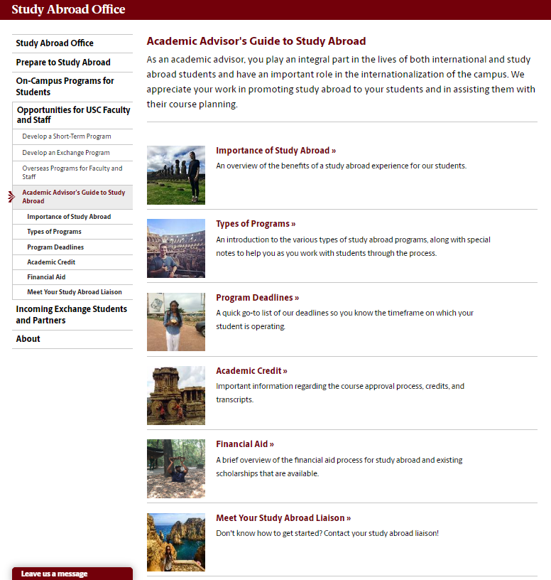
Study abroad updates
Spring 2020 #s
Education Abroad Application System (EAASy)
New Advisor Guide Online
Peace Corps Prep Program
4th Annual Advisor’s Conference on Study Abroad
https://sc.edu/about/offices_and_divisions/study_abroad/opportunities_for_usc_faculty_and_staff/academic_advisors_guide_to_study_abroad/

Slide 5

Study abroad updates
Spring 2020 #s
Education Abroad Application System (EAASy)
New Advisor Guide Online
Peace Corps Prep Program
4th Annual Advisor’s Conference on Study Abroad
Certificate program that gives you a competitive advantage when applying to the Peace Corps
Become more familiar with the Peace Corps application process while also highlighting your own skills and experiences
Centers on four core competencies
Work sector
Foreign language skills
Intercultural Competence
Professional & Leadership Development

Slide 6
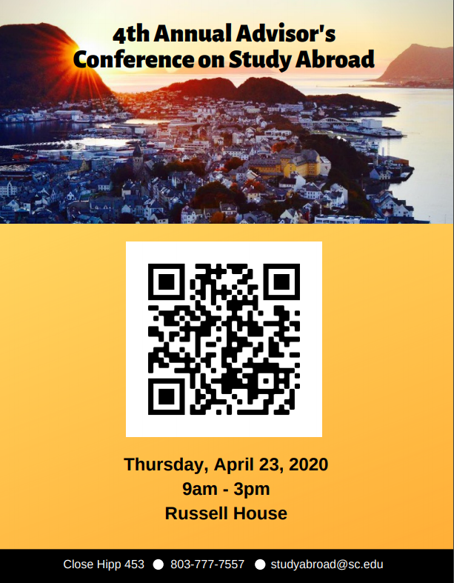
Study abroad updates
Spring 2020 #s
Education Abroad Application System (EAASy)
New Advisor Guide Online
Peace Corps Prep Program
4th Annual Advisor’s Conference on Study Abroad

