Slide 1
Controller’s Office – Journal Entry Training March 19, 2019

Slide 2
Discussion Topics
Journal Entry Overview
How to create/copy/delete a Journal Entry
Journal Entry demonstration in PeopleSoft
Where to find the Resources referenced in this presentation
General Accounting Email Address

Slide 3
Journal Entry Overview
PeopleSoft journal entries (JEs), are used to make any adjustment other than PeopleSoft AP payment voucher adjustments and Expense Module adjustments.
• JEs are processed by departments using PeopleSoft's online system. Once they are submitted and approved by the department, the Controller’s Office will then review, approve and post the entries.
When to Create a Journal Entry:
• Deposit corrections; 86/81 transfers; Creating/correcting RQs/llTs.
• Any ONL source transaction adjustment (Online Journal Entry.)
• Any Single Pay “Travel Expense” AP payment vouchers.
• Any transaction that happened prior to PeopleSoft.
When Not to Create a Journal Entry:
• To adjust AP (non-travel related) Vouchers.
A Journal Voucher (JV eForm) should be submitted via PeopleSoft. Instructions on JV eForms can be found on the Controller’s website.
• To adjust Expense Module transactions for the following:
(Employee Travel, Procurement Card and Team Card)
An Expense Module Correction Form must be used. This form is located on the Controller’s website.

Slide 4
How to Create a Journal Entry
Journal Entries are created within the General ledger.
Navigation Path: Main Menu → General Ledger → Journals → Journal Entry → Create/Update Journal Entries
Click the Add a New Value tab.
Click the Add button.
Do not enter a JE # - system will assign

Slide 5
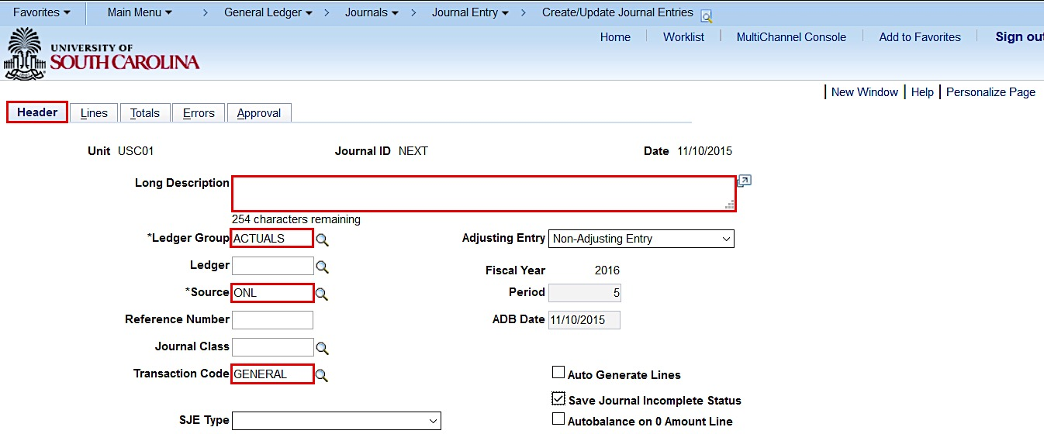
How to Create a Journal Entry
Use the Header tab to ensure the following fields are populated:
Ledger Group - ACTUALS, Source - ONL, Transcode – GENERAL (DO NOT CHANGE THESE FIELDS)
Long Description(required) –should reflect purpose of JE; required for JE approval to post.

Slide 6
How to Create a Journal Entry
Use the Header tab to ensure:
The Adjusting Entry field is “Non-Adjusting Entry”. Adjusting Entries are the year end adjustments that are made by Controller’s Office.
It is recommended you check the Save Journal Incomplete Status box. If you cannot, please contact pssecure@mailbox.sc.edu so they can update your user preferences.

Slide 7
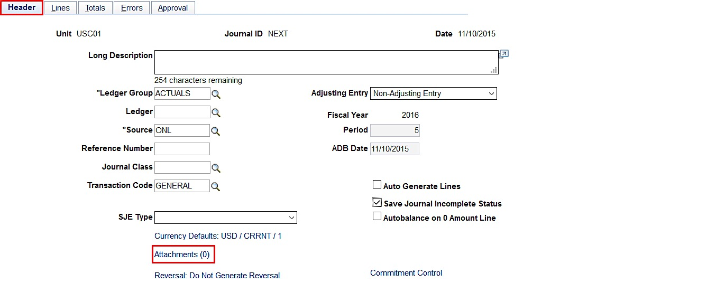
How to Create a Journal Entry
Add Attachments on the Header tab:
Click the Attachments link.
If you have more than one document to attach, you can scan and attach them as one document or you can attach each document separately. When adding documents separately be sure to Save after attaching each one.

Slide 8
How to Create a Journal Entry
Types of supporting documentation:
Pages or screenshots from PeopleSoft or the Finance Intranet. Also Spreadsheets, emails, letters or memos are acceptable.
81/86 Transfer: Documentation from PeopleSoft or the Finance Intranet showing the funds are available in the account where the funds are being moved from to verify the funds are available for the move.
A journal entry must be self-containing so that someone reviewing the entry (including auditors) can see what adjustment was made and why.
Relevant attachment is required for JE approval to post
When attaching documents be sure to add a description of the document using the Description field.

Slide 9
How to Create a Journal Entry
Use the Lines tab to enter chartfield string information.
Before entering the chartfield string you can use the Personalize link to hide or sort columns.
On the Lines tab, enter the chartfield string in respective boxes. Refer to the PeopleSoft Crosswalk for chartfield information as needed.
Note: PC Bus Unit, Project, and Activity are only used for projects and grants (in addition to the required chartfields).
Note: PC Bus Unit, Project, and Activity are only used for projects and grants (in addition to the required chartfields).

Slide 10
How to Create a Journal Entry
When creating a journal entry, at least 2 journal lines need to be added, a positive line and a negative line.
Add the 1st journal line.
Once you have keyed the first line, you have the option to click on the Template List link to control which items are copied down to the next row. (see later slide).
Click the Insert Lines button – you can add one line at a time or multiple lines.

Slide 11
How to Create a Journal Entry
Use the Template List page to select the fields that you want to be copied down when you add a journal line.
Select the STANDARD line.
Check the boxes for the fields you would like to copy down.
Click the Return/OK button to save your selections.

Slide 12
How to Create a Journal Entry

Slide 13
How to Create a Journal Entry

Slide 14
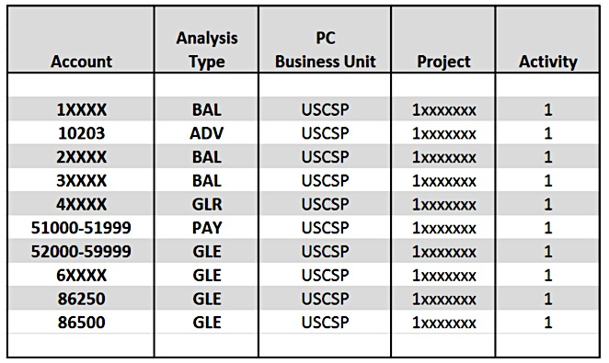
How to Create a Journal Entry
University of South Carolina
Grants and Funds Management
USCSP Analysis Type Guide
Note: All GL journal transaction lines related to the USCSP, USCIP, USCCP, USCEN, USCMP & USCSA, PC Business Units must follow the above Analysis Type Guide to ensure accurate data is cost collected into the Grants module.

Slide 15
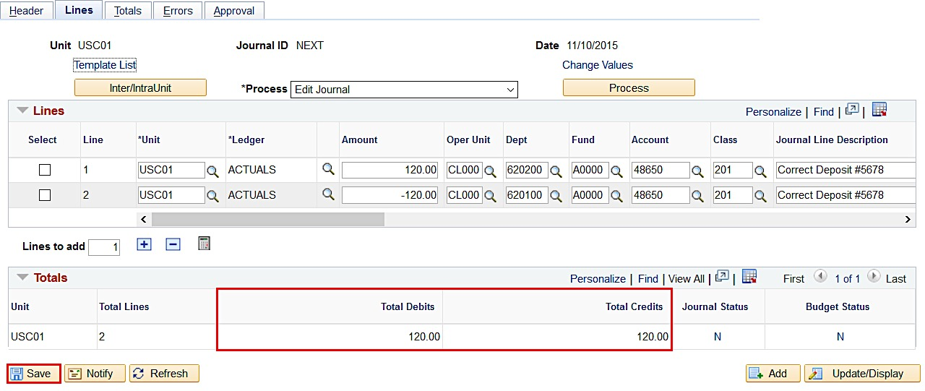
How to Create a Journal Entry
Before processing the journal entry click the Save button and make sure the Total Debits equals the Total Credits.
Save often when working in PeopleSoft!!

Slide 16
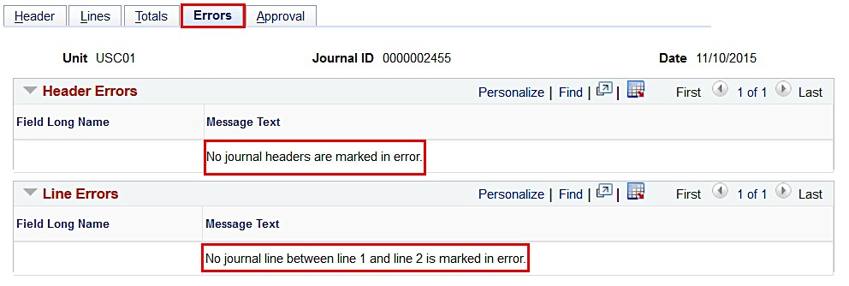
How to Create a Journal Entry
Now it’s time to Process the journal entry.
Select Edit Journal from the Process dropdown list.
Click the Process button.
If the Budget Status is showing “E” for Errors after processing, go to the Errors tab to correct the errors before posting the journal.

Slide 17
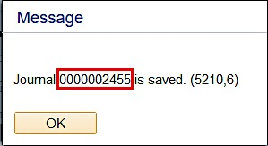
How to Create a Journal Entry
If there are no errors and the Budget Status is “Valid”, a Journal ID is assigned.

Slide 18
How to Create a Journal Entry
Use the Approval page to route the Journal for the proper approvals.
Click the Approval tab.
Click the Submit button.
Click the Approval History expand button to view who the approvers are.

Slide 19
How to Create a Journal Entry
The Journal Status and Budget Status is now showing “Valid”.
A journal can be edited after it has been submitted for approval. It can be edited after it has been approved but a change will require it go through the approval process again.
A journal can not be edited once it has been posted and the Journal Status is “P”.

Slide 20
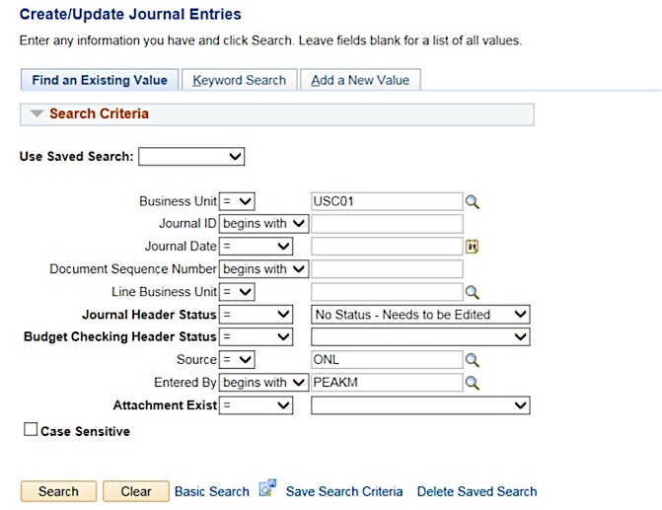
How to Search for a Journal Entry
Searching for a Journal Entry
Navigation Path: Main Menu → General Ledger → Journals→ Journal Entry → Create/Update Journal Entries
Click on Find Existing Value
Search by name, date, JE #, etc.

Slide 21
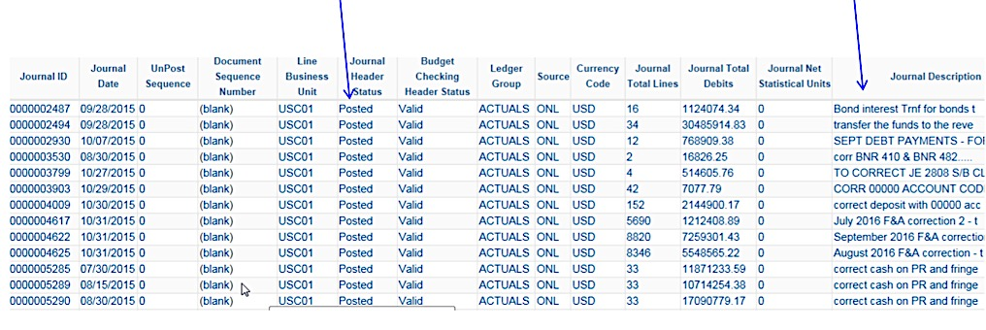
How to Search for a Journal Entry
Searching for a Journal Entry
Listing provides Status, date, description If the status is “In Process” – contact Controller’s Office

Slide 22
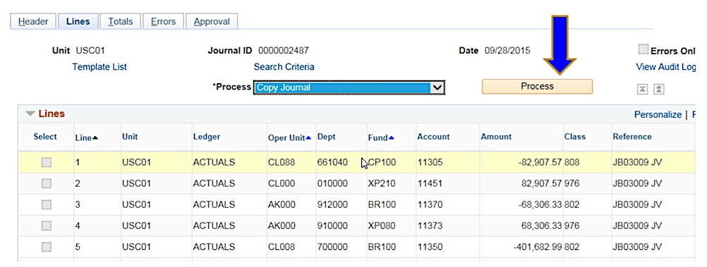
How to Copy a Journal Entry
Copying a Journal Entry

Slide 23
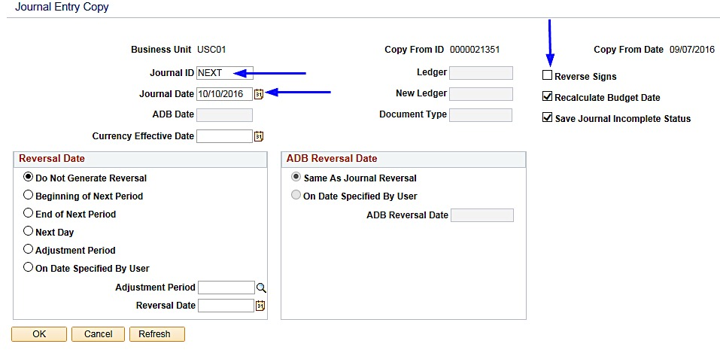
How to Copy a Journal Entry
Copying a Journal Entry
System will assign #, user may choose to reverse signs if needed, choose date to assign (will only go to open periods) - leave other information as is unless you have discussed with Controller’s Office

Slide 24
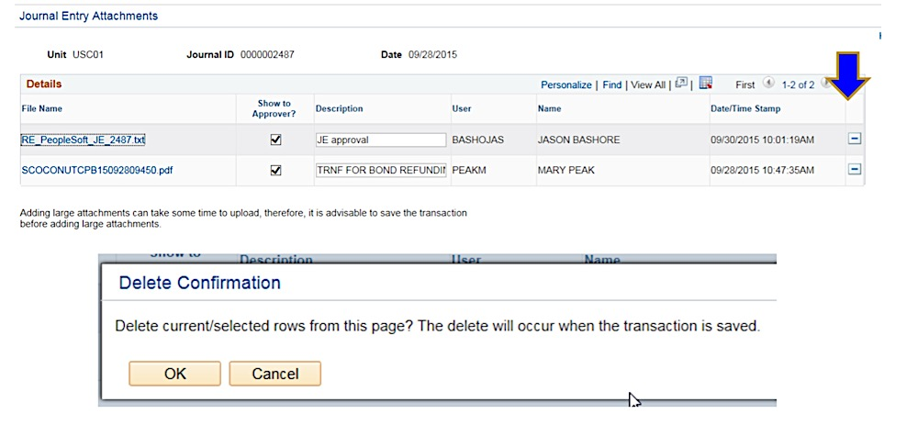
How to Delete a Journal Entry
Deleting a Journal Entry
Before attempting to delete an entry, make sure there are no Account 10300 lines. If there are, contact General Accounting to delete the entry for you.
On Header tab, delete any attachments prior to deleting the entry
Be sure to save entry with “Attachments (0)”; else system will not let you delete

Slide 25
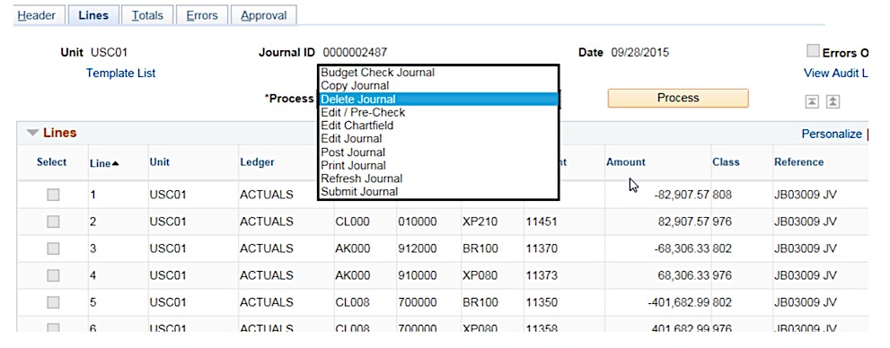
How to Delete a Journal Entry
Deleting a Journal Entry
On Lines tab, select delete and Process
System will give error message if attachments were not deleted.
Cannot delete if posted.
Once deleted – it is GONE! … therefore please be sure attachments, line info, etc. is saved elsewhere before deletion

Slide 26
PeopleSoft Demonstration

Slide 27
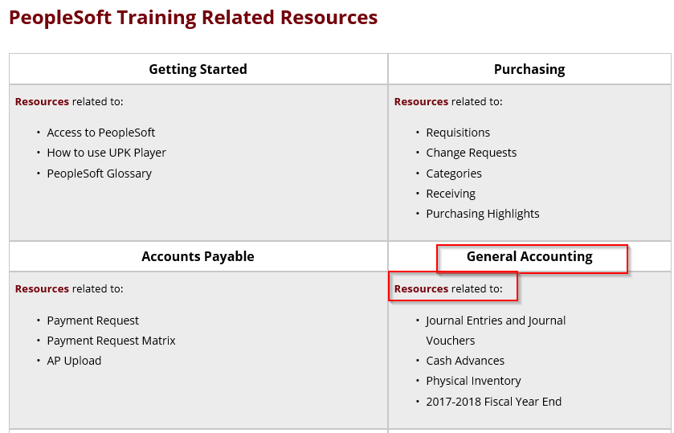
Where to Find the Resources Referenced in this Presentation

Slide 28
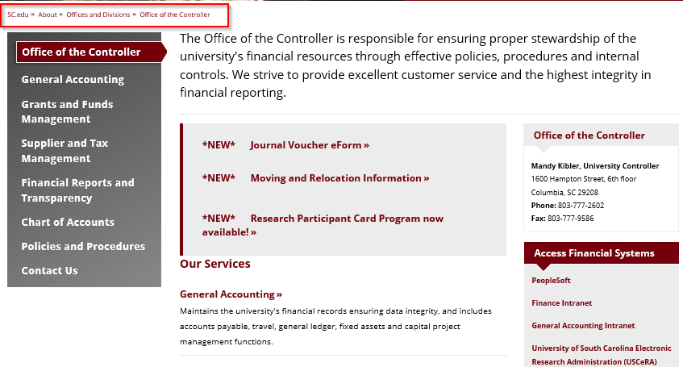
Where to Find the Resources Referenced in this Presentation
Controller’s Website – General Accounting:
https://sc.edu/about/offices_and_divisions/controller/index.php
Procedures and Forms for many processes - more being added

Slide 29
General Accounting Contact
For assistances or questions on journal entries, please email the General Accounting mailbox below:
Email: GENACCTG@mailbox.sc.edu

Slide 30
Questions

