Slide 1
Service Delivery and Support Program Update – April 25, 2018

Slide 2
What have we done this month?
Improved Incident processes
After-Hours support, 24x7x365 support for Priority 1 & 2 Incidents
Continually decreasing the amount of Open Incidents in ServiceNow

Slide 4
Incident Management Reminders
Incidents with the “On Hold” status should be regularly reviewed for updates (internal and external)
Incidents older than 30 days should be reviewed to determine if still an incident
Closure notes are not visible to the customer. These are internal to DoIT (similar to work notes)

Slide 5
Incident Management Reminders
It is important to acknowledge all incidents with a customer note to provide good customer service, and to meet the “Time to Respond” metric OLA
“If it’s not in the ticket, it didn’t happen”
Detailed work and customer notes help us better document our work
Attach documents to tickets to reduce duplication

Slide 6
Customer Service Reminders
Technicians should review and verify the mapped business service, and adjust if a more appropriate option is available
System notifications are sent to the Caller rather than the Affected User
You should communicate with your customers through ServiceNow, rather than replying to email notifications

Slide 7
Customer Service Reminders
REQUEST | ITEM | TASK
A customer can request multiple items within single request | Notes left on RITM tickets ARE sent to the customer | Notes left on TASK tickets are NOT sent to the customer
This is the level identifying who will receive services or products | This is the level where we provide customer service and is what shows up in the Self-Service Portal | Remember the Yellow Box Customers cannot see what activity is in a task
Think of this as a shopping cart | Think of this as items in the cart | Think of this as the task to provide the items to the customer

Slide 8
Phase I is complete!

Slide 9
Service Delivery and Support – Phase I
Business Services
A list of our services is available as a global report
Want to add, modify, or remove a business service? Submit a ServiceNow request, or contact Joyce Shealy
To view captured time by Business Service, visit our Knowledge Base

Slide 10
Service Delivery and Support – Phase I
Time Worked
Available in ServiceNow
Open Forums for time capture this week
Today, at 11AM and 1PM, plus mobile app training, Room 320
Tomorrow, from 2-4PM, Room 308
Defined procedure for entering time available in our Knowledge Base

Slide 11
The goal of reporting time in ServiceNow is to track the time we spend on Operational Work (Incident and Request) compared to Strategic Work (Projects and Enhancements)
Time Worked will be available throughout the platform (Incident, Tasks, etc.)
Remember, This is not ITAMS

Slide 12
Questions?

Slide 13
2018 Program Timeline
Define Business Services
Website launches
Phase II begins
Jan
Feb
Mar
Apr
May
Jun
Jul
Aug
Announce
Time Capture
*Go-Live
Time Capture
Training
* Problem Management
* Mass Mail and Desktop Service Agreements still in progress

Slide 14
2018 Program Timeline

Slide 15
What’s Coming Next?
ServiceNow Kingston Upgrade
Service Delivery and Support team has begun discussing the upgrade to the latest ServiceNow release, Kingston
Production freeze, design of integrations with other systems

Slide 16
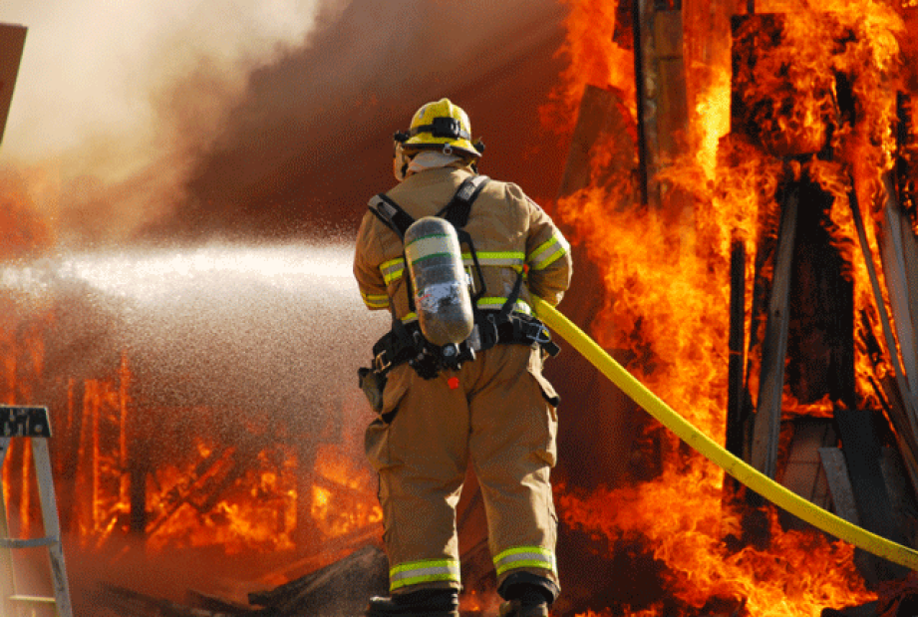
What is Problem Management?
Problem Management involves managing the lifecycle of IT service problems, diagnosing root causes of incidents, and helping determine solutions to prevent future incidents from occurring
Incident | Problem

Slide 17
Don’t Forget!
Service Delivery and Support Website
Keeps you informed of our progress
Submit feedback to let us know how we can improve
http://bit.ly/DoIT-SDS

Slide 18
Questions?

