Slide 1
Service Delivery and Support Program Update – June 27, 2018

Slide 2
Service Management Updates
Ashley Ward is our Service Delivery Manager
Stephanie Kelly is now our Incident Manager
Greg Cherry is our Problem Manager
VS
Notes:
Having our Incident Management process fulfilled by the Service Desk ensures we provide end-to-end support for services, and that we restore IT Services to their defined Service Levels as quickly as possible.
Problem Management involves managing the lifecycle of IT service problems, diagnosing root causes of one or more incidents, and helping determine solutions to prevent future incidents from occurring.

Slide 3
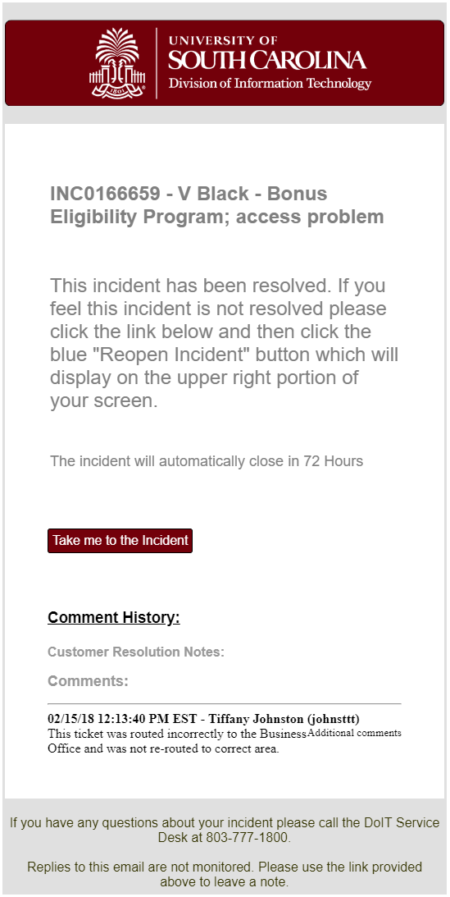
Incident Management Updates
Enhanced Incident Notifications
Improved Layout
Delivers more relevant info to our customers

Slide 4
Incident Management Updates
Updates to Closure Notes
Existing “Closure Notes” field renamed to “Technical Resolution Notes”
Additional field to communicate with customers, “Customer Resolution Notes”

Slide 5
Incident Management Updates
What should Customer Resolution Notes look like?
Customer friendly
Avoid technical jargon
Example: "Thank you for contacting Division of IT. Service has been restored. Please let us know if we can assist further."

Slide 6
Incident Management Reminders
Incidents with the “On Hold” status should be regularly reviewed for updates (internal and external)
Incidents older than 30 days will be reviewed to determine validity
If needed, close and open the correct ticket type (usually a Request)

Slide 7
Incident Dashboard

Slide 8
Incident Dashboard – Over 30 Days

Slide 9
Process Updates
Problem Management Process Guide now available!
Hosted in our Knowledge Base
Also available on the Service Delivery and Support Program site

Slide 10
Time Card Entry
The goal of reporting time in ServiceNow is to track the time we spend on Operational Work (Incident and Request), Optimizational Work, and Strategic Work (Projects and Enhancements)
Available throughout the platform (Incident, Task, etc.)

Slide 11
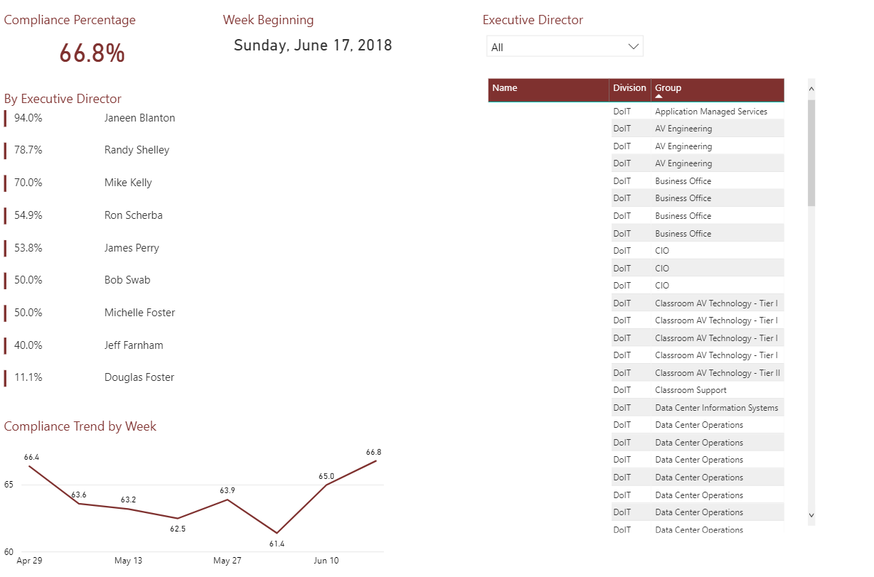
Time Card Entry

Slide 12
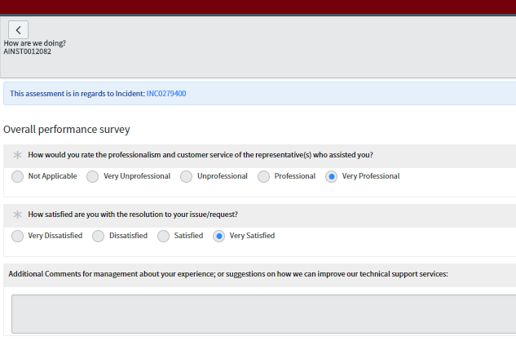
Customer Service Surveys
Surveys are sent to customers upon closure of an Incident, with additional surveys for incidents and requests closed by Service Desk or Desktop Support agents

Slide 13
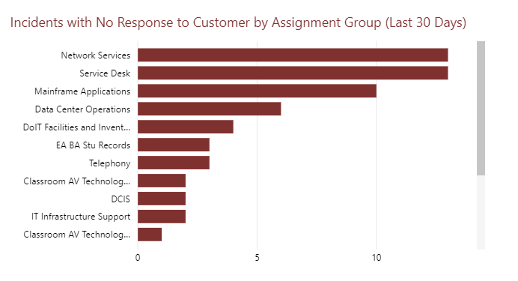
Customer Service & Incident Dashboards
Notes:
Includes Closed Incidents

Slide 14
Customer Service & Incident Dashboards

Slide 15
Customer Service Reminders
It is important to acknowledge all tickets with a customer-friendly note
“If it’s not in the ticket, it didn’t happen”
Communicate through ticket to avoid email fatigue
Detailed work and customer notes help us better document the services we provide
Attach documents to tickets to reduce duplication

Slide 16
Customer Service Reminders
REQUEST | ITEM | TASK
A customer can request multiple items within single request | Notes left on RITM tickets ARE sent to the customer | Notes left on TASK tickets are NOT sent to the customer
This is the level identifying who will receive services or products | This is the level where we provide customer service and is what shows up in the Self-Service Portal | Remember the Yellow Box Customers cannot see what activity is in a task
Think of this as a shopping cart | Think of this as items in the cart | Think of this as the task to provide the items to the customer

Slide 17
Questions?

Slide 18
2018 Program Timeline

Slide 19
Service Delivery and Support
ServiceNow Kingston Upgrade
We have upgraded ServiceNow to the Kingston release
Since our re-baseline in July 2017, we have successfully completed two system upgrades.

Slide 20
Service Delivery and Support
Business Services
A list of our services is available as a global report
Services mapped to Business Portfolios
Want to add, modify, or remove a business service? Submit a ServiceNow request, or contact Joyce Shealy

Slide 21
Service Delivery and Support
Contracts & Service Portfolio Management
Operational within ServiceNow
File Share Agreements
Working on: Desktop Support Agreements, Mass Mail (Broadcast Email)
A high level process has been developed for Service Portfolio Management

Slide 22
What’s Coming Next?
Change Management
Design of Change Management within ServiceNow is underway
Confirming process and procedures for a successful implementation
If you are interested in testing, please let us know
Transition from ITC to ServiceNow

Slide 23
What’s Coming Next?
Inventory & Asset Management (ITAM)
Early stages of development and design for use within ServiceNow
Reaching out to Calero and Aptris for Statements of Work

Slide 24
What’s Coming Next?
Inventory & Asset Management (ITAM)
Pinnacle Integration – scope includes Incidents and Requests only
Billing processes

Slide 25
Don’t Forget!
Share with your teams!
You play an important role in our organization’s success!
Organization-wide communications sent to keep everyone informed
Submit feedback to let us know how we can improve

Slide 26
Don’t Forget!
Service Delivery and Support Website
Keeps you informed of our progress
Submit feedback to let us know how we can improve
http://bit.ly/DoIT-SDS

Slide 27
Questions?

Slide 28
THANK YOU!
Next scheduled meeting:
July 25, 2018

