Slide 1
SDS Phase 3 December 2018

Slide 2
Service Delivery & Support
The goal of this project is to leverage ServiceNow as the DoIT enterprise service management platform to provide best-in-class, reliable and cost-effective ITSM service delivery that align with the strategic goals of the University.
With co-operation from DoIT, our Service Management teams were able to make significant improvements to a wide range of applications and processes including:
Change Management
Problem Management
Contracts & Billing
Idea, Demand Management, Project Management, Enhancement
Emerging CMDB and Document Management

Slide 3
Problem Management – 10/31
Expand problem management functionality
Enable assignment of problem tasks to all of DoIT
Train staff on problem tasks
What does this mean?
We will be able to better track known issues and problems in the system
Problem tickets will be assigned and show up in technician’s work queues
Staff will be able to track time against problem tickets
Problem manager will be able to communicate status and knowledge articles across all tickets linked to problem
Completed 10/31/2018

Slide 4
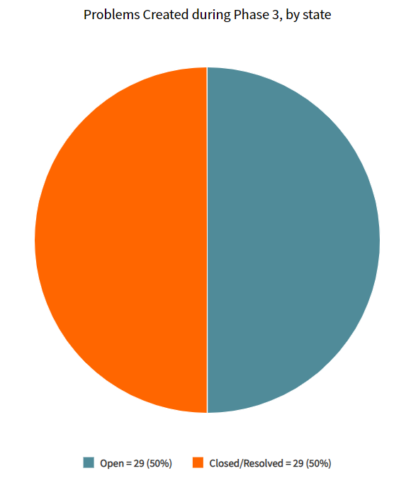
Stats from Phase III
Problem Mgmt.
58 Problems in Phase III
Some problem records proactively
documented in ServiceNow (without
associated Incident)
29 Open Problems
29 Closed or Resolved Problems

Slide 5
Major Incident – 10/31
Enable ability to link incidents in the tool, through Change, Problem, and Knowledge
Adjust reporting/metrics for linked incidents
Train staff on linking incidents
Improve P2 process regarding communication and accountability
Explore viability of linking incidents beyond P1/2
What does this mean?
We will improve our incident reporting by eliminating duplicate incidents from our metrics
We will improve customer service by providing consistent communication on status across all linked incidents
We will reduce change risk for P2 incidents by requiring additional communication and coordination between teams
Completed: 10/31/18

Slide 6
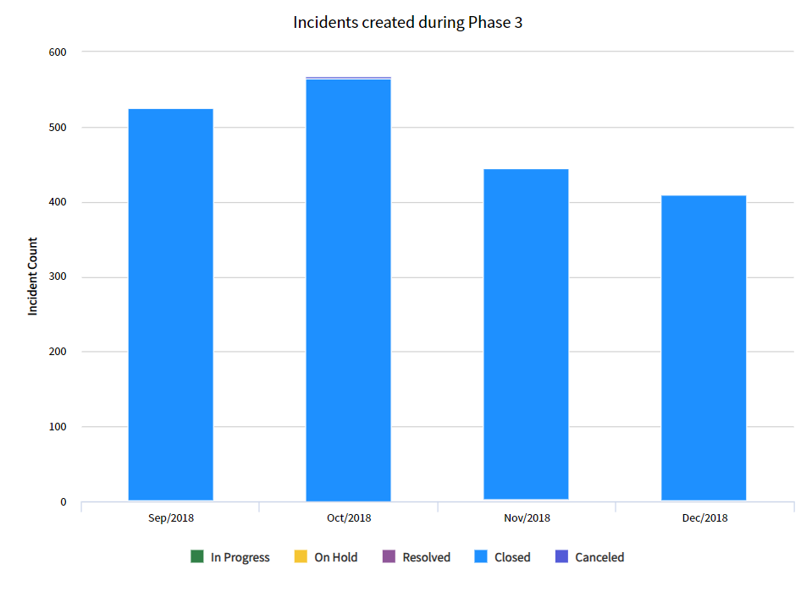
Incidents
Stats from Phase III
61 Parent Incidents
458 Child Incidents
154 Child Incidents - from INC0285798 (Some Blackboard Courses are Missing)
25 Outages associated with Incident records
21 Incidents caused by Changes

Slide 7
Document Management – 11/7
Pilot of document management module and document approval workflows in ServiceNow
Pilot with DCO, SMO and PMO
What does this mean?
We will have a secure, central repository for DoIT information assets
We are laying the foundation to eliminate redundancy with other document management tools (i.e. SharePoint)
During Phase IV we will begin using this module to capture process and procedure updates and additions, while continuing to use the Knowledge Base in tandem as necessary. The pilot will close at the end of the phase 4 with recommendations to be opened up to all of Division of IT or opened to a limited group of users
Pilot launched on 11/7/2018

Slide 8
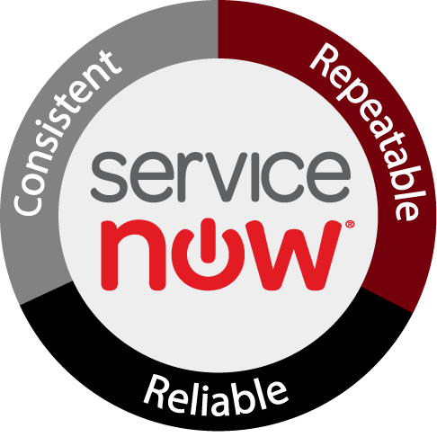
Stats from Phase III
Knowledge Articles
223 Created in Phase III
Documents – ~30 in ServiceNow as KB articles, to be added to Document Repository as a result of Phase III work
Communications:
Weekly emails providing status updates
Training flyers distributed
Improved email templates

Slide 9
Stats from Phase III
25 group training classes since September 2018
Lunch and Learn
One-on-One sessions
General sessions
Average Satisfaction Rating: 4.78/5

Slide 10
Change Management – 11/30
Establish key metrics and create dashboards/reports
Continue working with the CAB to improve the process
Transition outage communication to ServiceNow
Sunset ITC
What does this mean?
Better visibility into the change management process and its effectiveness through reports and dashboards in ServiceNow
We are able to report on the impacts of change (link incidents to changes)
We have transitioned a redundant system (ITC) to ServiceNow to display changes, maintenance, and outages through the Systems Status page
CAB & Metrics – Completed 11/30/18
Sunset ITC – Completed 1/2/19

Slide 11
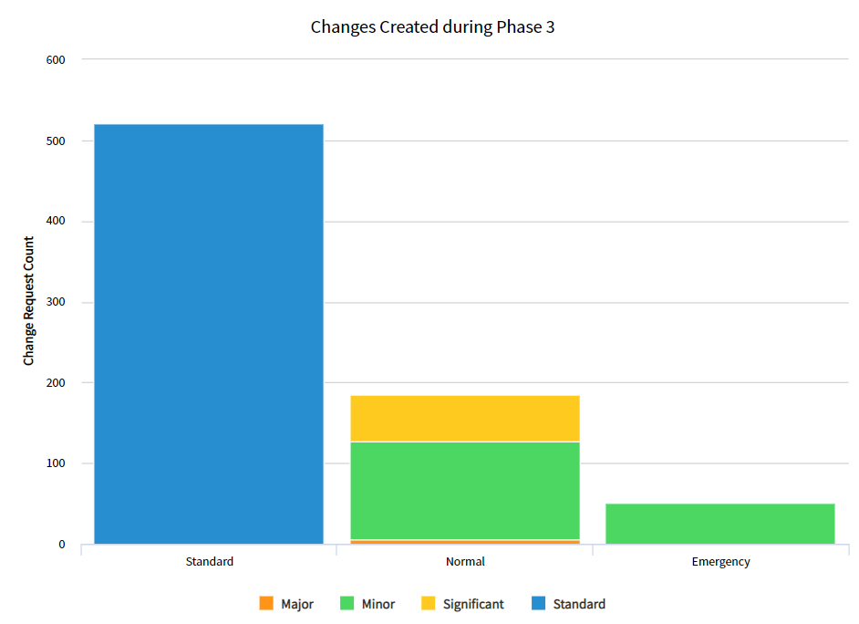
Stats from Phase III
Changes
521 Standard
185 Normal
Significant, 58
Minor, 121
Major, 6
51 Emergency

Slide 12
Contract Module – 11/30
Standardized service agreements
Streamline service agreement workflow
Move all service agreements into ServiceNow
Provide ability for service agreements to be electronically signed
Train service desk on how to view customer agreements
What does this mean?
We will improve customer service around the agreement process
The service desk and technicians will be able to see what service agreements a customer has in place
We are building the foundation to transition billing into ServiceNow
We are building the foundation to provide customers with SLA reports in the future
Completed on 11/30/18

Slide 13
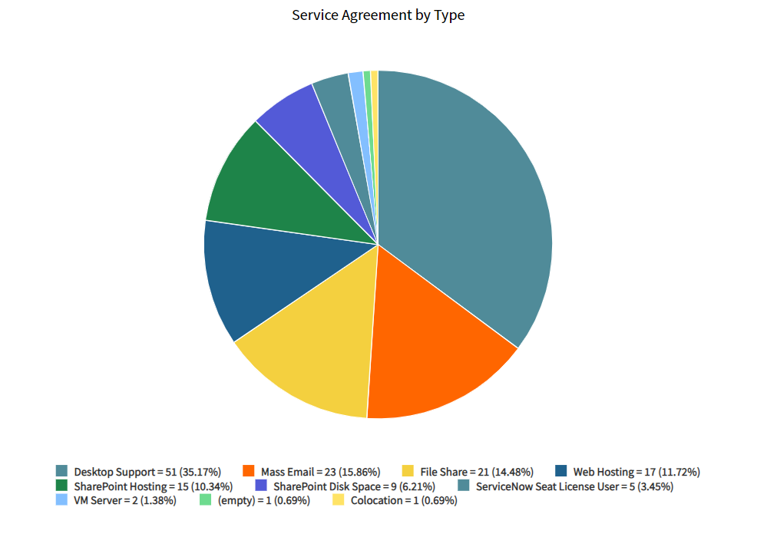
Service Agreements
Stats from Phase III
51 Desktop Support
23 Mass Email
21 File Share
17 Web Hosting
15 SharePoint Hosting
9 SharePoint Disk Space
5 ServiceNow Seat License User
2 VM Server
1 Colocation
1 (draft) SharePoint Hosting

Slide 14
Project Portfolio Suite – 12/21
Confirm portfolios and establish in tool
Designate and train portfolio managers and owners
Enable Demand, Enhancement and Project for all of DoIT
Train teams on Demand, Enhancement and Project
Work with teams on transition plans for in-flight projects and enhancements
What does this mean?
We will be ready to start transitioning project reporting into ServiceNow – starting January 1, 2019, projects will be managed through ServiceNow
We will be ready to start phasing out other project management tools
Request metrics will become more accurate
At this point ALL project work can be done through ServiceNow and all time tracked to tickets in ServiceNow
Notes:
Once Asset and Inventory Management is in SN and merged with the CMDB, we can evaluate if there is a need for any other ticketing system in production.

Slide 15
Project Portfolio Suite – 12/21
What does this mean?
System and staff will be ready to start running all projects and enhancements through ServiceNow
Staff will be able to track time worked on project and enhancement tasks
Ideas for projects and services will be able to be submitted by DoIT staff directly in the tool, and by customers though the Service Delivery Team (Ella, Eliza, Ashley, Rhiannon)
Governance framework will be setup in the tool
Portfolio Managers will guide ideas through the demand process
Portfolio owners and leadership team will serve in governance role until all groups are established
Completed 12/21/18

Slide 16
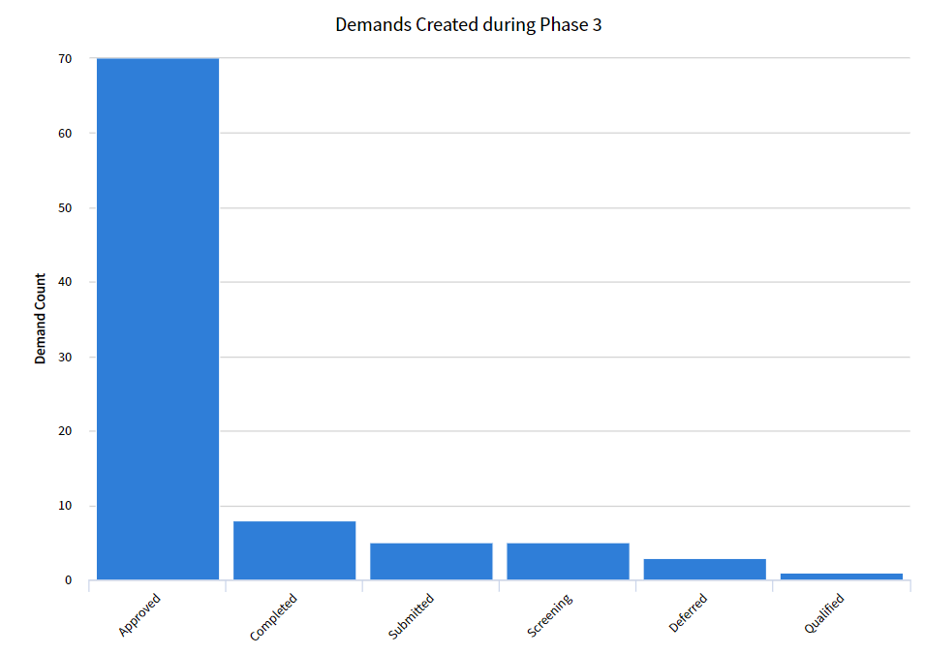
Stats from Phase III
Demands
92 created during Phase III
70 currently approved
21 records remain as Demands
51 promoted to Enhancement
20 promoted to Project

Slide 17
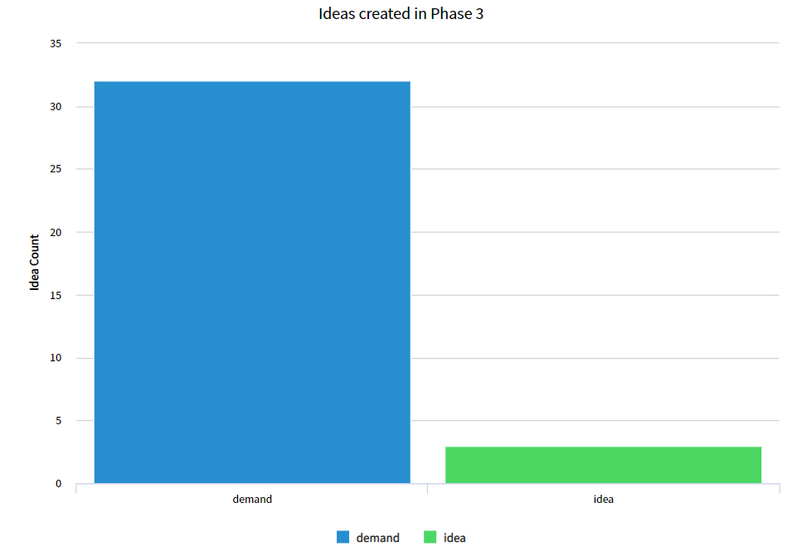
Stats from Phase III
Ideas
35 created during
Phase III
32 promoted to
Demand or greater
3 Ideas deferred

Slide 18
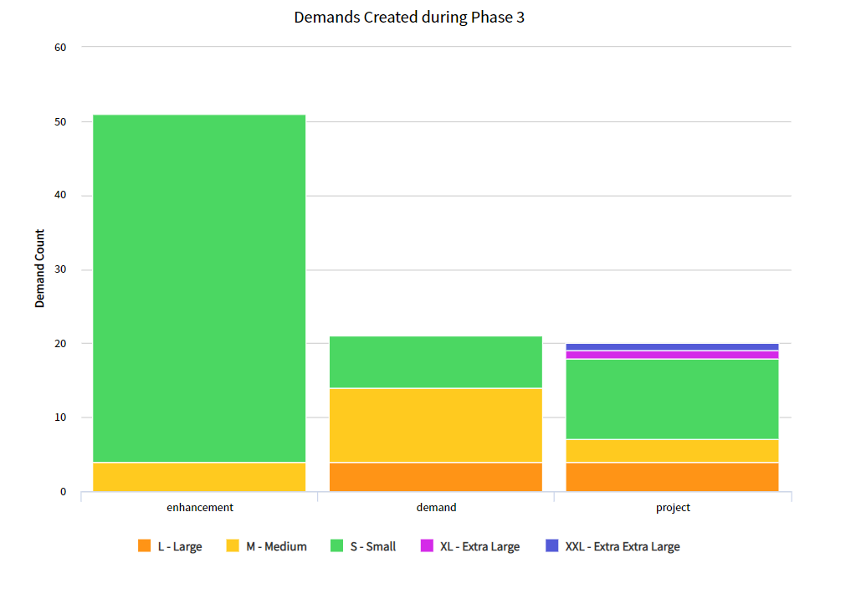
Stats from Phase III
Demands
T-shirt Size
Enhancements
47 Small, 4 Medium
Demand
7 Small, 10 Medium, 4 Large
Project
1 XXL, 1 Extra Large, 4 Large
3 Medium, 11 Small
Notes:
The differing sizes for Projects, Demands, and Enhancements may result in how individual areas assess and manage their work in ServiceNow.

Slide 19
CMDB – 12/21
Train Service Management team on tool and best practices
Define scope, roles, processes, and maturity plan
Evaluate discovery tools
Design CMDB architecture for configuration item management
What does this mean?
CMDB Scope Modification was approved in November 2018 after consultation with ServiceNow and DoIT Architects – Completed 12/21/18
A proof of concept was created between DoIT environment and ServiceNow Test environment – Completed 12/21/18
We will manually input pilot data and develop an implementation plan for phase 4 including integration and/or discovery options

Slide 20
Integrations – 12/21
PeopleSoft revised chart fields and payment files
Required integration due to PeopleSoft elimination of legacy general ledger codes, Transferred to next project phase 12/1/18
IAM
Required integration due to Mainframe decommission, Transferred to next project phase 12/1/18
What does this mean?
Both interfaces should improve quality and availability of user and billing data
ServiceNow team has completed all work that could be done in phase 3 and we are awaiting files from PeopleSoft and IAM/OIM teams

Slide 21
Continual Service Improvement (CSI)
Began defining processes and procedures so significant IT procurements are reviewed by the Technical Review Board (TRB)
Service Management worked to transition IBM’s Work Management needs into the ServiceNow platform to ensure consistency between DoIT and IBM, eliminating future redundancy between web applications
Began improving the VPN request and installation process
Workflows for Digital Certificates, Virtual Servers, Cloud Services, Co-Locate Servers, Desktop Support Agreements

Slide 22
Backlog
To be worked as/if time allows
HIVE integration – completed 12/22/18
Pinnacle integration/Elimination
Billing Design – completed billing indicator on task table 12/21/18
Asset/Inventory Design – time did not permit work on this item
Procurement process - time did not permit work on this item
SPIL elimination/replacement - time did not permit work on this item
Data Cookbook – cancelled after business analysis, no integration needed during Phase 3.

