Slide 1


Jessica Hope-Buckner
Financial Advisor
Mike Norris
Financial Planning Advisor

Slide 2
Agenda
Introducing Retirement Pathfinder
A case study: Maria Davis
Answering other retirement questions
Notes:
Today, we’ll cover these topics. [Read slide.]
At the end of my presentation, I would sincerely appreciate your feedback. I have provided you with a seminar evaluation form. Please complete it and leave it with me when the session ends. Thank you in advance for your feedback.

Slide 3
Introducing
Retirement Pathfinder.®

Slide 4
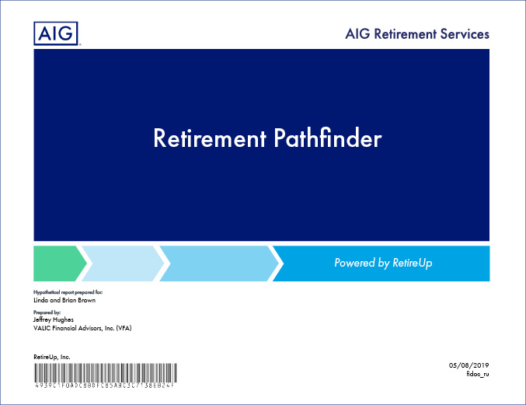
Introducing Retirement Pathfinder
Write your own personalized retirement story
Quickly and graphically model retirement scenarios
with your financial professional
Receive engaging new insight on your retirement plan
Real-time answers to questions such as:
Can I retire when I planned?
Am I saving enough to achieve my retirement goals?
Am I in danger of outliving or depleting my
retirement savings?
Your personalized report
Notes:
[There are animations on this slide. Click for text to appear.]
Retirement Pathfinder, a robust Retirement Income Planning Tool, is an interactive planning tool that allows you to “write your own” retirement story.
With Retirement Pathfinder, you and your financial professional can quickly and graphically model retirement scenarios, optimize savings strategies and identify the impact of varying market conditions on your retirement savings accounts.
Retirement Pathfinder can be used to:
Model your retirement plan instantly using a variety of market conditions
Optimize saving strategies to meet varying goals, adjusting your retirement date and more
Create multiple dynamic plans to explore different scenarios

Slide 5



Introducing Retirement Pathfinder
Three broad categories of retirement savers
Employees who are:
Not currently enrolled or no longer contributing to a retirement savings plan
Currently enrolled in or saving to a retirement plan, but do not know the impact of the savings on their retirement
Nearing retirement and need to develop a retirement budget
Notes:
[There are animations on this slide. Click for text to appear.]
When it comes to retirement planning, there are generally three broad categories of employees:
The first category includes those who have not enrolled in a retirement savings plan or are no longer contributing to an existing retirement savings plan.
The second category includes those who are currently enrolled or contributing to a retirement savings plan, but do not know the impact of their savings on their future retirement.
The third category includes those nearing retirement and have an understanding of their retirement income sources, but need to figure out a retirement budget or identify what they can afford.

Slide 6
A case study: Maria Davis.
Notes:
Let’s take a look at a sample case of someone who fits the profile of those in the second category; someone currently saving, but wants to see the impact of the savings on their retirement.

Slide 7

A case study: Maria Davis
Hypothetical client: “Maria Davis”
Age: 35 Annual Salary: $50,000 (2% annual increase) Retirement Age: 62
Estimated Retirement Expenses: $50,000 (in today’s dollars with 2.5% inflation)
Retirement Account Balance: $40,000
Retirement Contributions: $2,600 annually
Estimated Rate of Return: 7% before retirement; 4% after retirement
Pension: $35,000 at age 62 (2% annual increase)
Social Security: $3,505 monthly (future value at age 62; 2% annual increase)
Notes:
[There are animations on this slide. Click for text to appear.]
As our sample client, we have Maria Davis, a hypothetical client.
Maria is a 35-year-old teacher earning $50,000 annually. Her earnings are expected to increase by 2% annually. She is single and does not have any dependents.
When she retires at age 62, Maria will collect a pension as well as Social Security. Maria expects to have $50,000 in estimated annual retirement expenses (in today’s dollars with 2.5% annual inflation).
Maria currently contributes $2,600 per year to her 403(b) account which has a balance of $40,000. She expects to earn a 7% annual return on her investments prior to retirement and a 4% annual return after retirement.
Now let’s begin creating Maria’s retirement plan.
[Begin live demonstration or use optional slides]

Slide 8
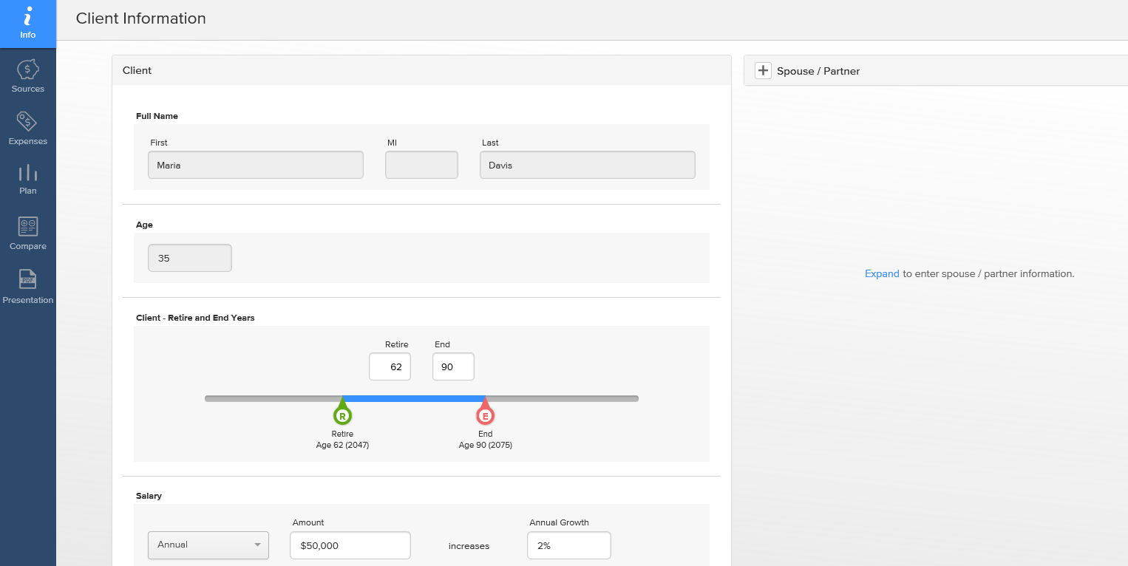
A case study: Maria Davis
1
2
3
4
Notes:
[There are animations on this slide. Click for arrows to appear.]
[OPTIONAL]
To begin the process of creating a Retirement Pathfinder analysis for Maria, we will select the Info tab from the main navigation menu.
After selecting the Info tab, we can then enter her salary (either on a monthly or annual basis); here, we used a $50,000 annual salary with an annual inflation increase of 2.00%.
We will also enter her desired retirement at age 62.

Slide 9
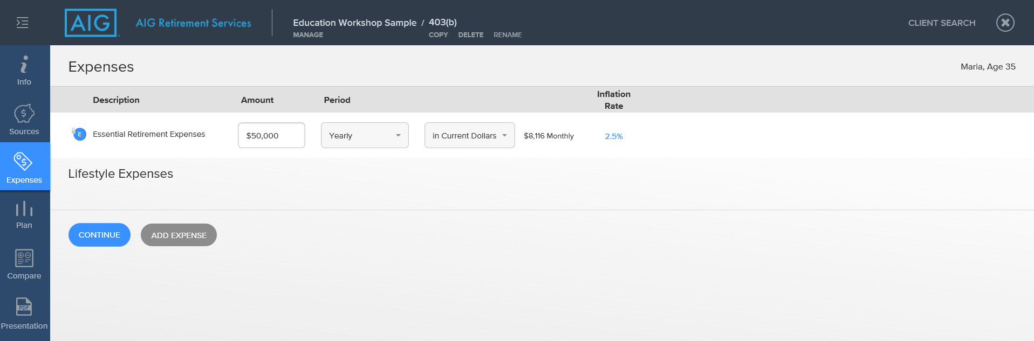
A case study: Maria Davis
1
2
Notes:
[There are animations on this slide. Click for arrows to appear.]
[OPTIONAL]
We will now enter Maria’s desired annual retirement income goal. Select the Expenses tab from the main navigation menu and enter $50,000 as the essential retirement expense in current dollars with a 2.5% inflation assumption. Again, the Essential Retirement Expenses (income needed in retirement) can be entered in either a monthly or annual format.
If you plan to have non-essential or discretionary retirement expenses such as travel or hobbies, they can also be entered into your customized retirement analysis.

Slide 10
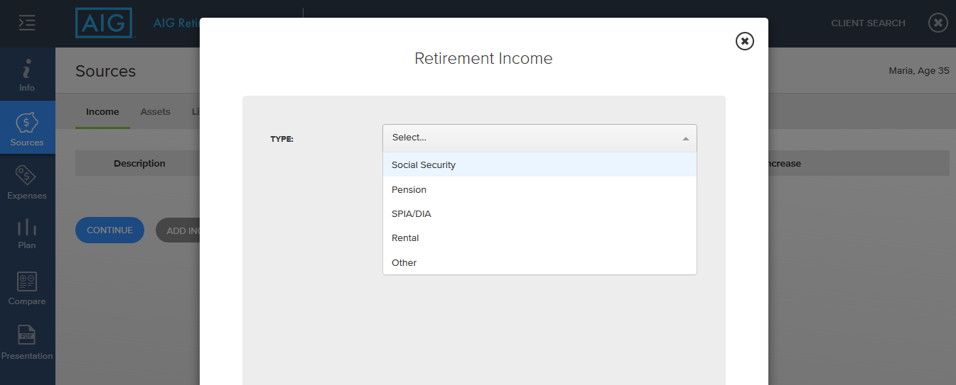
A case study: Maria Davis
2
1
3
Notes:
[There are animations on this slide. Click for arrows to appear.]
[OPTIONAL]
Retirement Pathfinder has the ability to accommodate any sources of income you expect to receive during your retirement years. This includes Social Security benefits, pension payments, as well as other income sources such as rental income or income from part-time or post-retirement work.
With all income sources, you can indicate an expected start year, end year and annual increase if applicable to the income source.
For this sample case, Maria expects to receive Social Security and pension income in retirement. First let’s add the Social Security income by selecting Sources from the main navigation menu, followed by Income in the subsection.
Next we select Add Income Source, and then select Social Security from the drop down menu of income types.

Slide 11
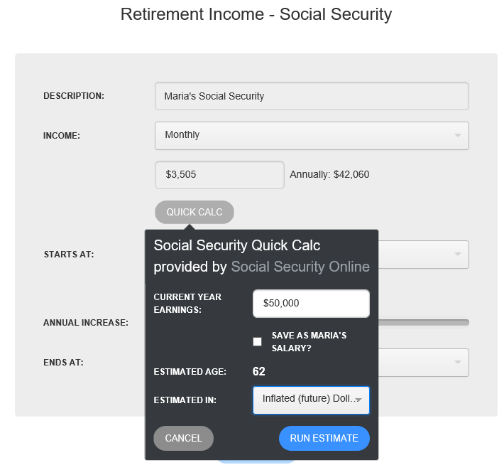
A case study: Maria Davis
1
2
Notes:
[There are animations on this slide. Click for arrows to appear.]
[OPTIONAL]
If you are currently receiving a Social Security retirement benefit, or if you have a current statement of your Social Security benefit, the monthly or annual amount can manually be entered.
If you do not have a current statement, we can use the Quick Calculator to provide an estimate. The Quick Calculator uses the Social Security Online calculator to project a benefit. The benefit calculated is based on the current year earnings and estimated retirement age. The benefit amount can be reflected in Today’s dollars or Inflated (future) dollars.
For this sample case, Maria’s current year earnings and retirement age have populated the calculator fields. We will select “Inflated (future) Dollars” and then click the “Run Estimate” icon.

Slide 12
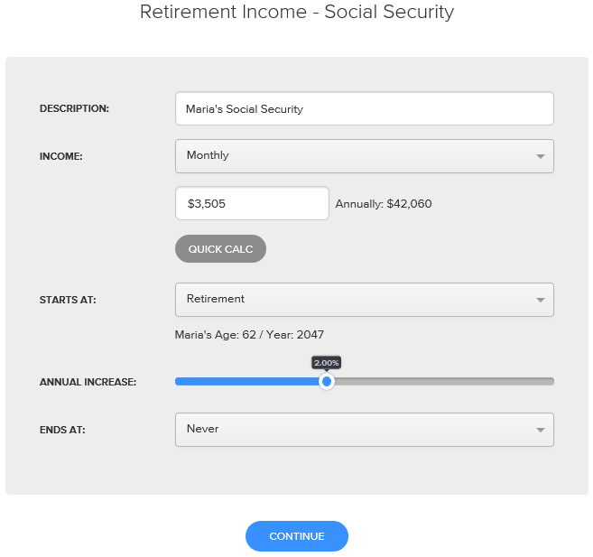
A case study: Maria Davis
1
Notes:
[There are animations on this slide. Click for arrows to appear.]
[OPTIONAL]
Based on these entries, Maria’s Social Security benefit at age 62, in the year 2047 is estimated to be $3,505 monthly. Alternatively, you could enter the estimated annual Social Security benefit.
We can now save the Social Security benefit to add it to the plan.
Next, we will add Maria’s pension benefit.

Slide 13
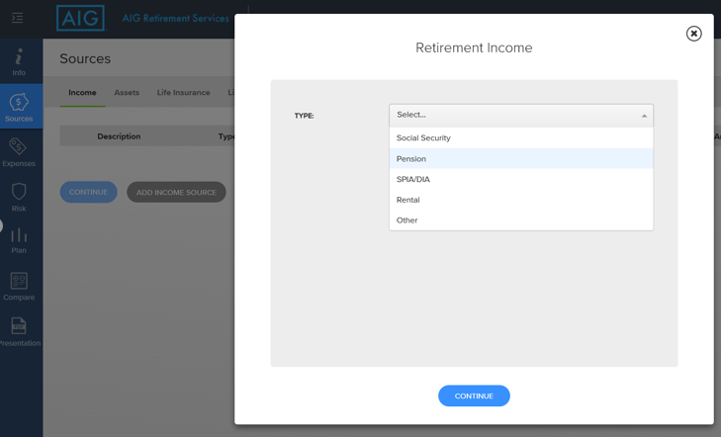
A case study: Maria Davis
1
Notes:
[OPTIONAL]
While still in the Income section within Sources, we will select the Add Income Source icon a second time. This time we will select Pension from the drop down menu of income types.

Slide 14
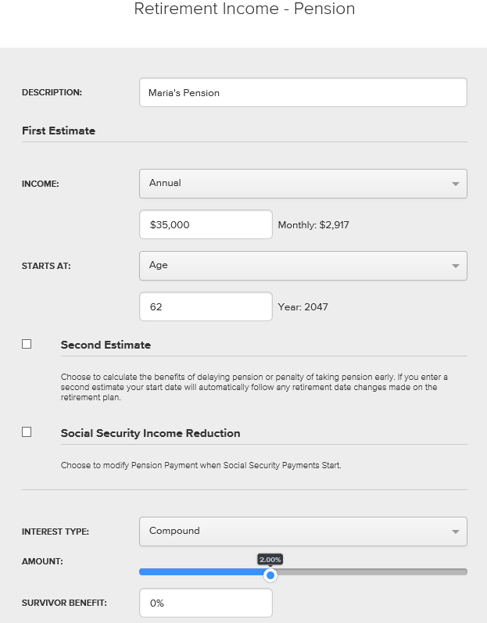
A case study: Maria Davis
1
2
3
Notes:
[There are animations on this slide. Click for arrows to appear.]
[OPTIONAL]
According to Maria’s pension projections she received from her pension administrator, she will receive $35,000 annually beginning at her retirement at age 62. You could also enter the expected pension information as a monthly amount.
Her pension benefit also includes a 2% compounded annual cost of living increase.
Since Maria is single with no dependents, she will not elect to provide survivor benefits. If you plan to select survivor benefits on your pension election, the specifics of your choice can be modeled in your customized plan.

Slide 15
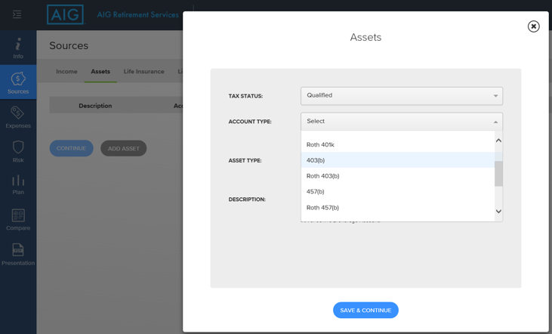
A case study: Maria Davis
1
3
2
4
Notes:
[OPTIONAL]
Once the retirement income sources are entered, the value of any savings or investment accounts you plan to use during your retirement years will be entered in the Assets section.
Examples of retirement investment accounts include group retirement accounts such as 403(b)s or 401(k)s, as well as individual accounts such as IRAs. Additionally, other types of accounts such as after-tax brokerage accounts, money market accounts and bank savings accounts can also be entered into the retirement plan.
In this example, Maria has a 403(b) mutual fund account with a current balance of $40,000.
After selecting the Assets subsection link within the Sources tab, we will select the Add Asset icon. Once we are in the add assets module, we will select Qualified from the Tax Status drop down menu and then select 403(b) from the Account Type drop down menu.

Slide 16
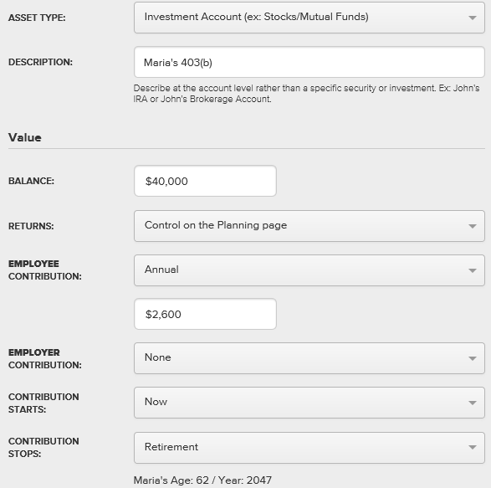
A case study: Maria Davis
1
2
3
Notes:
[There are animations on this slide. Click for arrows to appear.]
[OPTIONAL]
After selecting the account type, we will select Investment Account from the Asset Type drop down menu.
Following that selection, we will enter $40,000 as the value.
Finally, we also indicate Maria’s contributions to the account by entering $2,600 as the Annual Contribution.
After selecting the Save icon, we have completed entering all of the data and are now ready to enter the investment return assumptions and view the results of the analysis.

Slide 17
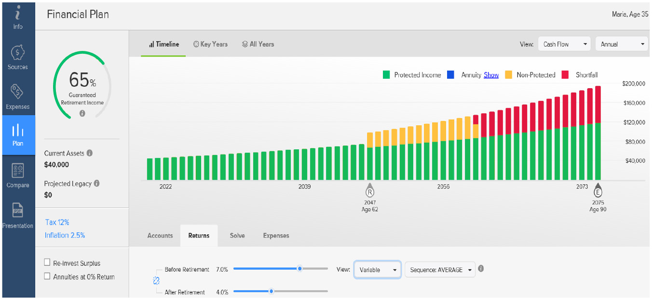
A case study: Maria Davis
2
1
3
Notes:
[There are animations on this slide. Click for arrows to appear.]
[OPTIONAL]
To enter Maria’s expected rates of return, we will select the Plan link from the main navigation, then select the Timeline subsection. We will then click the Returns tab and select 7% as the Before Retirement return and 4% as the After Retirement return. To account for varying market returns, we will also select Variable and Average as the sequence of returns.
As we change the Returns assumptions and other variables in the Retirement Plan section, we will see the real-time impact of the changes reflected on the cash flow graph and Guaranteed Retirement Income Percentage, or GRIP as we like to call it.
When viewing the cash flow graph, the areas in green represent income received from guaranteed income sources. This includes income from sources such as pensions and Social Security. The guaranteed income amounts are not impacted by fluctuations to investment accounts caused by stock market performance.
The areas in yellow represent withdrawals from investment assets. The withdrawals are needed to cover the difference between the guaranteed income sources and the retirement expenses. The areas in yellow are impacted by fluctuations to investment accounts caused by stock market performance.
Finally, the areas in red represent a retirement shortfall. This is an indication that retirement savings accounts have been depleted and the guaranteed income sources are not sufficient to meet the retirement expenses.

Slide 18
A case study: Maria Davis
1
2
Notes:
[There are animations on this slide. Click for arrows to appear.]
[OPTIONAL]
Also included on the timeline is the GRIP, which illustrates your retirement income security.
If your GRIP is low, you may want to consider how challenges such as a market decline or living longer than expected could impact your long-term retirement income strategy.
If your GRIP is high, you have the assurance of knowing that a greater portion of your total annual expenses in retirement may be covered with income that’s guaranteed.

Slide 19
A case study: Maria Davis
2
1
Notes:
[There are animations on this slide. Click for arrows to appear.]
[OPTIONAL]
Based on the information we entered for Maria, she has a GRIP of 65%. We also see on the cash flow graph that she is likely to deplete her retirement savings beginning in the year 2060 when she is 75.
Since Maria has a projected retirement shortfall, we can now begin interactively making changes to her plan and see the results immediately.

Slide 20
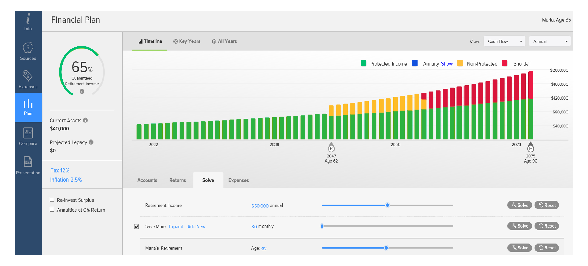
A case study: Maria Davis
1
Notes:
[There are animations on this slide. Click for arrows to appear.]
[OPTIONAL]
From the Solve section of the Plan timeline screen, we can change variables including Income Goal, Retirement Age and Retirement Contributions.
We can also see the impact of other economic changes such as changes to inflation assumptions or tax rates.

Slide 21
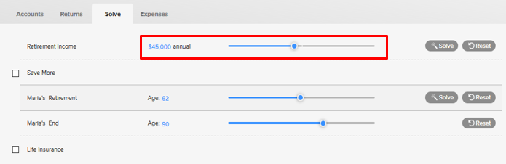
A case study: Maria Davis
1
Notes:
[OPTIONAL]
Maria previously indicated she would be willing to change her income goal from $50,000 to $45,000.
To make the change to the income goal, we can either move the slider or manually enter a value for the income goal.

Slide 22
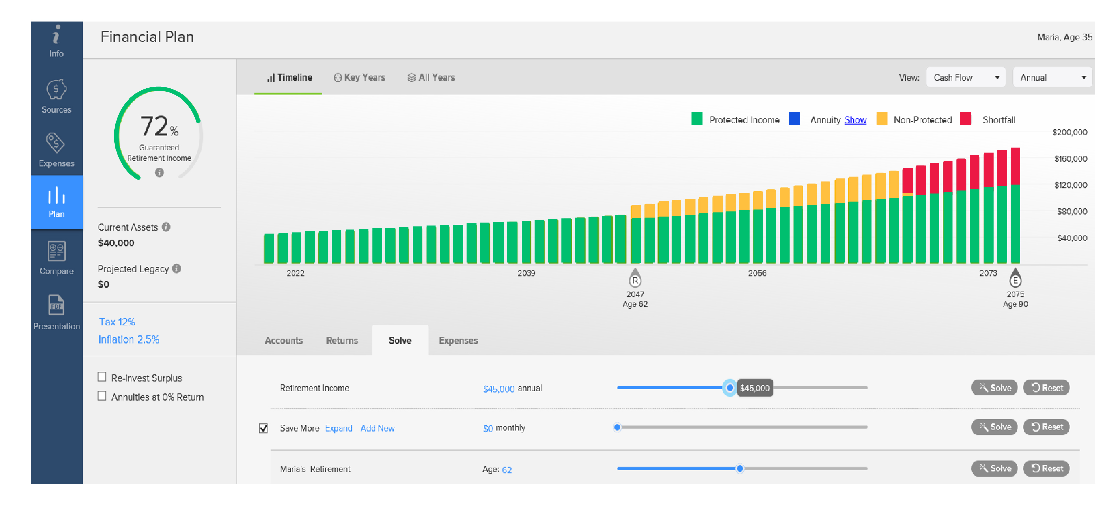
A case study: Maria Davis
1
Notes:
[There are animations on this slide. Click for arrows to appear.]
[OPTIONAL]
Although reducing the income goal helps, the cash flow graph illustrates Maria is still projected to have a retirement shortfall beginning in 2067 at age 82, versus 2060 when she is 75 as we previously illustrated.

Slide 23
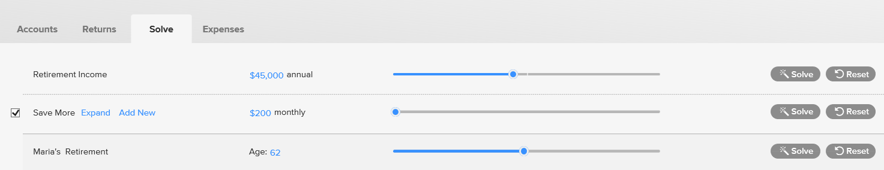
A case study: Maria Davis
1
Notes:
[There are animations on this slide. Click for arrows to appear.]
[OPTIONAL]
In addition to reducing her income goal, Maria also indicated she is willing to save an additional $200 per month.
To add the additional savings, we will select the Save More option within Solve and then move the slider to the $200 value, or click on the field and manually enter $200 as a numeric value. We also have the option of letting the software calculate an optimal savings amount.

Slide 24
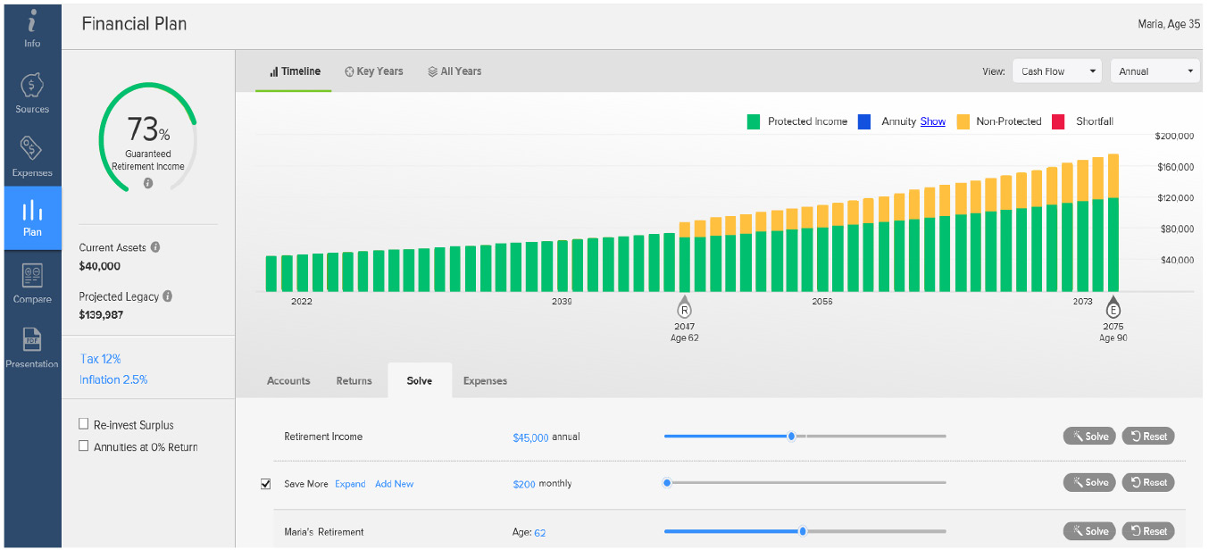
A case study: Maria Davis
2
1
Not an actual case and is a hypothetical representation for illustrative purposes only. Figures are based on an annual 7% rate of return and a 22% federal marginal income tax bracket. Withdrawals may be subject to withdrawal charges and federal and/or state income taxes. A 10% federal early withdrawal tax penalty may apply if taken before age 59½ in addition to ordinary income tax. Partial withdrawals may reduce benefits and contract value. Fees and charges, if applicable, are not reflected in this example and would reduce the results shown. Remember, investing involves risk, including possible loss of principal.
Notes:
[There are animations on this slide. Click for arrows to appear.]
[OPTIONAL]
After reducing the income goal and increasing retirement savings, the cash flow graph illustrates the projected retirement shortfall is eliminated.
In addition to eliminating the retirement shortfall, these actions have also increased the GRIP from 65% to 73%.

Slide 25
A case study: Maria Davis
Once the plan is finalized, your financial professional can provide an electronic or physical copy of the analysis for your records.

Slide 26
Answering other retirement questions.

Slide 27


Answering other retirement questions
Additional questions Retirement Pathfinder
can help answer include:
Is it possible to guarantee my retirement income?
How do I convert retirement savings into income?
What happens if I die prematurely?
Notes:
[There are animations on this slide. Click for text to appear.]
As you have seen, Retirement Pathfinder is a powerful planning tool. It can also be used to provide answers to other retirement questions such as:
Is it possible to guarantee my retirement income?
How do I convert retirement savings into income?
What happens if I die prematurely?

Slide 28
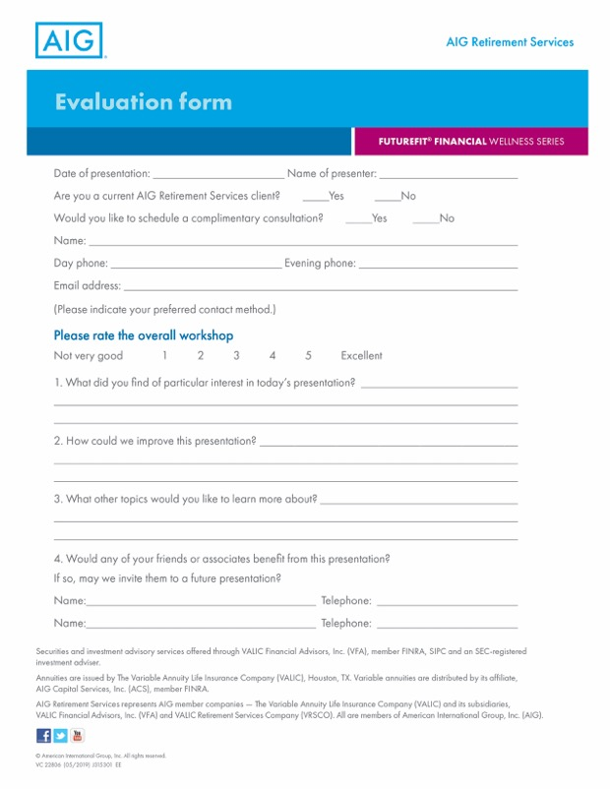
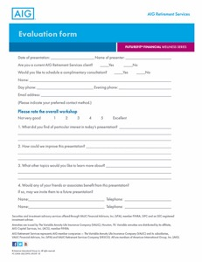
Answering other retirement questions
Evaluation
Notes:
[This slide has automatic animations.]
Thank you so much for your time today. Please take a moment now to complete the evaluation form. Your feedback is very important to me. If you would like to set up an appointment with me, check the box on the evaluation and I will contact you within 48 hours.
Thanks again!

Slide 29
Answering other retirement questions
Get more control over your retirement savings strategy
Contact your financial advisor to
make an appointment for a Retirement Pathfinder analysis and get answers to your important retirement questions.
Notes:
Contact your financial advisor and schedule an appointment if you would like to have a customized Retirement Pathfinder analysis created so you can get answers to your important retirement questions.

Slide 30


Answering other retirement questions
Schedule an appointment today!
Sign up to benefit from personal attention and get answers to help you plan for a more secure financial future.
Visit our website at www.aig.com/RetirementServices
Jessica Buckner
803.995.3623
jessica.buckner@aig.com
Mike Norris
610.310.2089
michael.norris@aig.com
Notes:
[OPTIONAL]
Here’s a chance for us to get acquainted. Schedule a time today to meet with me that is convenient for you.

Slide 31
This information is general in nature, may be subject to change, and does not constitute legal, tax or accounting advice from any company, its employees, financial professionals or other representatives. Applicable laws and regulations are complex and subject to change. For advice concerning your situation, consult your attorney, tax advisor or accountant.
Securities and investment advisory services offered through VALIC Financial Advisors, Inc. (VFA), member FINRA, SIPC and an SEC-registered investment adviser.
Annuities are issued by The Variable Annuity Life Insurance Company (VALIC), Houston, TX. Variable annuities are distributed by its affiliate, AIG Capital Services, Inc. (ACS), member FINRA.
AIG Retirement Services represents AIG member companies — The Variable Annuity Life Insurance Company (VALIC) and its subsidiaries, VALIC Financial Advisors, Inc. (VFA) and VALIC Retirement Services Company (VRSCO). All are members of American International Group, Inc. (AIG).
© American International Group, Inc. All rights reserved.
VC 28513 (01/2020) J491802 EE

Slide 32
Questions?
Jessica Hope-Buckner
Financial Advisor
Mike Norris
Financial Planning Advisor

