Slide 1
Sexual Health Education for Upperclassmen

Slide 2

Importance of Sexual Health
Can affect the ability of a unit to be combat ready
Can result in immediate termination from the DON
Port calls with high STD incident rates throughout the DON
Service members need to be aware of the consequences that can come from making poor sexual decisions

Slide 3

Learning Topics
Introduction
Definition
Sexually transmitted diseases
Birth Control
Abstinence
Preparing for cases
Dealing with cases

Slide 4

What is Sexual Health
A state of physical, emotional, mental and social well-being in relation to sexuality
Requires a positive and respectful approach to sexuality and sexual relationships
Free of coercion, discrimination and violence
Notes:
Not merely the absence of disease, dysfunction or infirmity.

Slide 5


Reality
Sailors and Marines will visit places where they will have ample opportunity to engage in high risk sexual behavior
As a newly appoint Ensign/ 2nd LT, how do you keep them out of trouble?

Slide 6
Dealing with Sailors and Marines
The best way to deal with sailors and marines regarding good sexual health is through fear of consequences
Before every port call make sure you let your sailors and marines know the consequences if they make bad sexual decisions
Maintain a buddy system and make sure sailors and marines follow it (no one leaves the ship without condoms)

Slide 7
Sexually Transmitted Diseases
STDs can be a major problem and prevent sailors and marines from doing their jobs
If a sailor or marine does contract an STD it can result in his/her separation from the DON
Types of STDs
Syphilis
Herpes
Hepatitis B
Crabs & Scabies
HIV
Gonorrhea
Chlamydia

Slide 8
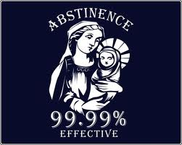
Abstinence
100% Effectiveness:
Abstinence is the only 100% effective method of preventing both pregnancy and sexually transmitted diseases. All other birth control options carry some risk of failure.

Slide 9
Birth Control Options and Effectiveness
ABSTINENCE — 100%
Surgery — 99%
BARRIER METHODS — 75-95%
IMPLANTABLE DEVICES — 95%-99%
BIRTH CONTROL PILLs — 99.9%
Notes:
ABSTINENCE
This is a traditional method of birth control that is simple and straightforward. Abstinence simply means refraining from having sex. This is becoming more and more popular among teens who choose not to make adult decisions before they feel they are old enough to handle it.
SURGERY
A safe and in some cases drastic measure of birth control is pursuing surgery. For females, this would be a tubal ligation. The tubal ligation is a surgery wherein the fallopian tubes are severed at the end, burned and then tied off to prevent an egg from fertilizing. This is considered a permanent method although in some cases it can be reversed. A vasectomy is for men who have decided they no longer want to have children. A small area of the vas deferens is cut or burned then sealed so that sperm cannot pass through into an ejaculation. Both procedures are about 99 percent effective.
BARRIER METHODS
The barrier method of birth control consists of creating a barrier or blocking the sperm from entering the birth canal and impregnating the woman. Common barrier methods include condoms for both men and women and the diaphragm. Male condoms are around 88 to 97 percent effective, female condoms are 75 to 95% effective and the diaphragm is around 82 to 94 percent effective at preventing pregnancy. It is recommended to use a spermicide or spermicidal jelly when using a barrier method, as they can break or tear during sex.
IMPLANTABLE DEVICES
Implantable devices are also popular with some women. One of the most common is the IUD or intrauterine device. This plastic device is implanted into the uterus by a gynecologist. It thickens the wall of the cervix so that sperm is unable to pass through. Typically, an IUD will last between five and 10 years. They are between 95 and 99 percent effective at preventing pregnancy. The Norplant system is implanted under the skin of the arm and prevents pregnancy by up to 99.9 percent.
BIRTH CONTROL PILLS
Birth control pills remain a popular option for many women. Most pills contain estrogen and progestin to prevent ovulation. They also create a cervical mucus to prevent sperm from passing through. The pill is a very effective form of birth control if taken properly---every day of the month. The pill provides a 99.9 percent pregnancy prevention rate.

Slide 10

Unplanned Pregnancy
Can result in separation from the DON
Effects combat readiness and result in the sailor/marine not being able to effectively complete his/her job
The DON will work with service members to try to make planned pregnancies as easy as possible

Slide 11
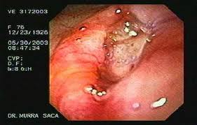
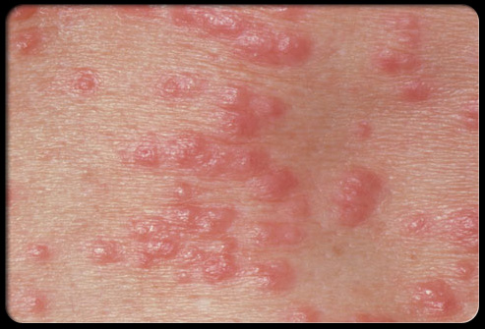
Fear
The best way to deal with sailors and marines is to talk to them before every port call
Show them the effects of getting an STD or having an unplanned pregnancy
If sailors know the outcomes they are less likely to make poor sexual decisions

Slide 12

Setting the Example
As an officer your sailors or marines will look to you as the example
Do not make poor sexual decisions yourself
Avoid places that have bad reputations
Control your alcohol level

Slide 13

Conclusion
Set the example
Make sure you sailor or marines know the consequences
Maintain a buddy system
Make sure your sailors or marines are prepared
Scare your sailors or marines with the truth

Slide 14
Resources
OPNAVINST 6100.2A
Sexual Health
http://www.sexualhealth.com/
Center for Disease Control
http://www.cdc.gov/sexualhealth/
WebMD
http://www.webmd.com/sex/default.htm
How Stuff Works
http://health.howstuffworks.com/sexual-health/sexuality
Science Daily
http://www.sciencedaily.com/news/health_medicine/sexual_health/

