Slide 1
Performance Evaluations
Notes:
PCC II-K.3

Slide 2

Learning Topics
Introduction
Brag Sheets
Fitness Reports

Slide 3
Introduction
Throughout your career in the DON you will always be evaluated
  These evaluations will follow you throughout your entire career
  A lot of them effect your ability to be promoted and other opportunities
  In the ROTC units we conduct performance evaluations to train for how they will be conducted in the fleet

Slide 4

Brag Sheets
The best way to influence a good evaluation is by outstanding performance
The second best way to influence a good evaluation is through an excellent brag sheet
The more you can include on your brag sheet the better
    Get involved
    Volunteer for activities
    Maintain stellar performance
    The better the input of the quality you put in the better evaluation you will receive

Slide 5
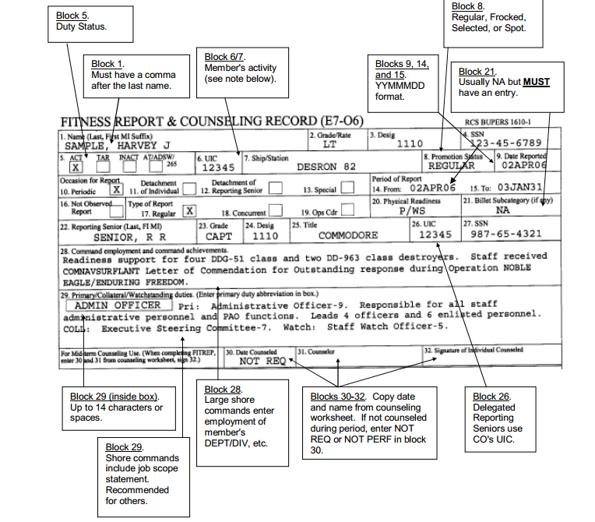
Fleet FITREPS
Notes:
Recommend a handout to help midshipmen follow along

Slide 6
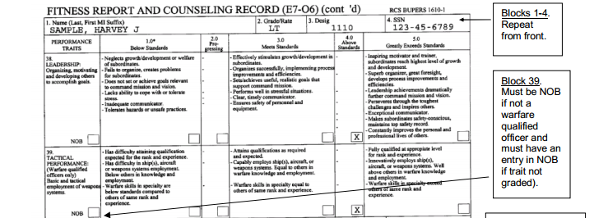

Slide 7
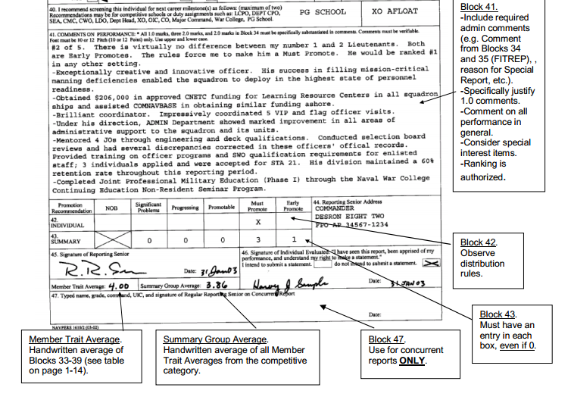

Slide 8
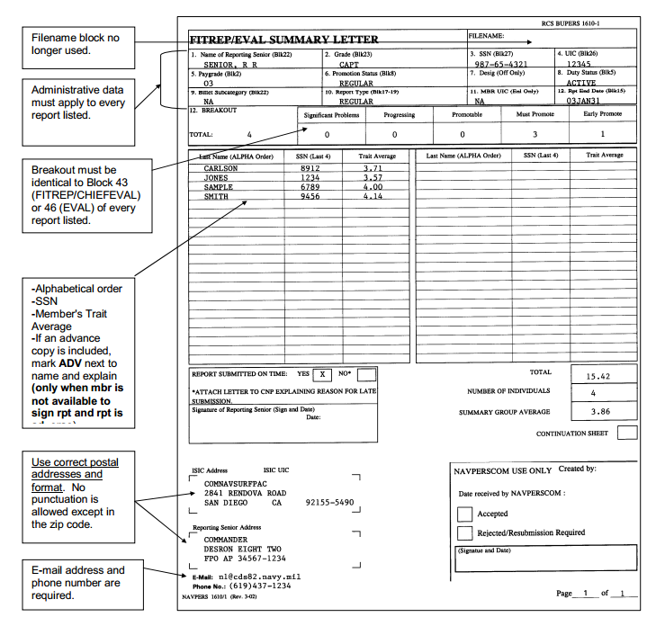
Summary Letter

Slide 9
Do
Give the individual the evaluation that they deserve
Use the individual’s brag sheet and make informed comments about their performance throughout the rating period

Slide 10

Do Not
Take personnel bias into account when you are evaluating someone
Give an individual fives because you like them
  A five is only given to sailors with absolutely outstanding performance
  Threes are the average and what should be given out most of the time

Slide 11
What happens next?
Once evaluations are signed by reporting senior you will receive your final evaluations from your academic advisor
  You will be able to see the comments made
  You will be allowed to see your final evaluation score on 1-5 scale
  Compare you score with
    Summary group’s average
    Reporting senior’s average
    Your prior evaluations
  You will have to sign the form every rating period

Slide 12
Deadlines
Evaluations are reviewed by multiple levels in the chain of command
Deadlines will be established accordingly
Keep a running brag sheet over the rating period, don’t do it at the last minute

Slide 13
Conclusion
The best way to get good evaluations is to maintain stellar performance
Take brag sheets seriously and include as much relevant information on them as possible
If you are evaluating someone, make sure you take the time to give the evaluation he deserves

Slide 14
Resources
Bupers Instruction 1610.10B
http://navyfitrep.com/files/161010.pdf
Navy Personnel Command
http://www.public.navy.mil/bupers-npc/career/performanceevaluation/Pages/default.aspx
Official Website of the United States Navy
http://www.navy.mil/search/display.asp?story_id=59911

