Slide 1
Force Protection
Notes:
PCC. III-K

Slide 2
What is Force Protection?
Force protection (FP) is a term used by the US military to describe preventive measures taken to mitigate hostile actions in specific areas or against a specific population.
Notes:
This is usually for Department of Defense personnel (including, but not limited to, family members and chaplains), resources, facilities, and critical information.

Slide 3
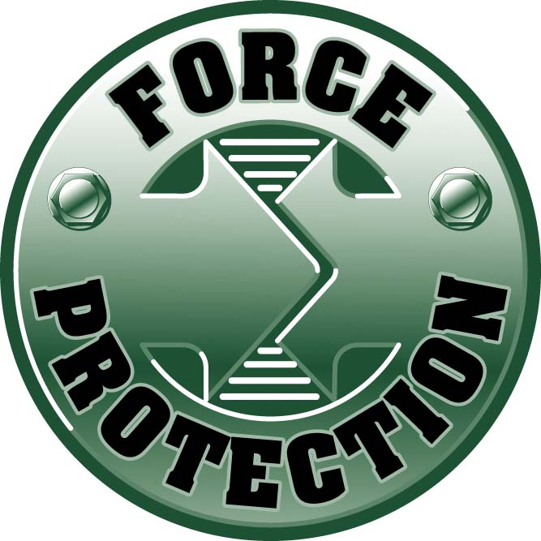
Who is the target?
All military units in the United States. When force protection condition is applied it is to raise the level of awareness and thereby protect our country

Slide 4
Force Protection Condition(FPCON)
Force Protection Condition (FPCON) is a terrorist threat system overseen by the Department of Defense directive, and describes the measures security agencies need to take in response to various levels of terrorist threats against military facilities
Notes:
As opposed to DEFCON, which assesses the amount of military forces needed to be deployed in a situation with a certain likelihood of attack against the civilian population

Slide 5
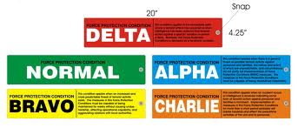
Purpose of FPCON
FPCON is used to determine the minimum security a certain area will have
Notes:
This security can be as simple as requiring proper credentials to get inside a building and can become as stringent as inspecting every single vehicle to pass through a gate.

Slide 6
Normal
FPCON NORMAL describes a situation of no current terrorist activity. The only security forces needed are enough to stop the everyday criminal, similar to civilian police forces

Slide 7
Alpha
FPCON ALPHA describes a situation where there is a small and general terrorist activity that is not predictable. Agencies will inform personnel that there is a possible threat and a standard security procedure review is conducted
Notes:
http://www.dtic.mil/whs/directives/corres/pdf/200016p.pdf
An FPCON level may also be designated as "+", meaning the facility shall institute extra security measures beyond those specified for the FPCON Level. Generally this is used to provide an extra layer of security for FPCON Alpha.

Slide 8
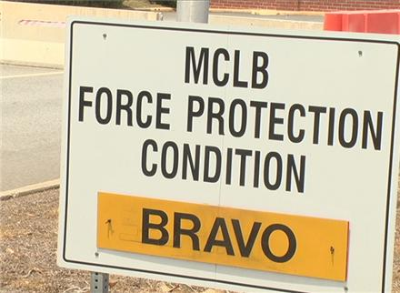
Bravo
FPCON BRAVO describes a situation with somewhat predictable terrorist threat. Security measures taken by agency personnel may affect the activities of local law enforcement and the general public

Slide 9
Charlie
FPCON CHARLIE describes a situation when a global terrorist attack has occurred or when intelligence reports that there is local terrorist activity imminent.

Slide 10
Delta
FPCON DELTA describes a situation when a terrorist attack is taking place or has just occurred in the immediate area. FPCON Delta usually occurs only in the areas that are most vulnerable to or have been attacked.
Notes:
One example is the September 11, 2001 Attacks. (Army or Air Force Bases are Restricted to only Military Personnel)
The key significant differences between FPCON Charlie, and FPCON Delta, is that FPCON Delta references a specific, known threat, whereas FPCON Charlie is used to prepare for imminent threats of a general, non-targeted nature. FPCON Charlie can also be maintained for a significant length of time, several weeks, while FPCON Delta is generally only maintainable for several days.

Slide 11
Types of Threats
Bio Terrorism – the release of germs or viruses, such as anthrax
Chemical Terrorism – the release of poisonous chemicals
Cyber Terrorism – the electronic attack on critical computer infrastructure
Nuclear Terrorism – the use of nuclear materials in a terrorist attack, either a nuclear bomb or a "dirty bomb" (highly radioactive chemicals spread by an ordinary explosive)
Eco Terrorism - the use of acts of violence, sabotage, vandalism, property damage and intimidation committed in the name of environmentalism
Religious Terrorism - terrorism motivated by religion

Slide 12
Conclusion
Pay attention to the level of threat at your base
Keep a look out for anything suspicious that might be related to that threat
Make sure you are able to provide more than one idea for any of the elevated threat levels
Be familiar with the FPCON instruction specific to your command

Slide 13
Resources
Force Protection Agency
http://www.pfpa.mil/
DoD Antiterrorism Standards
http://www.dtic.mil/whs/directives/corres/pdf/200016p.pdf

