Slide 1
Homeland Security
Notes:
PCC. V-D

Slide 2
Learning Topics
Purpose
Introduction
History
Homeland Security Act
Homeland Defense
Terrorism
Advisory System
Keeping yourself safe

Slide 3

Introduction
Homeland security refers to the security efforts the United States takes in order to protect against terrorist activities.
Homeland security deals with:
Preventing terrorist attacks
Lowering our vulnerability to terrorism
Recovering from terrorist attacks

Slide 4
History
Homeland Security Act of 2002
Signed into law on November 25, 2002 in response to the September 11, 2001 terrorist attacks. The Act brought together approximately 22 separate federal agencies to establish the Department of Homeland Security and sets forth the primary missions of the Department.
The Act has been amended over 30 times since its original passage.

Slide 5
Homeland Security Act
Title I - Department of Homeland Security
Sec. 101. Executive Department; Mission
(a) Establishment. - "There is established a Department of Homeland Security, as an executive department of the United States within the meaning of title 5, United States Code.
(b) Mission(1) In General. - The primary mission of the Department is to
(A) prevent terrorist attacks within the United States;
(B) reduce the vulnerability of the United States to terrorism;
(C) minimize the damage, and assist in the recovery, from terrorist attacks that do occur within the United States."From the Homeland Security Act of 2002

Slide 6
Homeland Defense
Definition: The protection of U.S. Territory, sovereignty, domestic population, and critical infrastructure against external threats and aggression.
Notes:
Different from homeland security which is a concerted national effort to prevent terrorist attacks.

Slide 7

Terrorism
Protecting the American people from terrorist threats is the founding purpose of the Department and our highest priority
The Department's efforts to battle terrorism,
detecting explosives in public spaces and transportation networks
helping protect critical infrastructure and cyber networks from attack
detecting agents of biological warfare

Slide 8
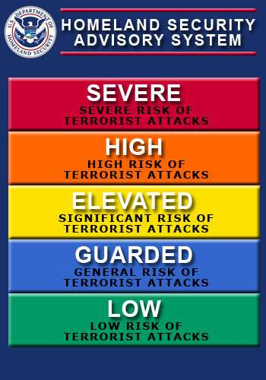
Homeland Security Advisory System

Slide 9
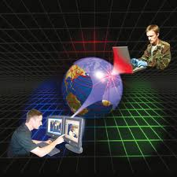
Cyber Security
National Cyber Security Division - Responsible for the response system, risk management program, and requirements for the cyber security in the U.S.
Helps identify many things such as identity theft and other online criminal activity

Slide 10

Why This Matters To You
You never know who is on the other side of a computer and what type of information could be useful to them
Never give up sensitive information that someone could use against you in the future

Slide 11

Reporting Threats
Department of Homeland Security's National Infrastructure Coordinating Center:
(202) 282-9201 (report incidents relating to national security and infrastructure issues)

Slide 12
Conclusion
Homeland security was set up to combat the terrorism throughout the United States
Remain vigilant and if you suspect any reasonable threats report them to the hotline

Slide 13
Resources
Homeland Security
http://www.homelandsecurity.com/
Homeland Security Act of 2002
http://www.dhs.gov/xlibrary/assets/hr_5005_enr.pdf

