Slide 1
Trafficking In Persons

Slide 2
Learning Topics
Importance
Definition
History
Trafficking laws
Global extent
What to look for?
Places to avoid
Actions to take
People to inform
Notes:
“As unimaginable as it seems, slavery
and bondage still persist in the early 21st century.
Millions of people around the world still suffer in
silence in slave-like situations of forced labor and
commercial sexual exploitation from which they cannot
free themselves. Trafficking in persons is one of the
greatest human rights challenges of our time.” (Paula
J. Dobrinsky, Under Secretary of State for Global
Affairs, April 2004). Trafficking in persons (TIP)
is, in fact, the 3rd largest criminal activity in the
world. Involvement with such activities carries grave
consequences.

Slide 3
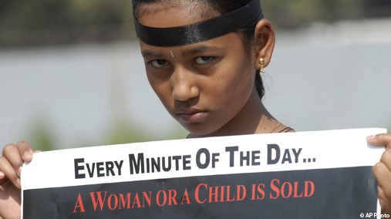
Importance
Worldwide problem
Many Sailors/Marines will encounter indentured servants
Occurs in many ports the Navy visits
Notes:
Human Trafficking in modern society is a worldwide problem that needs to be abolished. The mistreatment of humans happens in many countries the U.S. Navy visits.
Many sailors and marines will encounter a person that is an indentured servant being held against their will.

Slide 4
Definition
The act of recruiting, harboring, transporting, providing, or obtaining a person for labor services, or commercial sex acts by means of force, fraud, and coercion
For the purpose of
Exploitation
Involuntary servitude
Peonage
Debt bondage
Slavery

Slide 5
Introduction
Growing industry- second only to drug industry
$9 billion in revenue each year
2.5 million people from 127 countries- U.S. State Department recognizes 194 countries
Notes:
Human trafficking is an extremely lucrative industry which is only growing.
Trafficking of persons is second only to the drug industry as the most profitable illegal industry.
Total revenue for trafficking in persons were estimated to be as high as 9 billion a year.
An estimated 2.5 million people from 127 different countries are being trafficked.
The U.S. State Department only recognizes 194 countries across the world.

Slide 6
History
Trafficking and slavery prevalent throughout history
Gladiators
Serfs (Middle Ages)
Triangle Trade
2012 http://femmefairness.wordpress.com/about/
Notes:
Human Trafficking is a term in which many do not realize the full extent of the problem. Throughout history many countries have taken steps to prevent its spread, however many countries still allow the practice.
Roman Gladiators were slaves
Serfs in the Middle Ages were generally slaves
Triangle trade between Europe, North America and Africa trafficked people as slaves

Slide 7
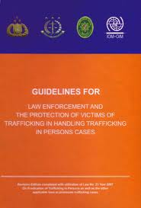
Trafficking Laws
Vary from country to country
International Labor Organization says NO
Not honored by many countries
http://www.uate.org/?eng/menu/31
Notes:
Laws of trafficking vary from country to country. Many countries still do not have any laws outlawing the practice.
Legislation by the International Labor Organization states that trafficking of persons of any type is strictly illegal.
Many countries do not honor this legislation.

Slide 8
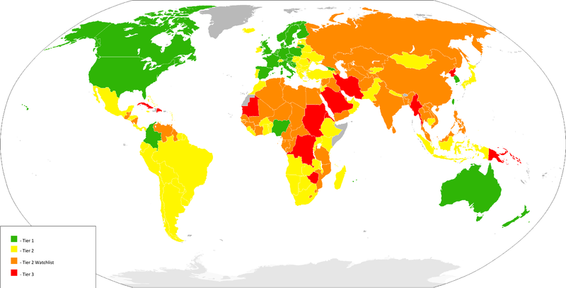
Global Extent
Tier 1= Lowest Amount of Trafficking
Tier 3=Highest Amount of Trafficking
http://globalgendercurrent.com/category/trafficking/

Slide 9
Tip-offs of Indentured Slaves
Trafficking victims work long hours
Receive little or no pay
May be guarded by other employees
Be aware of fatigue, bruises, or other evidence of injury
May be wary of unsanctioned contact with outsiders
May be censored by others
May be held against their will on false promises
Notes:
Remain in a state of constant vigilance in high-risk areas.
Trafficking victims work long hours
Receive Little or no pay
May be guarded by other employees
Be aware of fatigue, bruises, or other evidence of injury
Look for workers who may look afraid of unsanctioned contact with outsiders and whose statements may be censored by others.
Look out for people in common labor jobs being held against their will on false promises.

Slide 10
Places to Avoid
Often promised access to a country/opportunity in exchange for services
Strip clubs
Bars
Prostitution rings
“Employees” are often held against their will
Sailors will still go to places they are instructed not to go to
Notes:
Many sailors during port calls will attend places that they are instructed to avoid.
Many places such as strip clubs, bars, and prostitution rings will be using people that are being held against their will.
Persons are often promised access to a country, or other opportunities in exchange for services.
Strip clubs
Bars
Prostitution rings

Slide 11
Actions to Take
Ensure sailors will report questionable activity
Stress an open door policy on reporting - Even if they were someplace they weren’t supposed to go
You need to report the problem up the chain and to local authorities
Leave it to the authorities to take care of the problem
Notes:
Ensure that any sailors who observe any type of questionable activity are not afraid to report it.
Even in sailors attend places they were instructed not to go, ensure they feel that the can come to you in order to report the problem.
If you are informed of any activity or see any activity yourself report the problem up the chain and to the local authorities.
Do not try and attempt to take care of the problem yourself.

Slide 12
People to Inform
Human Trafficking Hotline
1-888-373-7888
24/7 bilingual hotline that can be used to report trafficking cases and ask for assistance.

Slide 13
Conclusion
Human trafficking is an international problem that is only growing
If you see or hear anything that might be human trafficking report it to the proper people
Make sure the sailors you will be leading are informed of human trafficking and inform their chain if they observe anything

Slide 14
References
U.S. Department of State, Office to Monitor and Combat Trafficking in Persons
http://www.state.gov/g/tip/.)
U.S. Department of State, Office to Monitor and Combat Trafficking in Persons June 2003
http://www.state.gov/g/tip/rls/tiprpt/2003/21262.htm.
U.S. Department of State, “Trafficking in Persons Report,” June 2004
http://www.state.gov/g/tip/rls/tiprpt/2004.
The Police Chief: The professional voice of law enforcement
http://www.policechiefmagazine.org/magazine/index.cfm?fuseaction=display_arch&article_id=174&issue_id=122003

