Slide 1
Physical Fitness and Recreational/Home Safety
Notes:
PCC IX (FITNESS AND WELLNESS PROGRAMS)- D.2 (Physical Fitness) slides 4-10
PCC IX (FITNESS AND WELLNESS PROGRAMS)- D.5 (Off-duty Safety) slides 14-18

Slide 2
Learning Topics
Importance of physical fitness
Importance of recreational home safety
Physical fitness test
Male & female standards
Definitions
Stretching
10 basic stretches
Chemical warning labels
Some dangerous home material
Recreational safety
Definition of PPE
Conclusion

Slide 3
Importance
Able to maintain physical readiness
Working out safely
Being safe recreationally
Being safe at home
Notes:
Being able to pass the Navy’s Physical Readiness Test is a huge part of being a Naval Officer.
Must be able to set the example for your men and women by doing more than simply barely passing the PRT.
There are right and wrong ways to work out. Must be able to work out properly to avoid injury.
There are a lot of fun activities that can be done away from work. One must know the dangers of every activity they take part in and know how to stay safe.
There are many hazardous chemicals and activities that can be done at home. One must be aware of these and take the proper precautions to keep everyone in the house safe.

Slide 4
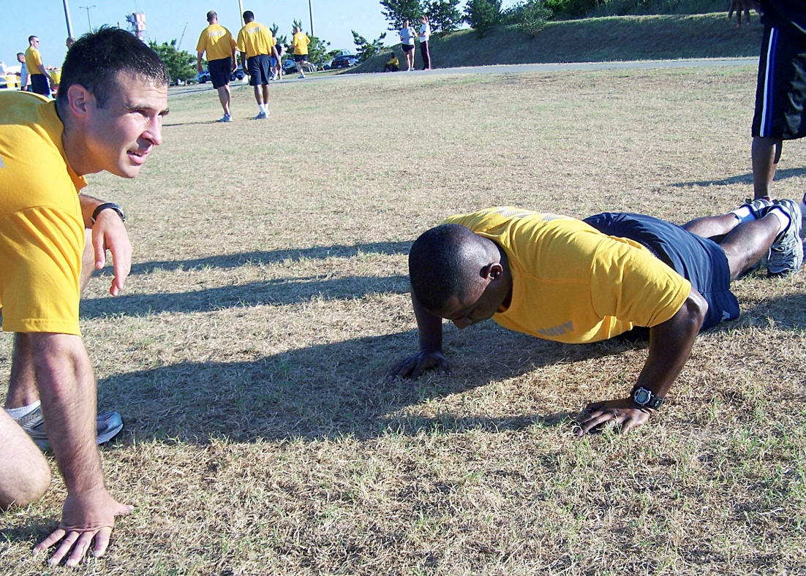
Physical Readiness Test
Navy
Curl-Ups
Push-ups
1.5 mile run/walk
Marines
Pull-ups
Curl-ups
3 mile run/walk
Notes:
PCC IX (FITNESS AND WELLNESS PROGRAMS)- D.2 (Physical Fitness)
Curl-Ups: Curl-ups are performed with a partner holding the member’s feet. Any other means of securing the member’s feet is not authorized. Members are required to wear shoes. Curl-ups are to be performed on a flat, level surface. Blankets, mats, or other suitable padding may be used, however the member must be entirely on or off the padding, i.e., member’s upper body cannot be on the padding with feet off.
Push-ups are to be performed on a flat, level surface. Blankets, mats, or other suitable padding may be used. However, member must be entirely on the padding or off, i.e., member’s upper body cannot be on the padding with feet off. Members are required to wear shoes.
Event consists of running or walking 1.5 miles as quickly as possible. Any combination of running or walking is allowed to complete the event.
Commander’s Intent and Concept of Operations(1) Commander’s Intent. Every Marine must be physically fit, regardless of age, grade, or duty assignment, as per reference (a). The MCPFP emphasizes the requirement for all Marines to adopt a healthy lifestyle and a lifelong commitment to fitness. This combination has a direct and positive impact on job performance and combat readiness.
Reference:
OPNAV6110.1J

Slide 5
17-19 Male PRT Standards
Performance | Points | Curl-ups | Push-ups | 1.5 mile run
Levels
Maximum | 100 | 109 | 92 | 8:15
Outstanding | 90 | 102 | 86 | 9:00
Excellent | 75 | 90 | 76 | 9:45
Good | 60 | 62 | 51 | 11:00
Satisfactory | 45 | 50 | 42 | 12:30
Failure | FAIL | <50 | <42 | >12:30
Notes:
PCC IX (FITNESS AND WELLNESS PROGRAMS)- D.2 (Physical Fitness)
Midshipmen must maintain a Good, overall
Reference: OPNAVINST 6110.1J Checked 30MAY2012

Slide 6
Males: Age 20-24
Performance | Points | Curl-ups | Push-ups | 1.5 mile run
Levels
Maximum | 100 | 105 | 87 | 8:30
Outstanding | 90 | 98 | 81 | 9:15
Excellent | 75 | 87 | 71 | 10:30
Good | 60 | 58 | 47 | 12:00
Satisfactory | 45 | 46 | 37 | 13:30
Failure | FAIL | <46 | <37 | >13:30
Notes:
PCC IX (FITNESS AND WELLNESS PROGRAMS)- D.2 (Physical Fitness)
Reference: OPNAVINST 6110.1J Checked 30MAY2012

Slide 7
17-19 Female PRT Standards
Performance | Points | Curl-ups | Push-ups | 1.5 mile run
Levels
Maximum | 100 | 109 | 51 | 9:29
Outstanding | 90 | 102 | 47 | 11:30
Excellent | 75 | 90 | 42 | 12:30
Good | 60 | 62 | 24 | 13:30
Satisfactory | 45 | 50 | 19 | 15:00
Failure | FAIL | <50 | <19 | >15:00
Notes:
PCC IX (FITNESS AND WELLNESS PROGRAMS)- D.2 (Physical Fitness)
Midshipmen must maintain a Good, overall
Reference: OPNAVINST 6110.1J Checked 30MAY2012

Slide 8
Females: Age 20-24
Performance | Points | Curl-ups | Push-ups | 1.5 mile run
Levels
Maximum | 100 | 105 | 48 | 9:47
Outstanding | 90 | 98 | 44 | 11:30
Excellent | 75 | 87 | 39 | 13:15
Good | 60 | 58 | 21 | 14:15
Satisfactory | 45 | 46 | 16 | 15:30
Failure | FAIL | <46 | <16 | >15:30
Notes:
PCC IX (FITNESS AND WELLNESS PROGRAMS)- D.2 (Physical Fitness)
Reference: OPNAVINST 6110.1J Checked 30MAY2012

Slide 9
Marines (Male)
Notes:
PCC IX (FITNESS AND WELLNESS PROGRAMS)- D.2 (Physical Fitness)
See MOI/AMOI for more extensive lists
Reference MCO P6100.13 Checked 30MAY2012

Slide 10
Marines (Female)
Notes:
PCC IX (FITNESS AND WELLNESS PROGRAMS)- D.2 (Physical Fitness)
See MOI/AMOI for more extensive lists

Slide 11
A Few Definitions
Aerobic activity- exercises including walking, riding a bike, or swimming. This helps your heart, lungs, and muscle tone.
Muscle strength- exercises include types of resistance training. This helps build strong bones and muscles.
Stretching- helps with flexibility and balance. Do all stretches gradually. Don't push or bounce the stretch. You should feel a stretch, not pain.
Notes:
Aerobic activity makes your heart and lungs work harder and builds up your endurance. It gets more oxygen to your muscles, which allows your muscles to work longer.
Moderate aerobic activity for at least 2½ hours a week. Moderate activity means things like brisk walking, brisk cycling, or shooting baskets. You notice your heart beating faster with this kind of activity.
Vigorous aerobic activity for at least 1¼ hours a week. Vigorous activity means things like jogging, cycling fast, cross-country skiing, or playing a basketball game. You breathe harder and your heart beats much faster with this kind of activity.
Service members should exercise on a regular basis (e.g., three to five times each week) and to an intensity that provides a training effect. Individuals with injuries and on medical profiles, shall be placed on a medically approved exercise program only after consultation with medical authorities.
E1.1.1. Aerobic Capacity (Aerobic Fitness or Cardio-Respiratory Endurance). The functional capacity of the heart, lungs, and blood vessels to deliver oxygen to the working muscles, and its utilization by the muscles to oxidize energy sources (carbohydrates and fats) to generate energy over sustained periods of time. Essentially, it is the body's capability to receive and use oxygen, carbohydrates, and fats to produce energy.E1.1.2. Body Fat. The body is composed of fat and fat-free mass (which includes body water, bone mineral, proteins, glycogen, and other minerals). "Body fat" is expressed as "a percentage of total body weight." Total body fat is composed largely of stored fat and a small amount of "essential" fat that makes up cell membranes, nerve sheaths, and structural fat padding vital structures.E1.1.3. Body Mass Index. A mathematical expression that describes the normal proportions between weight and height. For example, two individuals of different heights, 5'6" and 6'2", would have comparable "skinny" proportions (i.e., the same low body mass index of 19 (kg/m2 ) at 117 and 148 pounds, or "heavy" proportions (the same high body mass index of 27.5 (kg/m2 ) at 170 and 214 pounds, respectively. Body mass index is calculated as weight (in kilograms) divided by the square of height (in meters); the equation for use with English units is BMI=704.5 x wt/ht2 where wt is in lbs and ht in inches.

Slide 12
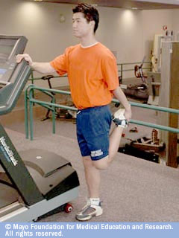
Stretching
Warm up first
Hold each stretch for at least 30 seconds
Don't bounce
Focus on a pain-free stretch
Relax and breathe freely
Stretch both sides
Stretch before and after activity
Notes:
http://www.mayoclinic.com/health/stretching/SM00043
This is a slide show from the Mayo Clinic to discuss the proper way to stretch and 10 basic stretches.
Proper stretching techniques:
Use dynamic stretches for before workouts. Keep static stretches for after.
Warm up your muscles for 5 to 10 minutes before your stretch them.
Increase your heart rate by doing aerobic activity such as walking or jogging. This will help increase blood flow to your working muscles.
Try to hold each stretch for 15 to 30 seconds.

Slide 13
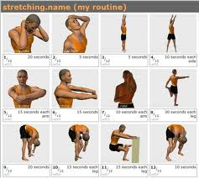
10 Basic Stretches
Calf Stretch
Hamstring Stretch
Quadriceps Stretch
Hip Flexor Stretch
Iliotibial Band Stretch (ITB)
Knee-to-Chest Stretch
Shoulder Stretch
Shoulder Stretch with Towel
Neck Stretch
Upper Back Stretch
Notes:
http://www.mayoclinic.com/health/stretching/SM00043
Mayo Clinic. 10 basic stretches
Calf Stretch
Stand at arm's length from a wall or a piece of sturdy exercise equipment.
Place your right foot behind your left foot.
Slowly bend your left leg forward, keeping your right knee straight and your right heel on the floor.
Hold your back straight and your hips forward. Don't rotate your feet inward or outward.
Hold for about 30 seconds.
Switch legs and repeat.
To deepen the stretch, slightly bend your right knee as you bend your left leg forward.
2. Hamstring Stretch
Lie on the floor near the outer corner of a wall or a door frame.
Raise your left leg and rest your left heel against the wall. Keep your left knee slightly bent.
Gently straighten your left leg until you feel a stretch along the back of your left thigh.
Hold for about 30 seconds.
Switch legs and repeat.
As your flexibility increases, maximize the stretch by gradually scooting yourself closer to the wall or door frame.
3. Quadriceps Stretch
Stand near a wall or a piece of sturdy exercise equipment for support.
Grasp your ankle and gently pull your heel up and back until you feel a stretch in the front of your thigh.
Tighten your stomach muscles to prevent your stomach from sagging outward, and keep your knees close together.
Hold for about 30 seconds.
Switch legs and repeat.
4. Hip flexor stretch
Kneel on your right knee, cushioning your kneecap with a folded towel.
Place your left foot in front of you, bending your knee and placing your left hand on your left leg for stability.
Place your right hand on your right hip to avoid bending at the waist. Keep your back straight and abdominal muscles tight.
Lean forward, shifting more body weight onto your front leg. You'll feel a stretch in your right thigh.
Hold for about 30 seconds.
Switch legs and repeat.
5. Iliotibial Band Stretch
Stand near a wall or a piece of sturdy exercise equipment for support.
Cross your left leg over your right leg at the ankle.
Extend your left arm overhead, reaching toward your right side. You'll feel a stretch along your left hip.
Hold for about 30 seconds.
Switch sides and repeat.
6.Knee-to-Chest Stretch
Lie on your back on a firm surface with the backs of your heels flat on the floor.
Gently pull one knee up to your chest until you feel a stretch in your lower back.
Bring the knee as close to your chest as comfortably possible.
Keep the opposite leg relaxed in a comfortable position, either with your knee bent or with your leg extended.
Hold for about 30 seconds.
Switch legs and repeat.
7.Shoulder Stretch
Bring your left arm across your body and hold it with your right arm, either above or below the elbow.
Hold for about 30 seconds.
Switch arms and repeat.
8. Shoulder Stretch with Towel
Grasp a rolled-up towel firmly with both hands, as shown.
Gently pull the towel toward the ceiling with your top hand. You'll feel a stretch in the shoulder of your opposite arm as your lower hand is gently pulled farther up your back.
Hold for about 30 seconds.
Switch hands and repeat.
9. Neck Stretch
Bend your head forward and slightly to the right.
With your right hand, gently pull your head downward. You'll feel a nice, easy stretch along the back left side of your neck.
Hold for about 30 seconds.
Repeat on the opposite side.
10. Upper Back Stretch
Stand in a relaxed position with your arms extended in front of you, parallel to the floor (top image).
Pull your shoulder blades together behind you, bending your arms slightly at the elbows. You'll notice that your arms spread a little wider as you do this (bottom image).
Hold about 30 seconds
Repeat as desired.

Slide 14
Home Safety
Be aware of common warning labels
Be aware of dangerous home materials
Know intended use of chemicals
Notes:
PCC IX (FITNESS AND WELLNESS PROGRAMS)- D.5 (Off-duty Safety)

Slide 15
Chemical Warning Labels
DANGER means that the chemical is harmful or fatal if swallowed
WARNING means that the chemical is harmful if swallowed
CAUTION means that the chemical is harmful if swallowed
Notes:
PCC IX (FITNESS AND WELLNESS PROGRAMS)- D.5 (Off-duty Safety)
DANGER means that the chemical is harmful or fatal if swallowed. Ingestion of a small taste to a teaspoon could kill an average sized adult. WARNING means that the chemical is harmful if swallowed. Ingestion of a teaspoon to an ounce could kill an average sized adult. CAUTION means that the chemical is harmful if swallowed. Ingestion of an ounce to a pint could kill an average adult.
DO NOT DRINK!!!

Slide 16
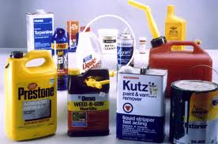
Some Dangerous Home Material
12 Most Dangerous Household Chemicals
1. Air Fresheners
2. Ammonia
3. Bleach
4. Carpet and Upholstery Shampoos
5. Dishwasher Detergents
6. Drain Cleaners
7. Furniture Polish
8. Mold and Mildew Cleaners
9. Oven Cleaner
10. Antibacterial Cleaners
11. Laundry Room Products
12. Toilet Bowl Cleaners
Use Chemicals for their intended use!
Notes:
PCC IX (FITNESS AND WELLNESS PROGRAMS)- D.5 (Off-duty Safety)
http://www.achooallergy.com/blog/dangerous-household-chemicals/
Make sure these materials are kept in a secure location. Out of reach of children.
Be sure to follow all warning labels when using such products.

Slide 17
Recreational Safety
Be Aware of all safety issues for any recreational activity
Know and use all proper personal protective equipment (PPE)
Do all to prevent injury/death for all parties involved
Notes:
PCC IX (FITNESS AND WELLNESS PROGRAMS)- D.5 (Off-duty Safety)
http://www.bannerhealth.com/Services/Health+And+Wellness/Safety/Recreation+Safety.htm

Slide 18
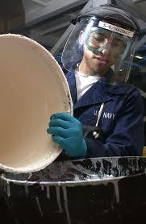
Definition of PPE
Personal Protective Equipment (PPE) - Specialized clothing or equipment worn by employees for protection against health and safety hazards.
Personal protective equipment is designed to protect many parts of the body, i.e. eyes, head, face, hands, feet, and ears.
Notes:
PCC IX (FITNESS AND WELLNESS PROGRAMS)- D.5 (Off-duty Safety)

Slide 19
Conclusion
Be aware of Official Navy PRT standards and strive for improvement
Practice safety in all physical activities
Know your household chemicals and make sure they are secure
Wear all proper PPE for all recreational activities you choose to participate in

Slide 20
References
Banner Health, Recreation Safety Tips-
http://www.bannerhealth.com/Services/Health+And+Wellness/Safety/Recreation+Safety.htm
12 Most dangerous household chemicals
http://www.achooallergy.com/blog/dangerous-household-chemicals/
MayoClinic, A guide to 10 basic stretches
http://www.mayoclinic.com/health/stretching/SM00043
Navy Personnel Command
http://www.public.navy.mil/BUPERS-NPC/SUPPORT/PHYSICAL/Pages/Guides.aspx
Department of Defence Instruction
www.dtic.mil/whs/directives/corres/pdf/130803p.pdf
Navy PRT Standards
OPNAVINST 6110.1J
Marine Corps Order 6100.13 W/CH 1
http://www.marines.mil/news/publications/Documents/MCO%206100.13%20W_CH%201.pdf

