Slide 1
Personal Financial Management for Underclassmen
Notes:
PCC. III-H

Slide 2

Learning Topics
Importance
Introduction
College Life
Expenses
Stipend
Wasting Money
Loans
Debt
Interest

Slide 3

Importance
Money is one of the biggest concerns of most people in the world
It influences everything you will be able to do
Wasting it is extremely easy to achieve in college
The Navy pays a lot of money and you have to be able to manage that money

Slide 4
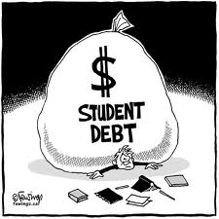
College Life
College life is stressful and hard
You need to be focusing on your studies
Adding monetary problems to the picture will only make life more stressful for yourself
Food
Room and Board
Tuition
Many other issues

Slide 5

College Life
You don’t live with your parents anymore!
You need to start being responsible for you own decisions
If you can’t take care of your own finances how can you be expected to take care of enlisted personnel under your command?

Slide 6
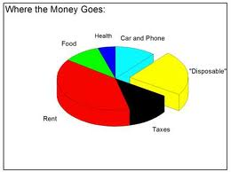
Expenses in College
Since there are so any expenses in college you need to effectively manage them and make sure you are not falling into debt
Keep track of where your money goes. This will allow you to see where you can cut spending in order to save money.
You always want to have a certain amount of saved money in case of unforeseen expenses.

Slide 7
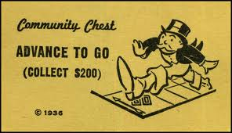
Navy Stipend
Freshmen-250/month
Sophomore-300/month
Junior-350/month
Senior-400/month
Living on campus has its benefits
Book stipend-375/semester

Slide 8

How to Avoid Wasting Money
Live on campus to take advantage of the possible room and board assistance
Avoid eating out on regular basis
Walk to class
Spend money on things you need, not want

Slide 9

Loans
College loans are expensive
Many of you will not have college loans due to the NROTC Scholarship
However, if you do make sure you have them correctly financed
Pay them off as soon as you can

Slide 10

Credit Cards
If you spend $4,000 on credit cards at 18.5% interest and pay only the minimum payments, it will take you 11 years to pay off ($7,800 total)
Make sure you stay on top of your payments if you choose to get a credit card

Slide 11
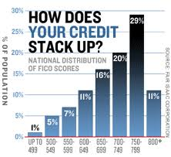
Credit Cards Continued
Build good credit by consistently paying your bills on time
Do not carry a credit card balance month to month
Having good credit will open many doors for you in the future
If you neglect your bills it will hurt you credit history and make life difficult for you in the future

Slide 12
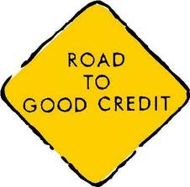

Credit Card Tricks
The old bait and switch
Musical Address
Over the limit fees
Cash advance fees and rates
Increasing the rate based on other accounts
Notes:
-The old bait and switch: You have applied for a great credit card that gives you tons of frequent flier miles. When and if you get the card, study the terms carefully. If you do not qualify for the credit card, the credit card company can send you a completely different card with different terms.
-Musical Address: Credit card companies sometimes change their payment P.O. Box. If you send your payment to the wrong one, it may meander around the postal system before finding its way to the payments department. This means you are responsible for the late fee and your interest rate could be raised. To avoid falling for this trick use the envelope provided in your statements.
-Over the limit fees: This fee is a no-brainer ---- do not go over your limit.
-Cash advance fees and rates: Do not take cash out of your credit card. Credit cards usually have reasonable rates on purchases. The rate for cash advances is always much higher and there is not a grace period. You start paying interest right away on your cash advance. Aside from paying a higher interest rate, you are going to pay a fee, usually 2 to 4 percent of the amount advanced. Monthly payments will be applied to the lower-interest balance (purchases) before they are applied to the cash advance.
-Increasing the rate based on other accounts: Your credit card company may use your late auto loan payment to justify increasing the interest rate on your credit card.

Slide 13

Signs of Predatory Lending
1. Triple digit interest rate: Payday loans carry very low risk of loss, but lenders typically charge fees equal to 400% APR and higher
2. Short minimum loan term: Payday customers unable to repay their loan within two weeks are forced to get a loan "rollover" at additional cost. In contrast, small consumer loans have longer terms
3. Lenders who advertise to E-1, E-2, and E-3s are often looking to take advantage of their lack of financial management experience
4. Single balloon payment: Unlike most consumer debt, payday loans do not allow for partial installment payments to be made during the loan term. A borrower must pay the entire loan back at the end of two weeks

Slide 14
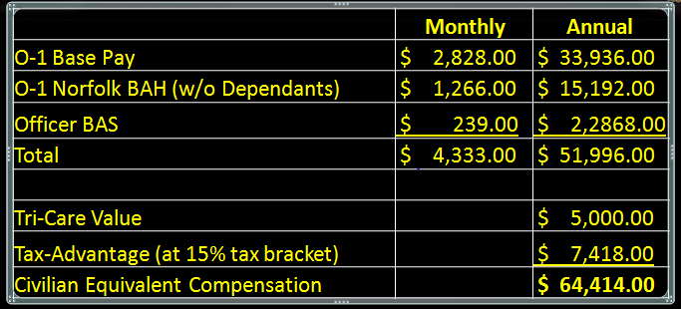
Navy Salary (O-1)

Slide 15
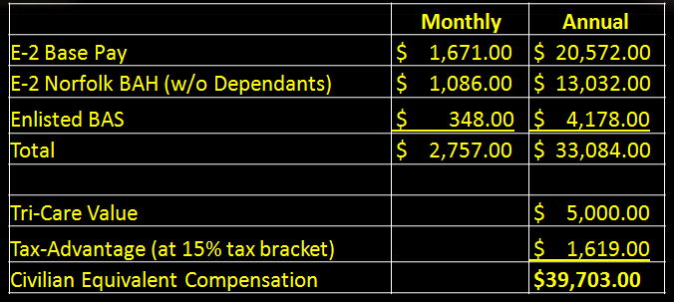
Navy Salary (E-2)

Slide 16
Conclusion
You need to be responsible for yourself now
College is an expensive place and in many cases the Navy stipend will not seem like enough to survive
You need to effectively manage your expenses and be wise with your money

Slide 17
References
Roth IRA
http://www.kiplinger.com/columns/starting/archive/2006/st0309.htm
Social Security Online
http://www.ssa.gov/retire2/
About
http://retireplan.about.com/

