Slide 1
Nutrition & the Body Composition Assessment/Program For Upperclassmen
Notes:
PCC IX (FITNESS AND WELLNESS PROGRAMS)- D.2 (Nutrition and weight control)

Slide 2
Learning Topics
Definition of nutrition
Tips to eating healthy
Eating a healthy breakfast
10 food types to avoid
Body composition
How to measure body composition
How to improve body composition

Slide 3
Importance
Eating healthy can help your overall well being and reduce stress
It is important to eat healthy to maintain an active life style

Slide 4
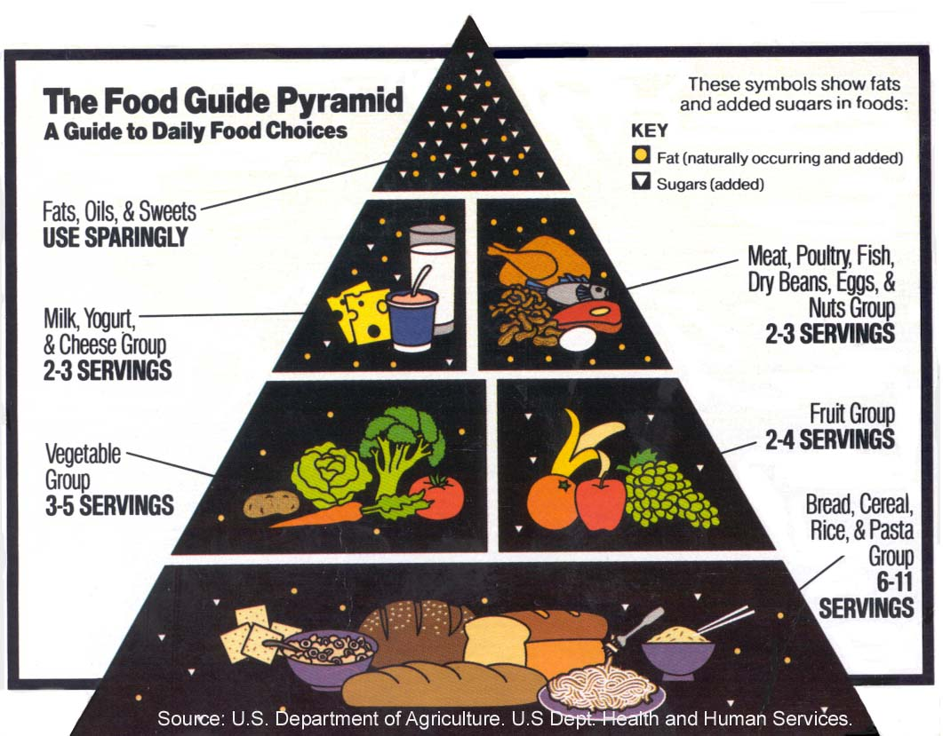
Definition of Nutrition
The provision, to cells and organisms, of the materials necessary (in the form of food) to support life.
Notes:
PCC IX (FITNESS AND WELLNESS PROGRAMS)- D.2 (Nutrition)

Slide 5
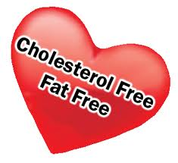
Tips to Healthy Eating
Limit calorie intake to the amount needed to attain or maintain a healthy weight
Consume foods from all food groups
Reduce intake of solid fats
Replace solid fats with oils when possible
Reduce intake of added sugars
Reduce intake of refined grains and
increase whole grains.
Notes:
PCC IX (FITNESS AND WELLNESS PROGRAMS)- D.2 (Nutrition)
Individuals should meet the following recommendations as part of a healthy eating pattern and while staying within their calorie needs. Increase vegetable and fruit intake. Eat a variety of vegetables, especially dark- green and red and orange vegetables and beans and peas. Consume at least half of all grains as whole grains. Increase whole-grain intake by replacing refined grains with whole grains. Increase intake of fat-free or low-fat milk and milk products, such as milk, yogurt, cheese, or fortified soy beverages.58Choose a variety of protein foods, which include seafood, lean meat and poultry, eggs, beans and peas, soy products, and unsalted nuts and seeds. Increase the amount and variety of seafood consumed by choosing seafood in place of some meat and poultry. Replace protein foods that are higher in solid fats with choices that are lower in solid fats and calories and/or are sources of oils. Use oils to replace solid fats where possible. Choose foods that provide more potassium, dietary fiber, calcium, and vitamin D, which are nutrients of concern in American diets. These foods include vegetables, fruits, whole grains, and milk and milk products.

Slide 6
Tips to Healthy Eating (Cont.)
Reduce intake of sodium
Limit alcohol intake to moderate levels
Increase intake of vegetables and fruits
Increase intake of milk and milk products
Replace whole milk and full-fat milk products with fat-free or low-fat
Increase seafood intake
Notes:
PCC IX (FITNESS AND WELLNESS PROGRAMS)- D.2 (Nutrition)

Slide 7

Eating a Healthy Breakfast Gives You:
A more nutritionally complete diet, higher in nutrients, vitamins and minerals
Improved concentration and performance in the classroom or the boardroom
More strength and endurance to engage in physical activity
Lower cholesterol levels
Notes:
PCC IX (FITNESS AND WELLNESS PROGRAMS)- D.2 (Nutrition)

Slide 8
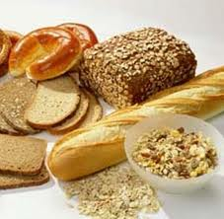
10 Food types to Avoid
Sugar
Hydrogenated fats
Pop
Aspartame and other artificial sweeteners
Fried foods
Refined grains
Processed meats
Ready to eat breakfast cereal
White rice
“Fat free”
Notes:
PCC IX (FITNESS AND WELLNESS PROGRAMS)- D.2 (Nutrition)
1. Sugar The foods from which sugar was originally derived (sugar cane and sugar beets) contain all of the nutrients (chromium, zinc, B vitamins, fiber, etc.) required for the body to properly metabolize the final isolated chemical we know as sugar (sucrose). Without these nutrients which are eliminated in processing, the body is greatly stressed. Sugar consumption is associated with weight gain, obesity, Type 2 diabetes, cardiovascular disease, immune depression and much more. 2. Hydrogenated Fats These “fake” fats (such as margarine, Crisco and anything referred to as hydrogenated or partially hydrogenated vegetable oils) are made by altering the natural chemical structure of a vegetable oil (liquid at room temperature) to act more like a saturated fat (solid at room temperature). In the process, the natural “cis” chemical configuration changes to a nasty unnatural “trans” configuration. This is very difficult for the body to process and it ends up getting stuck in our arteries and veins, even to a greater extent than a cholesterol molecule would. Cholesterol is natural and the body knows how to metabolize it in small amounts. Studies now show that these non-cholesterol containing hydrogenated products actually increase cholesterol levels in individuals more so than if the person would have eaten the butter! 3. Pop and other man-made “non-foods” Just 12 oz. of soda contains 10 teaspoons of sugar, plus phosphoric acid to rob your body of minerals contributing to an acidic system and osteoporosis. 4. Aspartame and other man-made artificial sweeteners Upon ingestion, aspartame (NutraSweet, Equal and Spoonful) is metabolized to two amino acids (phenylalanine and aspartic acid) and methanol. (Trefz) When the temperature of aspartame or aspartame containing products exceeds 86 degrees F, the methanol (which is wood alcohol) converts to formaldehyde and then to formic acid, which in turn causes metabolic acidosis. (Formic acid is the poison found in the sting of fire ants.) Methanol qualifies as an exceptionally toxic substance, even at very low doses. (Roe) child). (Kavet) Methanol toxicity mimics multiple sclerosis; thus, it seems many people are being diagnosed with having multiple sclerosis in error. The multiple sclerosis is not a death sentence, where methanol toxicity is. It is a slow silent killer. The EPA recently announced that there was an epidemic of multiple sclerosis and systemic lupus (for unknown reasons) across the United States. The US Congressional record states, "Aspartame makes you crave carbohydrates and will make you FAT." Dr. H. J. Roberts, diabetic specialist, stated that when he got patients off aspartame, their average weight loss was 19 pounds per person. It is NOT A DIET PRODUCT! 5. Fried foods These are loaded with trans fatty acids to damage your arteries, spike your blood sugar and cause weight gain. 6. White flour and other refined grains The processing of whole wheat to white flour removes up to 90% of at least 22 different nutrients including B vitamins (especially B-1,B-2, B-3, B-5 and B-6), vitamin E, iron, calcium, magnesium, chromium, zinc, copper, amino acids and unsaturated fatty acids. Stick to WHOLE grains that contain everything that God intended them to provide us. (Also avoid foods made with white flour such as most store-bought pasta, crackers, etc.) 7. Processed meats Added chemicals and trans fatty acids they contain actually increase your blood sugar, cholesterol decrease your ability to regulate your blood sugar and increase your risk of developing type 2 diabetes, heart disease, stroke, etc. In addition, most are also high in fat - Gwaltney Great Dogs Chicken Franks contain 10 or 11 grams of fat per frank. 8. Ready-to-eat breakfast cereal These popular refined convenience foods are high in sugar, low in fiber, low in nutrients and offer very little besides calories. Whole grains (from which these cereals were originally made from) may easily contain 40-50 different nutrients, although many of them may be in trace amounts, they are none-the-less of critical importance for us to metabolize these grains. Up to 90% of these are lost in processing, and enrichment of 9 to 11 or even 17 of these does little to make up for what what removed. The fiber removed from these carbohydrate foods, causes our blood sugar to jump sky high, which when dropping an hour or so later, leaves us feeling more hungry than we were before we ate.. and sleepy as well. A much better choice should be steel-cut oats provides soluble fiber (such as beta glucans) that helps lower bad cholesterol while improving good cholesterol and stabilize blood sugar levels, However, the mainstay of our breakfast should be protein (such as soft or hard boiled eggs or fish) to help stabilize our blood sugar for the day. (Note: Read John 21:12 and see that Jesus recommended eating fish for breakfast!) 9. White rice Brown rice and wild rice are much better choices as they have many nutrients that can't be found in white rice. They also have a lower glycemic index meaning brown and wild rice have less of an impact upon increasing our blood sugar after eating them compared to white rice. This is most likely due to the fiber content differences. One serving of white rice has approximately 1 gram of fiber. Brown rice has 2 grams and wild rice has 3-4 grams per serving. 10. Be wary of “Fat Free” Many foods naturally contain some fat. Removing the fat also removes some of the flavor so in order to make these foods palatable, companies often add sugar, salt and artificial flavors. Check and compare the labels yourself. Because fat provides a natural satiation response, without it, we often eat MORE! and can end up consuming more calories that we would have if we would have eaten the natural stuff!

Slide 9
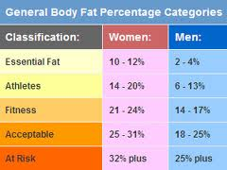
Body Composition
Body composition is used to describe the percentages of fat, bone and muscle in human bodies
Notes:
PCC IX (FITNESS AND WELLNESS PROGRAMS)- D.2 (Weight control)

Slide 10

How to Measure Body Composition
Use a non-stretching tape measure to measure the circumference in multiple places on the body
Males:
Neck
Abdomen
Females
Neck
Waist
Hips
Measurements are then used to
estimate total body fat
Notes:
PCC IX (FITNESS AND WELLNESS PROGRAMS)- D.2 (Weight control)
Reference: DODI 1308.3, November 5, 2002
Calculation:
Males: subtract neck from abdominal and compare with height using chart in reference
Females: add waist and hip measurements then subtract neck and compare with height using chart in reference

Slide 11


How to Improve Body Composition
Diet
Physical Fitness
Notes:
PCC IX (FITNESS AND WELLNESS PROGRAMS)- D.2 (Weight control)
Diet Dramatically reduce the amount of simple carbohydrates in your diet. Take in only carbohydrates from select vegetables such as fresh spinach and leafy greens the more the better. Avoid all grains and starches even grains with high fiber. Round out your diet with lean protein (chicken, fish, lean beef, eggs) and good fat high in omega 3's (fish oil, olive oil, coconut milk, and nuts). No need to count calories you will intuitively take in the right amount if you are eating lots of vegetables, eating lean protein, and getting those good fats. Don't be afraid to eat good fats they are important part of training your body to use them as fuel. Physical activity Be active at low to moderate intensity as frequently as possible. Avoid long high intensity cardiovascular sessions (this will raise your body's stress levels). Do resistance activities such as lifting weights for just 30 minutes 3 or 4 times a week. If you want to give yourself an added boost add one session per week of 10 repetitions of all out efforts either sprinting, on a bike, rowing machine, or jumping rope.

Slide 12
Conclusion
Eat breakfast
Stay away from “fake” or processed foods
Eat your daily calorie limit
Diet and exercise

Slide 13
Sources
The Many Benefits of Breakfast
http://www.medicinenet.com/script/main/art.asp?articlekey=50736
16 Ways to Eat Healthy While Keeping it Cheap
http://www.getrichslowly.org/blog/2007/07/30/16-ways-to-eat-healthy-while-keeping-it-cheap
How do you get good body composition
http://wiki.answers.com/Q/How_do_you_get_good_body_composition
10 Types of Food You Should Avoid
http://blpublications.com/html/body_foodstoavoid.html
DODI 1308.3

