Slide 1
Substance Abuse Prevention and Control
Notes:
PCC IX (FITNESS AND WELLNESS PROGRAMS)

Slide 2
Learning Topics
Definition of a substance
Definition of substance abuse
Warning signs of common drugs
Myths of drug abuse
Getting help
Dangers of marijuana
Other dangerous drugs
Alcohol
Dealing with an alcohol incident
5 ways to prevent abuse
Urinalysis testing
Consequences
Hot line

Slide 3
Importance
Knowing how to help abusers can save lives
Informing Sailors and Marines of the dangers of drugs could help prevent drug use
Knowing warning signs of drug abuse can allow you to help your Sailors and Marines

Slide 4
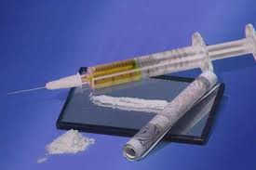
Definition of a Substance
Any substance that, when absorbed into the body of a living organism, alters normal bodily function
Recreational drug use is the use of psychoactive substances to have fun, for the experience, or to enhance an already positive experience

Slide 5
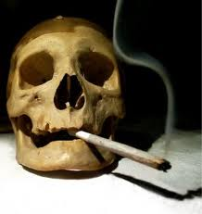
Definition of Substance Abuse
A pattern of harmful use of any substance for mood-altering purposes
Notes:
Medline's medical encyclopedia defines drug abuse as "the use of illicit drugs or the abuse of prescription or over-the-counter drugs for purposes other than those for which they are indicated or in a manner or in quantities other than directed."

Slide 6
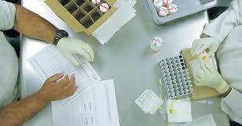
Warning Signs of Common Drugs
Psychological
Behavioral
Physical
Notes:
Psychological warning signs:
Unexplained change in personality or attitude.
Sudden mood swings, irritability, or angry outbursts.
Periods of unusual hyperactivity, agitation, or giddiness.
Lack of motivation; appears lethargic or “spaced out.”
Appears fearful, anxious, or paranoid, with no reason.
Behavioral warning signs:
Drop in attendance and performance at work or school.
Unexplained need for money or financial problems. May borrow or steal to get it.
Engaging in secretive or suspicious behaviors.
Sudden change in friends, favorite hangouts, and hobbies.
Frequently getting into trouble (fights, accidents, illegal activities).
Physical Warning Signs:
Bloodshot eyes, pupils larger or smaller than usual.
Changes in appetite or sleep patterns. Sudden weight loss or weight gain.
Deterioration of physical appearance, personal grooming habits.
Unusual smells on breath, body, or clothing.
Tremors, slurred speech, or impaired coordination.

Slide 7
Myths of Drug Abuse
1: Overcoming addiction is a matter of willpower
2: Addiction is a disease
3: Addicts have to hit rock bottom before they can get better
4: You can’t force someone into treatment
5: Treatment didn’t work before, so there’s no point trying again
Notes:
MYTH 1: Overcoming addiction is a simply a matter of willpower. You can stop using drugs if you really want to. Prolonged exposure to drugs alters the brain in ways that result in powerful cravings and a compulsion to use. These brain changes make it extremely difficult to quit by sheer force of will.
MYTH 2: Addiction is a disease; there’s nothing you can do about it. Most experts agree that addiction is a brain disease, but that doesn’t mean you’re a helpless victim. The brain changes associated with addiction can be treated and reversed through therapy, medication, exercise, and other treatments.
MYTH 3: Addicts have to hit rock bottom before they can get better. Recovery can begin at any point in the addiction process—and the earlier, the better. The longer drug abuse continues, the stronger the addiction becomes and the harder it is to treat. Don’t wait to intervene until the addict has lost it all.
MYTH 4: You can’t force someone into treatment; they have to want help. Treatment doesn’t have to be voluntary to be successful. People who are pressured into treatment by their family, employer, or the legal system are just as likely to benefit as those who choose to enter treatment on their own. As they sober up and their thinking clears, many formerly resistant addicts decide they want to change.
MYTH 5: Treatment didn’t work before, so there’s no point trying again. Recovery from drug addiction is a long process that often involves setbacks. Relapse doesn’t mean that treatment has failed or that you’re a lost cause. Rather, it’s a signal to get back on track, either by going back to treatment or adjusting the treatment approach.

Slide 8
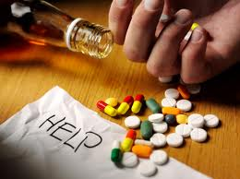
Getting Help
Types of Help:
Individual counseling
Medication
Detox
Inpatient treatment
Intensive outpatient treatment
Family help and interventions
Self help recovery groups
Notes:
PCC IX (FITNESS AND WELLNESS PROGRAMS)- D.1 (Treatment)
You can find many different kinds of help for a drinking or drug problem. Availability of kinds of help and helping agencies vary from area to area.
Individual:
In individual counseling, the person meets for a period of time with a professional substance abuse counselor.
Medication:
Physicians can prescribe medications that help the person stay substance free. Antabuse causes illness when alcohol is consumed. Naltrexone can help stop the craving or desire to drink or take drugs.
Detox:
can be accomplished in a variety of settings, depending on how complex or medically compromised a person's health and drug problem are. Detox settings include medical hospitals and alcohol and drug detox and treatment facilities.
Inpatient Treatment
goal of an inpatient program is to help the person become drug free and then to prepare him or her for a life back in the community
Intensive Outpatient Treatment
Like inpatient treatment, intensive outpatient treatment provides both individual therapy and group work. The major difference between the two is that the patient does not reside at the facility. Intensive outpatient treatment programs may require the person to attend the center six hours a day, seven days a week, or attend several nights a week.
Family Help and Interventions
The family talks to a substance abuse professional trained to help with interventions. Through this consultation, family members can get prepared to help the alcoholic or addict in a way that can motivate him or her to follow through with treatment. The family members have experienced problems related to the addiction and may not be aware of the total impact this has had on all of their lives. Family members should be educated about alcoholism/addiction and should learn new ways to communicate with each other.
Self Help Recovery Groups
Alcoholics Anonymous (AA)
Narcotics Anonymous (NA) and in larger areas Cocaine Anonymous

Slide 9
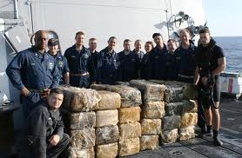
Dangers of Marijuana
Short-Term Effects (small doses)
Short-Term Effects (larger doses)
Long-Term Effects
Notes:
Short-Term Effects
In low doses, marijuana produces:
Poor memory and ability to learn
Difficulty in thinking and solving problems
Poor muscle coordination and judgment
Short attention span
Dangerous driving behavior
Altered sense of time and space
Food cravings
In larger doses, marijuana produces:
Hallucinations
Delusions
Poor memory
Not knowing where one is
Anxiety attacks or feelings of paranoia
Depression
Long-Term Effects
Cancer. Marijuana contains the same cancer-causing chemicals found in tobacco smoke.
Breathing problems. It creates the same kinds of breathing problems that cigarettes do: coughing and wheezing.
Immune system. The THC in marijuana can damage the cells and tissues in the body that help protect against disease.
Memory, learning, and energy are impaired.
Fertility. Reproductive hormones are decreased. In men, there is less testosterone, causing decreased sperm counts and possible erectile dysfunction. In women, there may be irregular periods. Both problems would result in a decreased ability to conceive but not lead to complete infertility.
Birth defects in unborn children.
http://www2.courtinfo.ca.gov/stopteendui/teens/resources/substances/marijuana/short-and-long-term-effects.cfm

Slide 10
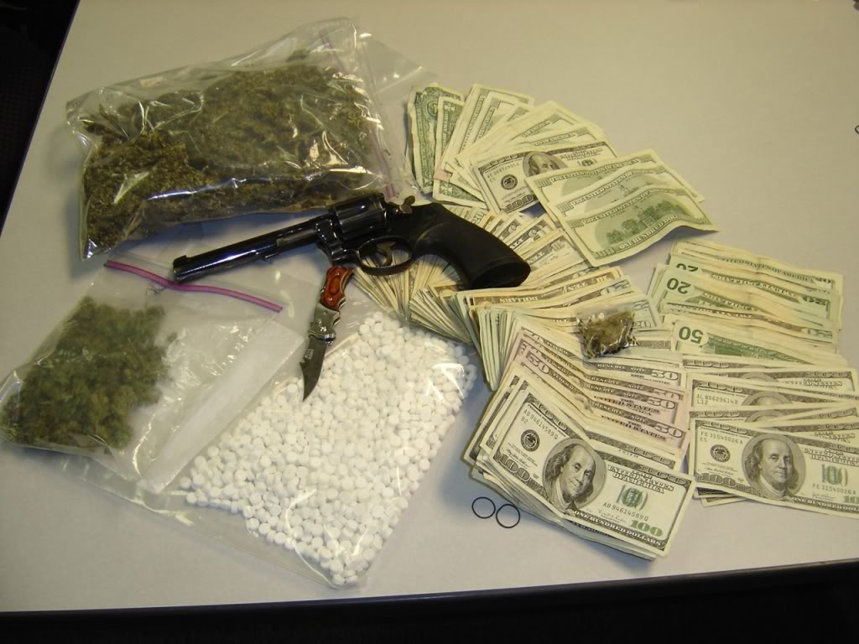
Other Dangerous Drugs
Meth
Ecstasy
Hallucinogens
Inhalants
Prescription Drugs
Bath Salts
Spice
Notes:
Meth
Short-Term Effects
A rush or high
Increased respiration
Elevated body temperature
Convulsions
Stroke
Feeling wide awake
Increased physical activity
Less appetite
Feelings of great pleasure
Irritability
Insomnia
Confusion
Tremors
Anxiety
Paranoia
Violence
Hypothermia
Higher heart rate and blood pressure
Irreversible damage to blood vessels in the brain
Long-Term Effects
Acute vision loss
Corneal ulcers
Strokes and deadly convulsions
Intense paranoia
Psychotic behavior
Memory loss
Aggression
Brain damage
Breathing problems
Heart damage and cardiovascular collapse
Severe tooth and gum disease
Irregular heartbeat
Unhealthy weight loss
Death
Visual and auditory hallucinations
Out-of-control rages and violent episodes
Body sores from scratching nonexistent “crank bugs.”
Loss of dopamine-producing cells in the brain; users become unable to experience natural feelings of pleasure.
Serotonin-containing nerve cells may be damaged even more extensively.
Those who inject the drug suffer exposure to HIV/AIDS and hepatitis B and C.
Ecstasy
Short-Term Effects
Gives you energy
Distorts time and perception
Increases enjoyment from touching
Inability to regulate temperature
Sharp increase in body temperature, hyperthermia, heatstroke
Liver, kidney, and cardiovascular system failure
Perceptual changes, anxiety, jaw-clenching, dry mouth, and appetite changes
Blood pressure increases
Headaches
Chills
Eye-twitching
Blurred vision
Nausea
Dehydration
Muscle tension
Severe sweating
Faintness
Seizures
Day-after depression
Death
Note: Heatstroke (hyperthermia) is the primary cause of death from ecstasy. Taking ecstasy with in combination with other drugs, such as alcohol, can increase the risk.
Long-Term Effects
Dramatic increase in heart rate, leading to serious complications for people with cardiovascular disease.
Dehydration can lead to liver and kidney failure.
Disturbing emotional reactions, confusion, depression, sleep problems, drug craving, severe anxiety, and heart palpitations. Symptoms last a long time after taking the drug.
Depletes the amount of serotonin in the brain and blocks uptake of serotonin.
Toxic to the brain.
Impairs memory.
Brain damage is directly related to amount and frequency of usage.
Hallucinogens
Short-Term Effects
Increased heart rate
Increased blood pressure
Heart failure
Abnormal, rapid breathing
Lung failure
Changed emotional feelings
Confusion
Disorientation
Suspiciousness
Mixed-up speech
Loss of muscle control
Meaningless movements
Irrational actions
Violent behavior
Distorted reality
Aggressiveness
Distorted sense of time and space
Sense of relaxation and well-being
Nausea and loss of appetite
Chills and flushing
Shaking
Poor coordination
Distorted body image, feeling of floating or out-of-body experiences
Dilated eyes
Seeing things that aren't really there
Unpredictable trips, which can be pleasant or a nightmare, causing panic
Long-Term Effects
Flashbacks weeks, months, or even years after the drug use
Flashbacks may be set off by using other drugs or by physical exercise
Flashbacks may be pleasant or a living nightmare
Most flashbacks last a very short time, only a minute or two
Decreased motivation
Prolonged depression
Increased panic
Impaired memory and concentration
Possible severe mental disturbances
Psychosis
Increased delusions
Bad trips may last hours, weeks, and even months
Inhalants
Short-Term Effects
Slurred speech
Clumsy movement
Dizziness
Lightheadedness
Hallucinations
Delusions
Sleepiness
Headache
Increase heart rate
Intoxication
Heart failure
Long-Term Effects
Death
Rapid and irregular heart rhythms
Heart failure
Asphyxiation
Suffocation
Choking
Long-lasting damage to the nervous system and organs
Permanent damage to the brain, heart, lungs, liver, and kidneys
Hearing loss caused by use of toluene (spray paints, glues, dewaxers) and trichloroethylene (dry-cleaning chemicals, correction fluids)
Limb spasms are caused by use of hexane (glues, gasoline) and nitrous oxide (whipped cream dispensers, gas cylinders)
Central nervous system or brain damage from toluene (spray paints, glues, dewaxers)
Bone marrow damage is caused by benzene (gasoline)
Blood oxygen depletion is caused by aliphatic nitrites (known on the street as poppers, bold, and rush) and methylene chloride (varnish removers, paint thinners)
Prescription Drugs
Opioids
Short-term effects: Relaxation, indifference to emotional or physical pain, drowsiness, constipation, slow breathing, and death.
Long-term effects: Highly addictive. As the body builds up tolerance for the drug, more is needed to maintain the desired feeling. Withdrawals can be long and physically painful. Combining opioids with alcohol and other drugs can lead to death from respiratory failure.
Central nervous system (CNS) depressants
Short-term effects: Slows normal brain functions, gives a drowsy feeling, but over time the effects fade as body builds tolerance.
Long-term effects: Addiction can result, withdrawal can be painful, and the drug may cause seizures and death. Mixing these depressants with alcohol or other drugs can kill you.
Stimulants
Short-term effects: Alertness, focus, sleeplessness, loss of appetite, increased blood pressure and heart rate, high body temperature.
Long-term effects: Addiction, paranoia and long-term insomnia, extreme weight change.
Bath Salts
What is it?
A synthetic, stimulant powder product that contains amphetamine-like chemicals, including mephedrone, which may have a high risk for overdose. Because the drug is new and some of the contents unknown, using it in any way is highly dangerous.¹⁰ Right now, bath salts are illegal in a growing number of U.S. states, as well as foreign countries like Canada, Australia and Great Britain.¹¹
The Risks
Between January and February 2011, there were over 250 calls to U.S. poison centers related to bath salts. This is well over the 236 calls received for all of 2010.¹⁰ Bath salts are a dangerous drug whose full risks and effects are still unknown. What doctors at poison centers have reported is that bath salts can cause rapid heartbeat, high blood pressure, chest pains, agitation, hallucinations, extreme paranoia and delusions.¹⁰
LONG-TERM EFFECTS
Bath salts are a relatively new drug, so it's hard to know the full long-term effects, but they seem to have many similarities to methamphetamine (meth). Taking a lot of it for a long time can lead to emotional and physical "crash-like" feelings of depression, anxiety and intense cravings for more of the drug.
Spice
This drug, called “Spice” or “K2” is said to give the user a marijuana-like high.

Slide 11
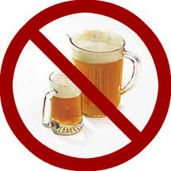
Alcohol
28% of all college dropouts are alcoholics
40% of all college students having academic problems abuse alcohol
It is part of your units standing orders that you will not consume alcohol under the age of 21 or do drugs
If caught you will go to a PRB and most likely be dropped from the program
Notes:
Resource: http://www.fit.edu/caps/documents/effects%20of%20drugs.pdf

Slide 12
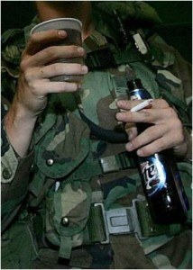
Dealing with Alcohol incident
Commanders, commanding officer, and officer in charge must exercise sound judgment in enforcing Navy’s alcohol policies and ensure proper disposition of individual cases
Cases are rarely set in black and white
Every case needs to be analyzed and treated differently, however sailors should never be given favor

Slide 13
5 Ways to Prevent Abuse
1. Effectively deal with peer pressure
2. Deal with life pressure
3. Get help for mental illness
4. Look at risk factors
5. Keep a balanced life
Notes:
1. Effectively deal with peer pressure. The top reason teens start using drugs is because their friends talk them into it. No one likes to be left out, and teens (and sometimes adults too) find themselves doing things they normally wouldn’t do, just to fit in. In these cases we need to either find a better group of friends that won’t pressure us to do harmful things, or we need to find a good way to say no. Teens should prepare ahead of time a good excuse or plan to keep from giving in to a tempting situation.
2. Deal with life pressure. Another way people become drawn into addiction is through their failure to deal with the pressures of life. People today are overworked and overwhelmed and often we feel like we deserve a break or a reward for all we do. Drugs will only make a person’s life more stressful, but we often fail to see this in the moment. To prevent using drugs as a reward, we need to find other ways to handle stress and to unwind. A person can take up exercising, or reading a good book, or volunteering with the needy. Anything positive that is relaxing will help take the mind off using drugs to relieve stress.
3. Get help for mental illness. Mental illness and substance abuse often go hand in hand. Those with mental illness often turn to drugs as a way to ease their pain. Those suffering from some form of mental illness such as depression, anxiety, or post traumatic stress disorder should seek the help of a trained professional for treatment, before it leads to substance abuse.
4. Look at risk factors. If we are aware of the biological, physical, and environmental risk factors that we possess we will be more likely to overcome them. A history of substance abuse in the family, living in a social setting that glorifies drug abuse, and family life that models drug abuse can all be risk factors.
5. Keep a balanced life. People take up drugs when something in their life is not working, or when they are unhappy about where their life is going. It is important to look at the big picture of life, and have priorities in order.
http://www.treatmentsolutionsnetwork.com/blog/index.php/2009/11/12/top-5-ways-to-prevent-substance-abuse/

Slide 14
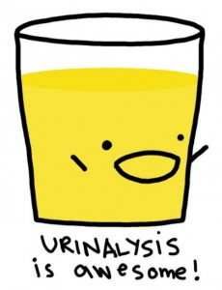
Urinalysis Testing
Unit wide urinalysis conducted once per semester
10% of the unit is randomly testing a month
Notes:
PCC IX (FITNESS AND WELLNESS PROGRAMS)- D.1 (urinalysis testing programs)

Slide 15
Consequences
Navy has a zero tolerance for substance and alcohol abuse
PRB
LOA
Disenrollment
Notes:
PCC IX (FITNESS AND WELLNESS PROGRAMS)- D.1 (Consequences)
PRB: anyone caught will have a PRB, where the outcome will most likely be “recommended for disenrollment”

Slide 16
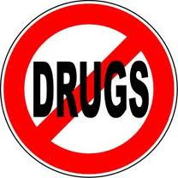
Conclusion
Anyone can abuse drugs
Know the warning signs of drug abuse
Know the dangers of drug abuse
Know how to get help

Slide 17
Hotline
Insert Campus Hotline For Substance Abuse

Slide 18
References
Stop DUIs
http://www2.courtinfo.ca.gov/stopteendui/teens/index.cfm
5 ways to prevent substance abuse
http://www.treatmentsolutionsnetwork.com/blog/index.php/2009/11/12/top-5-ways-to-prevent-substance-abuse/
Helpguide, Drug abuse and addiction
http://helpguide.org/mental/drug_substance_abuse_addiction_signs_effects_treatment.htm

