Slide 1
Suicide Awareness and Prevention
Notes:
PCC IX (FITNESS AND WELLNESS PROGRAMS)- D.4 (Suicide awareness)

Slide 2
Learning Topics
Suicide and suicide attempt
Suicide gesture and behavior
Key risk factors
Protective factors
First responder
Ask
Care
Treat
MAD
Suicide resources
Hotline

Slide 3
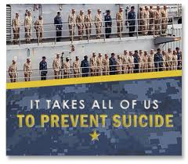
Importance
Loss of life to suicide is of great concern within the Department of the Navy (DON). The goal of the Navy’s suicide prevention program is to help you recognize and understand suicide risk, protective factors, and how to help and effectively intervene.

Slide 4
Suicide and Suicide Attempt
Suicide: an intentional act resulting in one’s own death.
Suicide attempt: an intentional act, causing self-harm, where death would have occurred without direct intervention.
Notes:
In other words, a suicide attempt is an act focused on taking one’s life that is unsuccessful in causing death.

Slide 5
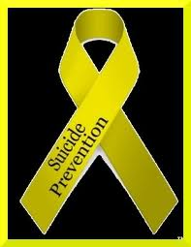
Suicide Gesture and Behaviors
Suicide Gesture: similar to a suicide attempt except there is NO attempt to kill ones self.
Suicide behaviors encompass a broad range of acts, including suicide attempts, gestures, threats, and suicidal thoughts.
Notes:
People who try to commit suicide are often trying to get away from a life situation that seems impossible to deal with. Many who make a suicide attempt are seeking relief from:
Feeling ashamed, guilty, or like a burden to others
Feeling like a victim
Feelings of rejection, loss, or loneliness
Most suicide attempts do not result in death. Many of these attempts are done in a way that makes rescue possible. These attempts are often a cry for help.
Some people attempt suicide in a way that is somewhat non-violent, such as poisoning or overdose. Males, especially elderly men, are more likely to choose violent methods, such as shooting themselves. As a result, suicide attempts by males are more likely to be completed.
Relatives of people who attempt or commit suicide often blame themselves or become very angry. They may see the suicide attempt as selfish. However, people who try to commit suicide often mistakenly believe that they are doing their friends and relatives a favor by taking themselves out of the world.

Slide 6
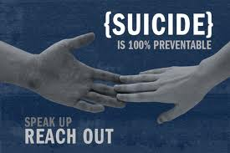
Key Risk Factors
Four key risk factors increase the likelihood for suicide:
1.Mental health problems, such as depression
2.Substance abuse or increased alcohol use
3.Situations that a Sailor labels as “hopeless”
4.Suicide behaviors, such as:
Previous suicide attempts or suicide gestures
Hints or talk about suicide
Notes:
Situations that a Sailor labels as “hopeless,” such as:
Relationship difficulties
Serious work problems
Serious legal trouble
Serious financial trouble
Traumatic events
EXPLAIN: You should be aware of the symptoms of depression so that you can help that person (or perhaps yourself) before it's too late. Symptoms of depression include:
Change in appetite, unwanted weight loss or gain
Change in sleep habits
Decreased productivity, poor performance
Decreased sex drive
Difficulty concentrating or remembering
Expressed feelings of inadequacy or worthlessness
Loss of energy, slowed speech, and muscle movement
Loss of interest in usually pleasurable activities
Negative thoughts about the future or the past
No apparent pleasure in response to praise or rewards
Tearfulness or crying

Slide 7
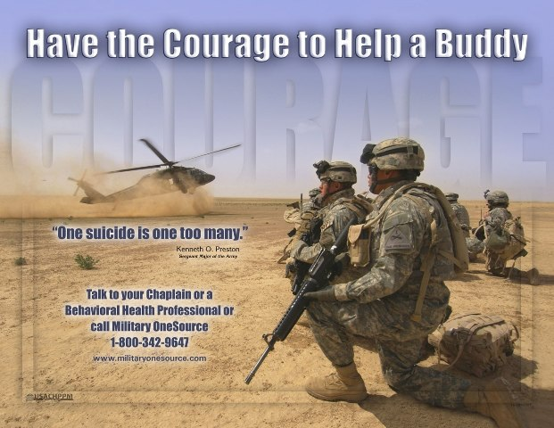
Protective Factors
One strategy to prevent suicide is to reduce risk factors or strengthen and increase protective factors, such as:
Belief that it is OK to get help
Early intervention by the command
Good problem-solving and coping skills
Optimistic outlook
Positive attitude about getting help early
Positive family and social support
Spiritual support
Notes:
By reducing risk factors and strengthening protective measures, you can help prevent the problems that contribute to suicide.

Slide 8
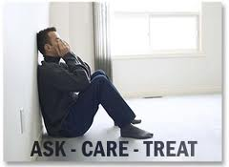
First Responder
To be a First Responder, you must:
Know the warning signs of suicide
Let your shipmate, friend, or family member know that you are worried, concerned, and care about him/her
Take all talk about suicide very seriously
As a First Responder, you can follow the acronym ACT:
Ask
Care
Treat
Notes:
The important thing is for you to ACT immediately.

Slide 9
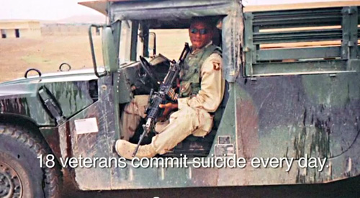
ASK
DO:
Ask your shipmate if he/she is thinking about suicide
Actively listen to what he/she has to say
Acknowledge his/her talk, behavior, and feelings
DON’T:
Debate whether suicide is right or wrong
Discuss whether feelings are good or bad
Lecture the person on the value of life
Notes:
If you notice some of the warning signs in a shipmate, friend, or family member, now is the time for you to respond.

Slide 10
CARE
DO:
Let your shipmate know you care and understand
Discuss and care about what is troubling him/her
Maintain good eye contact and give your undivided attention
Care if a shipmate has a plan for suicide
DON’T:
Encourage him or her to do it
Act shocked—this will put distance between you

Slide 11
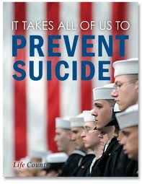
TREAT
DO:
Obtain professional help as soon as possible
DON’T:
Leave the person alone
Be sworn to secrecy
Notes:
by calling Medical, taking the person to the Emergency Room, or calling 911
Seek support NOW!

Slide 12
Don’t Get Mad
DON'T:
Miss or mistake signals
Avoid the person
Disregard signals
Notes:
It is so easy with our busy lives to get MAD and try to convince ourselves that a shipmate will be OK, even when we haven’t taken the time to really talk to him or her.

Slide 13
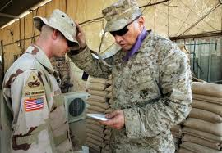
Suicide Resources
Chaplains
Command leadership
Fleet and family support centers
Marriage and family counselors
Medical services
University resources
Notes:
– In addition to contacting your local chaplain, the following website provides a phone number and email contact information to speak directly with a chaplain: http://chaplaincare.navy.mil/index.htm
Talk to your XO/CO
Go to Hospital/Doctor
Family Support Hotlines:
Navy (800) 372-5463 PURPOSE: Information and Referral service (e.g. general family support, Command Ombudsmen/family support groups and Care Lines, Web sites, Navy Casualty information, referral to nearest Navy FFSC.) Other FFSCs provide similar information locally during normal business hours. Marine Corps (800) 336-4663 - for Marines stationed East of the Mississippi River, excluding Wisconsin (800) 253-1624 - for Marines stationed West of the Mississippi River, including Wisconsin

Slide 14
Hotline
Insert Campus Hotline Here
Notes:
National Suicide Prevention Hotline: 1-800-273-8255

Slide 15
Resources
American Association of Suicidology – http://www.suicidology.org
Centers for Disease Control and Prevention
http://www.cdc.gov/ViolencePrevention/suicide/
Navy and Marine Corps Public Health Center– http://www.nmcphc.med.navy.mil/
Navy Suicide Prevention Program –
http://www.public.navy.mil/bupers-ncp/support/suicide_prevention/Pages/default.aspx
Mental Health – https://www.militarymentalhealth.org/welcome.asp
Military OneSource : www.miltaryonesource.mil
National Suicide Prevention Lifeline –http://www.suicidepreventionlifeline.org/
OPNAVINST 1720.4A

