Slide 1
Fraternization
Notes:
PCC. II-H.5
PCC. III-C

Slide 2
Learning Topics
Know its definition
Inappropriate relationships
Know examples and non-examples of fraternization
Relationship traits to avoid
Responsibility of juniors and seniors
Know possible outcomes

Slide 3
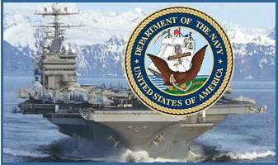
Introduction
Proper relationships between midshipman is at the core of good order and discipline and is imperative to fleet readiness after NROTC
Understanding fraternization will help you eliminate inappropriate relationships that could endanger the Fleet’s mission or bring discredit upon yourself and the Navy

Slide 4
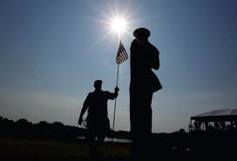
Importance
Understanding fraternization is vital to help all Sailors recognize and avoid it
Fraternization destroys good order and discipline
Fraternization can also get you into trouble

Slide 5

Definition
Fraternization is a personal relationship that goes beyond the customary bounds of acceptable senior/subordinate relationships
Notes:
At this point, ask the unit if there are any questions about the definition given
OPNAVINST 5370.2C definition: Fraternization is an unduly familiar personal relationship between an officer member and an enlisted member that does not respect the difference in rank or grade. Relationships between officer members and between enlisted members that are prejudicial to good order and discipline or of a nature to bring discredit on the Naval service are unduly familiar and also constitute fraternization.
PCC. III-C

Slide 6
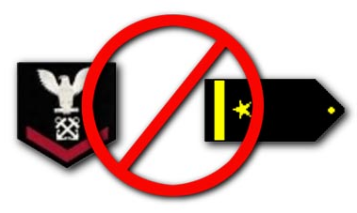
Inappropriate Relationships
Officer - Enlisted
Senior officer - Junior officer
Senior enlisted - Junior enlisted
Instructor - Student

Slide 7
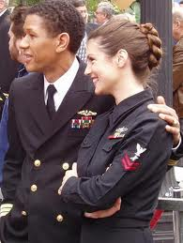
Examples
Fraternization could involve:
Dating
Living together
Sexual relationships
Commercial solicitations
Business partnerships
Borrowing

Slide 8
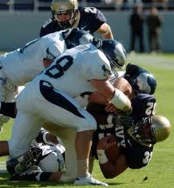
Non-Examples
Proper social interaction between seniors and juniors that is intended to build unit morale and camaraderie is healthy and clearly appropriate
The following are not fraternization
Command sports teams
Command sponsored events

Slide 9
PERCEPTION IS REALITY!
Notes:
At this point, discuss the following topics
1) how you see yourself
2) how others see you
3) How you really are
All three are different and they need to be aware of all three

Slide 10
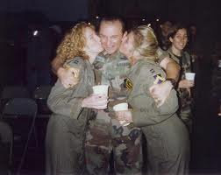
Relationship Traits to Help Avoid Fraternization
Respect
Propriety
Honesty and loyalty
Trust
Common ground
Non-harassing
Non-compromising
Core Values
Positive influence
Enhances professional commitment
Supports good order and discipline

Slide 11

Junior Person’s Responsibility
Do not seek:
Favoritism
Preferential treatment
Personal gain
Do be:
A role model
Honest and competent
A leader by example
There for them

Slide 12
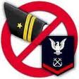
Senior Person’s Responsibility
Support command mission
Demonstrate loyalty to command and shipmates
Perform duties with honesty/integrity
Accept responsibilities
Desire to professionally advance
Display initiative
Honor family/personal commitments
Reliable in tough situations

Slide 13

Possible Outcomes
The questioning of a senior’s objectivity
Actual or perceived preferential treatment
Undermining the authority of a senior
Compromising the chain of command
Administrative or punitive action

Slide 14
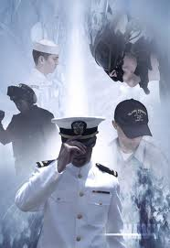
Conclusion
Respect difference in position and grade
Off duty relationships
Remember the Navy Core Values when dealing with fraternization
The Navy’s policy on fraternization
Don’t do it!
Notes:
Include any Command policies on fraternization.

Slide 15
References
Navy Knowledge Online
https://www.nko.navy.mil/
OPNAVINST 5370.2C

