Slide 1
Violence
An Exploration of
In Education

Slide 2
Research Team
Principal investigator/lead researcher
Dr. toby S. Jenkins
UofSC Fraternity & Sorority Life (Violence in Greek Life Exhibit)
Jaida Jackson
Mikayla Morris
The college of new jersey Projects
(LGBTQ Laws, Discipline survey, Gendered classrooms WORKBOOK & QR Code Exercise)
Frankie DiMedio Chelsea Triano
Jamie Bowne Rebecca Silver
Georgie Abdelmoety Marcus Allen
Genesis Lopez. Aviva Ron

Slide 3
This exhibition is not a complete history nor a comprehensive study of violence in education
It Is An Exploration Of Touch Points, Historical Moments,
And Critical Issues Meant To Educate,
Spark Dialogue, And Encourage Action.
We Hope For Our Students To Take Action
And Become More Aware.
We Hope For Our Teachers And Administrators To Wrestle With Practices, Policies And Approaches To Create Healthier Environments At All Levels Of Education.
We Hope For Our Research Scholars To Dig Deeper Into This Work In Order To Help Create Change.

Slide 4
It IS overwhelming
It IS too much
It IS infuriating
It IS depressing

Slide 5
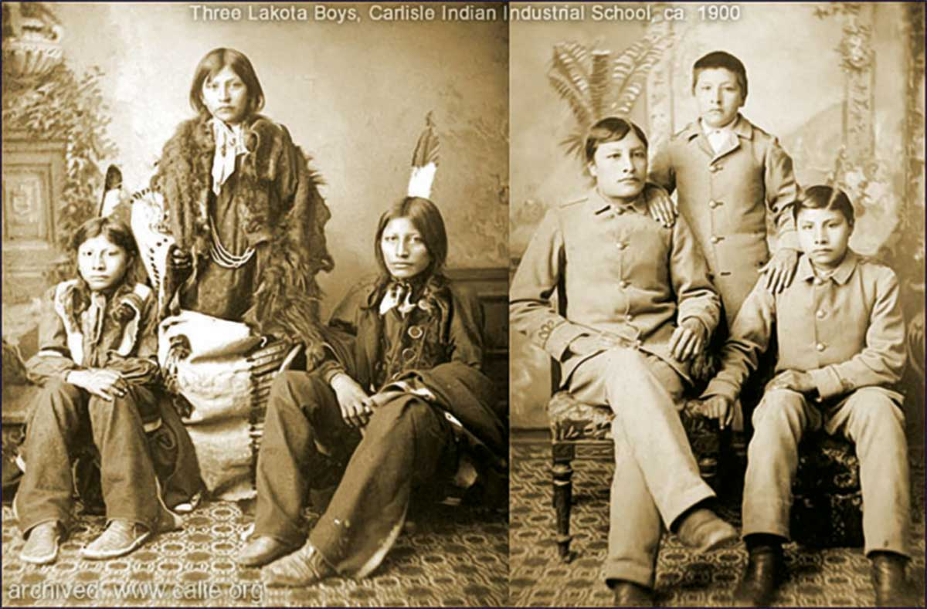

Slide 6
But it is also
Too important to ignore
Too urgent to wait
Too critical not to act

Slide 7
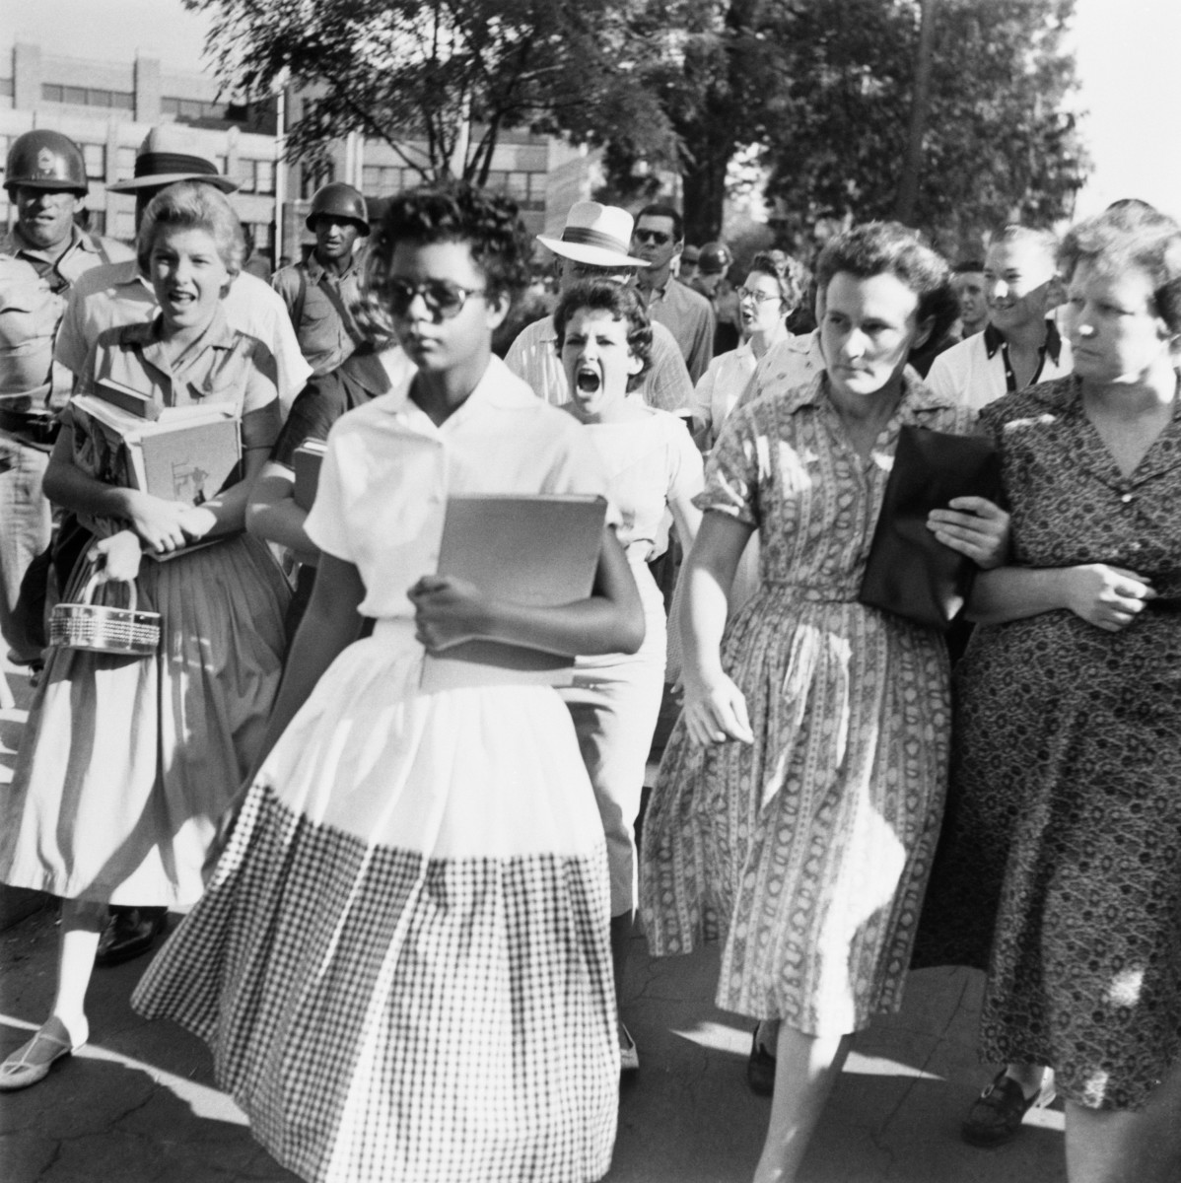
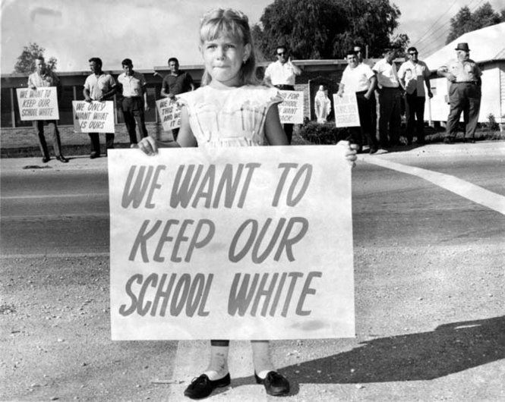

Slide 8
Real Change In Society Must Start From Individual Initiative
Dalai Lama

Slide 9
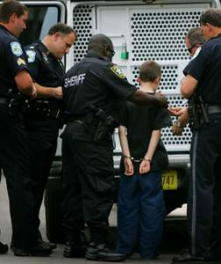

Slide 10
Violence Is Black Children Going To School For 12 Years And Receiving 6 Years' Worth Of Education.
Julian Bond

Slide 11
Children Are Coming To School With Trauma, Everyday Trauma, That They Live Under: Violence In The Homes, Alcoholism In The Community, Unemployment…We Need To Help Treat That Before They Can Even Go Sit In A Class And Learn About Math.
Denise Juneau

Slide 12
Joshua T. Dickerson is 38
and lives in Atlanta
On writing the poem:
Dickerson watched a child approach his teacher at an Atlanta school to ask for a pencil. The teacher said they’d give the student a pencil, but only if he traded in one of his shoes as collateral.
“The child took off the shoe and he had a dirty sock on and it caused the other students in the class to laugh at him,” Dickerson said. “I wrote a story about what I imagined happened prior to that moment.”

Slide 13
Education Is The Key To Preventing The Cycle Of Violence And Hatred That Marred The 20th Century From Repeating Itself In The 21st Century.
Elie Wiesel

Slide 14
All Over The World, Young Males And Females, Schooled In The Art Of Patriarchal Thinking, Are Building An Identity On A Foundation That Sees The Will To Do Violence As The Essential Way To Assert Being.
Bell Hooks

Slide 15
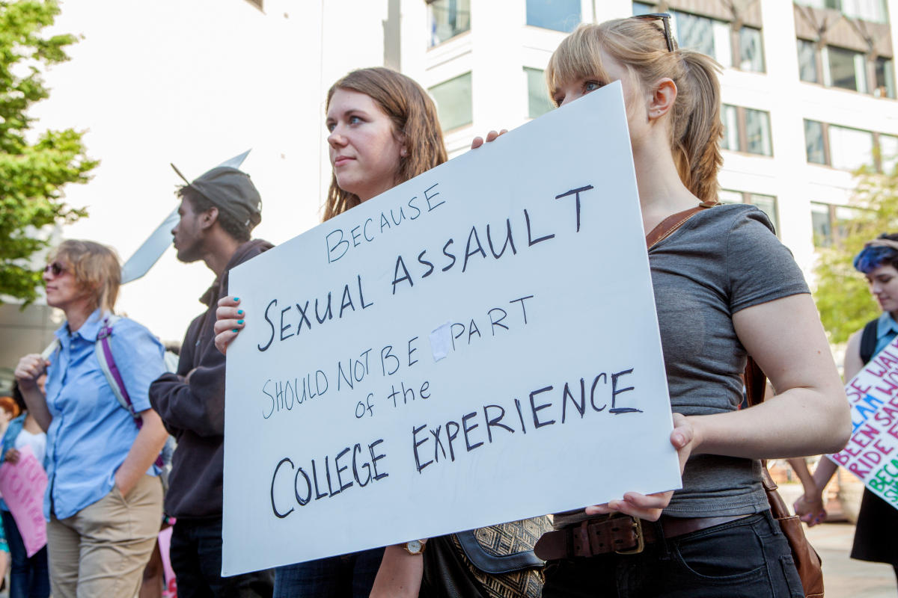

Slide 16
It's Naive Of Adults To Believe That Young People Aren't Aware Of What Is Going On In The World. The Best Thing We Can Do Is Confront That To Help Them Navigate It. We Can Help Them Say, 'These Things Are Happening. What Does That Mean For Your Life?’
Jason Reynolds

Slide 17
Young people navigate in a world where decisions are made “for” them and “about” them. It’s no wonder they resist, and push, and curse, and fight sometimes. It’s behavioral communication rooted in the need to be heard, understood, and loved. Give them microphones…
Dr. Tony Keith, Jr.

