Slide 1
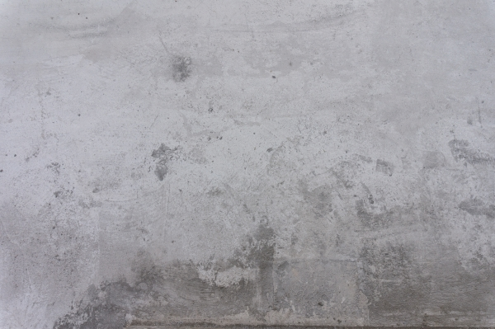



SCDOT CONCRETE Mix Design
(Chapter 6)

Slide 2

MIX PROPORTION DEVELOPMENT
The proportioning of a concrete mix design should result in an economical and practical combination of materials to produce concrete with the properties desired for its intended use, such as workability, strength, durability and appearance.

Slide 3
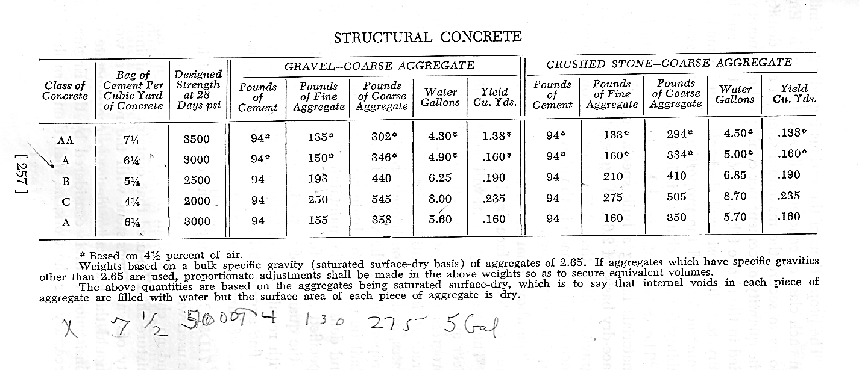
1955

Slide 4
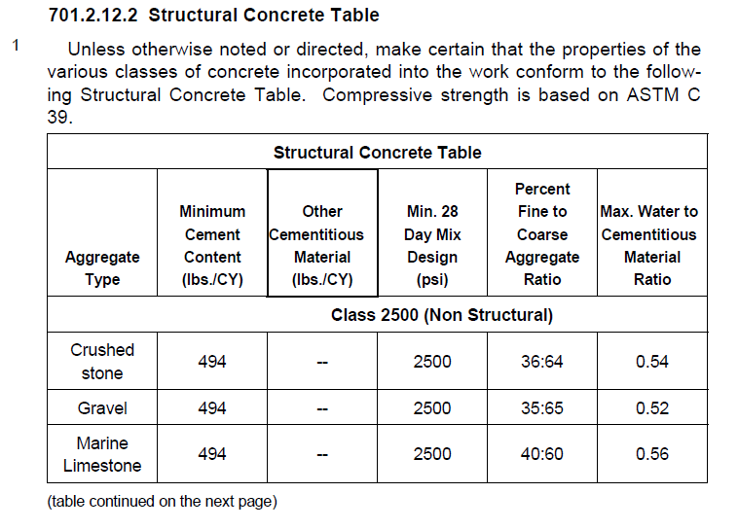
2007

Slide 5
Develop the Mix Proportions for a Class 4000 PCC using SCDOT Guidelines.
Class 4000 Concrete.
Design the Mix such that 20% of the cement is replaced with fly Ash.
Determine the required weight of each component to batch a total of 6 cubic yards.
Coarse Aggregate | Gravel | Specific Gravity (SG) = 2.70 | 1% Moisture Content
Fine Aggregate | Sand | Specific Gravity (SG) = 2.68 | 4% Moisture Content
Cement | ________________
Fly Ash | ________________
Silica Fume | ________________
Added Water | ________________
Fine Aggregate | ________________
Coarse Aggregate | ________________
How many gallons of Added Water were required? ______________

Slide 6
Density = . Mass .
Volume
Where Density = Specific Gravity * Unit Weight of Water
or in our case Density = Specific Gravity * 62.4 lb/ft³
If we rewrite it to determine volume
Volume = . Mass .
Density
or if we rewrite to determine mass
Mass = Volume * Density = Volume * Specific Gravity * 62.4 lb/ft³

Slide 8
Standard Specifications 701.20.C
STRUCTURAL CONCRETE TABLE
Aggregate Type | Minimum Cement Content (lbs/CY) | Other Cementitious Material (lbs/CY) | Min. 28 Day Mix Design (psi) | Percent Fine to Coarse Aggregate Ratio | Max. Water to Cement Ratio
Class 4000 (see note 4)
Crushed Stone | 611 | -- | 4000 | 35:65 | 0.40
Gravel | 611 | -- | 4000 | 34:66 | 0.40

Slide 9
STEP 1-3. Read the instructions carefully and refer to the step by step guide.
STEP 4A. Per the Structural Concrete Table located in the SCDOT Construction Manual, Section 701.20, a Class 4000 PCC made with gravel requires a minimum cement content of 611 lbs. per cubic yard. Since this mix calls for a 20% fly ash replacement, the necessary weight of cement will be 20% less than 611 lbs.
611 – (611 x 20%) = 488.8 = 489 lbs
STEP 4B. Convert 489 lbs to a volume expressed in cubic feet by dividing the weight by the product of 3.15 x 62.4. Carry the answer for three decimal places.
489/ (3.15 x 62.4) = 2.488 ft³ *round to three decimal places
Cement: $\frac{489}{3.15∗62.4}$ lbs = 2.488 ft³ cu. Yd batch Weight 489

Slide 10
489
2.488
489

Slide 11
STEP 5A. To determine the minimum weight of fly ash required per cubic yard, subtract the final weight of cement (489 lbs) from the initial weight of cement (611 lbs).
611 - 489 = 122 lbs Round to the nearest pound!
STEP 5B. SCDOT policy (701.25) requires a replacement ratio for fly ash not less than 1.2:1. This means that for each pound of cement removed, a minimum of 1.2 lbs of fly ash must be used as a replacement.
122 lbs x 1.2 = 146 lbs Round to the nearest pound!
STEP 5C. Convert 146 lbs to a volume expressed in cubic feet by dividing the weight by the product of 2.25 x 62.4. Carry the answer for three decimal places.
146/(2.25 x 62.4) = 1.040 ft³ Round to three decimal places!
Fly Ash: $\frac{146}{2.25 ∗ 62.4}$ lbs = 1.040 ft³ cu. Yd batch Weight 146

Slide 12
489
2.488
489
146
1.040
146

Slide 13
STEP 6. Determine the total cementitous material weight by adding the cement and fly ash cubic yard batch weights. This value will be required to determine the amount of added water.
489 + 146 = 635 lbs of cementitious material
STRUCTURAL CONCRETE TABLE
Aggregate Type | Minimum Cement Content (lbs/CY) | Other Cementitious Material (lbs/CY) | Min. 28 Day Mix Design (psi) | Percent Fine to Coarse Aggregate Ratio | Max. Water to Cement Ratio
Class 4000 (see note 4)
Crushed Stone | 611 | -- | 4000 | 35:65 | 0.40
Gravel | 611 | -- | 4000 | 34:66 | 0.40

Slide 14
REMINDER: STEP 6. Determine the total cementitous material weight by adding the cement and fly ash cubic yard batch weights. This value will be required to determine the amount of added water.
489 + 146 = 635 lbs of cementitious material
STEP 7. Determine the weight of added water necessary for one cubic yard of PCC by multiplying the water to cement ratio (w/c) found on the Structural Concrete Table by the total cementitious materials weight.
The w/c for class 4000 made with gravel is 0.40
0.40 x 635 (lbs of cementitious material) = 254 lbs Round to the nearest pound!
STEP 7. Determine the volume of added water by dividing the weight of added water by 62.4 (62.4 lbs is the weight of one cubic foot of water.)
635/(1*62.4) = 4.071 cubic feet Round to three decimal places!

Slide 15
489
2.488
489
146
1.040
146
254
4.071
254

Slide 16
STEP 9. Determine the volume of air (there is no weight to this component). To determine this volume, multiply the entrained air target value for SCDOT work, (4.5%) by 27.
27 x 4.5% = 1.215 cubic feet
Air: 27 x 4.5% = 1.215 ft³

Slide 17
489
2.488
489
146
1.040
146
254
4.071
254
4.5
1.215

Slide 18
STEP 10. Determine the volume of paste by summing the volumes of cement, fly ash, added water and air.
2.488 + 1.040 + 4.071 + 1.215 = 8.814 cubic feet Maintain (3) decimal places!
Volume of Paste: 8.814 ft³ (A)

Slide 19
489
2.488
489
146
1.040
146
254
4.071
254
4.5
1.215
8.814

Slide 20
STEP 11. Determine the volume of aggregate that will be required per cubic yard by subtracting the volume of paste from 27 ft³.
27.000 – 8.814 = 18.186 cubic feet Maintain (3) decimal places!
Volume of Aggregate: 27 – (A) 18.186 ft³ (B)

Slide 21
489
2.488
489
146
1.040
146
254
4.071
254
4.5
1.215
8.814
18.186

Slide 22
489
2.488
489
146
1.040
146
254
4.071
254
4.5
1.215
8.814
18.186

Slide 23
489
2.488
489
146
1.040
146
254
4.071
254
4.5
1.215
8.814
18.186
18.186
18.186

Slide 24
STEP 12. Determine the volume of Fine aggregrate that will be required per cubic yard by multiplying the appropriate percentage of fine aggregate by the total volume of aggregate (labeled (B)) For this example, the ratio of fine:coarse aggregate is given as 34:36 (based on the type of coarse aggregate) in the Structural Concrete Table.
STRUCTURAL CONCRETE TABLE
Aggregate Type | Minimum Cement Content (lbs/CY) | Other Cementitious Material (lbs/CY) | Min. 28 Day Mix Design (psi) | Percent Fine to Coarse Aggregate Ratio | Max. Water to Cement Ratio
Class 4000 (see note 4)
Crushed Stone | 611 | -- | 4000 | 35:65 | 0.40
Gravel | 611 | -- | 4000 | 34:66 | 0.40

Slide 25
489
2.488
489
146
1.040
146
254
4.071
254
4.5
1.215
8.814
18.186
18.186
0.34
18.186
0.66

Slide 26
489
2.488
489
146
1.040
146
254
4.071
254
4.5
1.215
8.814
18.186
18.186
0.34
6.183
18.186
0.66

Slide 27
Develop the Mix Proportions for a Class 4000 PCC using SCDOT Guidelines.
Class 4000 Concrete.
Design the Mix such that 20% of the cement is replaced with fly Ash.
Determine the required weight of each component to batch a total of 6 cubic yards.
Coarse Aggregate | Gravel | Specific Gravity (SG) = 2.70 | 1% Moisture Content
Fine Aggregate | Sand | Specific Gravity (SG) = 2.68 | 4% Moisture Content
Cement | ________________
Fly Ash | ________________
Silica Fume | ________________
Added Water | ________________
Fine Aggregate | ________________
Coarse Aggregate | ________________
How many gallons of Added Water were required? ______________

Slide 28
STEP 13. Review the problem statement to find the fine aggregate specific gravity. Transfer this value to the correct space as shown. (In this example, the fine aggregate SG was 2.68 and the coarse aggregate SG was 2.70)
STEP 14. Using the volume of fine aggregate, its specific gravity and the 62.4 conversion factor, caculate the weight of fine aggregate per cubic yard.
18.186 x 34% = 6.183 ft³ Round to three decimal places!
6.183 x 2.68 x 62.4 = 1034 lbs Round to the nearest pound!
Fine Aggregate: $\frac{18.186}{(B)}× \frac{34\%}{\%FA}= \frac{6.183 ft3}{(C)}×\frac{2.68}{SG}×6.24=1034 lbs$

Slide 29
489
2.488
489
146
1.040
146
254
4.071
254
4.5
1.215
8.814
18.186
18.186
0.34
6.183
2.68
1034
18.186
0.66

Slide 30
STEP 15-17. Repeat steps 12-14 for the coarse aggregate using the correct coarse aggregate percentage and the appropriate SG value.
18.186 x 66% = 12.003ft³ Round to three decimal places!
12.003 x 2.68 x 62.4 = 2022 lbs Round to the nearest pound!
Coarse Aggregate: $\frac{18.186}{(B)}× \frac{66\%}{\%FA}= \frac{12.003 ft3}{(D)}×\frac{2.70}{SG}×6.24=2022 lbs$

Slide 31
489
2.488
489
146
1.040
146
254
4.071
254
4.5
1.215
8.814
18.186
18.186
0.34
6.183
2.68
1034
18.186
0.66
12.003
2.70
2022

Slide 32

STEP 18. Perform a volume check. If the combined volumes of paste, fine aggregate and coarse aggregate do not equal 27 ft³, then a mistake has been made.
A + C + D must = 27ft³
Check Volume: (A) 8.814 + (B) 6.183 + (D) 12.003 = 27ft³

Slide 33
489
2.488
489
146
1.040
146
254
4.071
254
4.5
1.215
8.814
18.186
18.186
0.34
6.183
2.68
1034
18.186
0.66
12.003
2.70
2022
27.00

Slide 34
Develop the Mix Proportions for a Class 4000 PCC using SCDOT Guidelines.
Class 4000 Concrete.
Design the Mix such that 20% of the cement is replaced with fly Ash.
Determine the required weight of each component to batch a total of 6 cubic yards.
Coarse Aggregate | Gravel | Specific Gravity (SG) = 2.70 | 1% Moisture Content
Fine Aggregate | Sand | Specific Gravity (SG) = 2.68 | 4% Moisture Content
Cement | ________________
Fly Ash | ________________
Silica Fume | ________________
Added Water | ________________
Fine Aggregate | ________________
Coarse Aggregate | ________________
How many gallons of Added Water were required? ______________

Slide 35
STEP 19. Although now the form is now complete, the process of designing the mix is not. The aggregates each contain moisture, and this water must be accounted for in the mix preparation. The problem statement says that the fine aggregate has a moisture percentage of 4% and the coarse aggregate has 1% moisture beyond SSD conditions. To determine what the weight of aggregate moisture is – multiply the individual aggregate weights by their respective moisture contents as shown.
Fine Aggregate weight: 1034 lbs
1034 x 4% = 41 lbs Round to the nearest pound!
Coarse Aggregate weight: 2022 lbs
2022 x 1% = 20 lbs Round to the nearest pound!

Slide 36
STEP 20-21. The weights of 41 lbs and 20 lbs represent the weight of water that would enter the mix via the aggregates. The inclusion of this water also means that the weight of fine aggregate entering the mix is actually less than the 1034 measured. The same reasoning applies to the coarse aggregate. To compensate, 41 lbs of fine aggregate must be added to the mix design value of 1034 lbs. Also, 20 lbs of coarse aggregate must be added to the design weight of 2022 lbs.
Adjusted Fine Aggregate weight: 1034 + 41 = 1075 lbs
Adjusted Coarse Aggregate weight: 2022 + 20 + 2042 lbs
Fine Aggregate: $\frac{18.186}{(B)}× \frac{34\%}{\%FA}= \frac{6.183 ft3}{(C)}×\frac{2.68}{SG}×6.24=1034 lbs$
Adj. Wt. = 1034 + 41 = 1075 lbs
Coarse Aggregate: $\frac{18.186}{(B)}× \frac{66\%}{\%FA}= \frac{12.003 ft3}{(D)}×\frac{2.70}{SG}×6.24=2022 lbs$
Adj. Wt. = 2022 + 20 = 2042 lbs

Slide 37
489
2.488
489
146
1.040
146
254
4.071
254
4.5
1.215
8.814
18.186
18.186
0.34
6.183
2.68
1034
Adj. Wt. 1034+ 41 = 1075
18.186
0.66
12.003
2.70
2022
2022 + 20 = 2042
27.00

Slide 38
STEP 22. The weights of 41 lbs and 20 lbs that represent the weight of water entering the mix via the aggregates, must be subtracted from the quantity of added water. To compensate, 41 lbs of water must be subtracted because of the fine aggregate moisture and 20 lbs of water must be subtracted because of the coarse aggregate moisture.
Added Water – Fine Agg. Moisture – Coarse Agg. Moisture = Adj. Added Water Weight
Recall:
Added Water: = 254 $lbs$
Adjusted Added Water weight: 254 – 41 – 20 = 193 lbs

Slide 39
489
2.488
489
146
1.040
146
254
4.071
254
4.5
1.215
- 41
- 20
193 lbs
8.814
18.186
18.186
0.34
6.183
2.68
1034
Adj. Wt. 1034+ 41 = 1075
18.186
0.66
12.003
2.70
2022
2022 + 20 = 2042
27.00

Slide 40
STEP 23-24. Total the weights of the components to obtain the total weight per cubic yard for this mix.
Cement | 489
Fly Ash | 146
Silica Fume | 0
Added Water | 193
Fine Aggregate | 1075
Coarse Aggregate | 2042
Mix Wt./ cubic yard | 3945 lbs

Slide 41
489
2.488
489
146
1.040
146
254
4.071
254
4.5
1.215
- 41
- 20
193 lbs
8.814
18.186
18.186
0.34
6.183
2.68
1034
Adj. Wt. 1034+ 41 = 1075
18.186
0.66
12.003
2.70
2022
2022 + 20 = 2042
27.00

Slide 42
STEP 23-24. Total the weights of the components to obtain the total weight per cubic yard for this mix.
Cement | 489
Fly Ash | 146
Silica Fume | 0
Added Water | 193
Fine Aggregate | 1075
Coarse Aggregate | 2042
Mix Wt./ cubic yard | 3945 lbs

Slide 43
489
2.488
489
146
1.040
146
254
4.071
254
4.5
1.215
- 41
- 20
193 lbs
8.814
18.186
18.186
0.34
6.183
2.68
1034
Adj. Wt. 1034+ 41 = 1075
18.186
0.66
12.003
2.70
2022
2022 + 20 = 2042
27.00
3945

Slide 44
Develop the Mix Proportions for a Class 4000 PCC using SCDOT Guidelines.
Determine the required weight of each component to batch a total of 6 cubic yards.
Cement | ________________
Fly Ash | ________________
Silica Fume | ________________
Added Water | ________________
Fine Aggregate | ________________
Coarse Aggregate | ________________
How many gallons of Added Water were required? ______________

Slide 45
STEP 25. Multiply the single yard weights by the appropriate number of yards to determine the total weight of each mix component called for in the problem statement.
 | Weight per Yd³ | Totals for 6 Cubic Yards
Cement | 489 | 2934 lbs
Fly Ash | 146 | 876 lbs
Silica Fume | 0 | 0
Added Water | 193 | 1158 lbs
Fine Aggregate | 1075 | 6450 lbs
Coarse Aggregate | 2042 | 12252 lbs
Mix Wt./ cubic yard | 3945 lbs | 23670 lbs

Slide 46
Develop the Mix Proportions for a Class 4000 PCC using SCDOT Guidelines.
Determine the required weight of each component to batch a total of 6 cubic yards.
2,934
Cement | ________________
Fly Ash | ________________
Silica Fume | ________________
Added Water | ________________
Fine Aggregate | ________________
Coarse Aggregate | ________________
876
0
1,158
6,450
12,252
How many gallons of Added Water were required? ______________

Slide 47
STEP 26. Determine the total volume of Added Water required by dividing the total weight of water in pounds by 8.33, to obtain the total volume of water in gallons.
1158 lbs / 8.33 = 139 Gal Round down to the previous gallon!

Slide 48
Develop the Mix Proportions for a Class 4000 PCC using SCDOT Guidelines.
Determine the required weight of each component to batch a total of 6 cubic yards.
2,934
Cement | ________________
Fly Ash | ________________
Silica Fume | ________________
Added Water | ________________
Fine Aggregate | ________________
Coarse Aggregate | ________________
876
0
1,158
6,450
12,252
139
How many gallons of Added Water were required? ______________

