Slide 1


Important information for BMS faculty
April O. Buchanan, MD
Associate dean for curriculum

Slide 2
Content
Overview of UofSC School of Medicine Greenville
Brief Overview of Curriculum
  Program Level Objectives and Course Objectives
  Assessment
Equity, Diversity and Inclusion
Policies and Other Important Information
  Attendance
  Conflict of Interest
  Conduct in Medical Educator/Learner Relationship
  Student Mistreatment
  Professionalism Concerns or Commendations
  FERPA
  Supervision
  Exposure Policies
  Emergency Action Plan
  Faculty Handbook

Slide 3
Our vision
Cultivate a Culture of Curiosity and
Commitment to others
to Transform the Health and Wellness of
Communities

Slide 4
Our mission
We prepare physicians committed to improving the health and wellness of your family and your community through creative teaching, innovative research and quality clinical care.

Slide 5
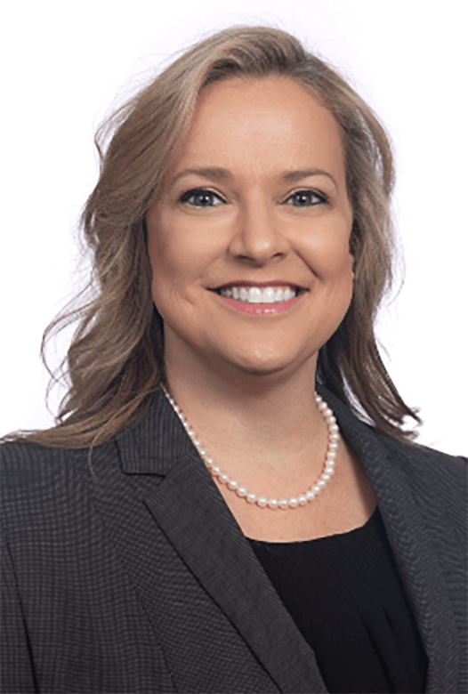
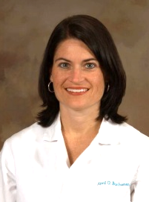
Office for Academic Affairs
Senior Associate Dean for Academic Affairs
Phyllis MacGilvray, MD, FAAFP
Associate Dean for Curriculum
April Buchanan, MD
Manager for Pre-Clerkship Education
Rachel Onley, M.Ed.
Pre-Clerkship Education Lead Coordinator
Emily Poveromo, MBA
Pre-Clerkship Education Coordinator
TBD
IPM Education Coordinator
Lacey Cooper, MPH

Slide 6
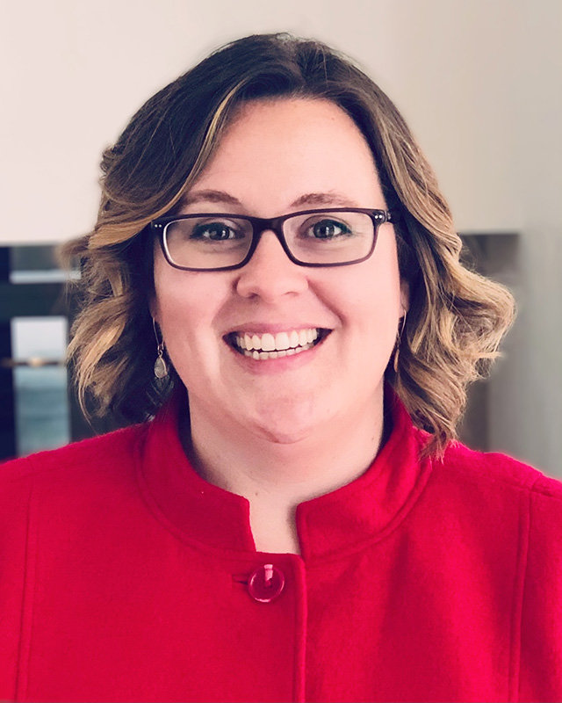
Biomedical sciences
Biomedical Sciences Chair
Kelly Quesnelle, PhD

Slide 7
Curriculum overview

Slide 8
Key educational components
  Early and ongoing immersion into the practice of medicine
  EMT Certification and Training
  Integrated basic science and clinical learning and practice
  Graduated continuum of clinical responsibility
  Small-group, student-centered learning environment
In addition to the traditional basic medical and clinical sciences, our school weaves three other pillars through all four years of the curriculum:
*Professionalism, *Lifestyle Medicine, and *Behavioral, Social and Population Health Sciences.

Slide 9
M1 and m2 modules
M1 Modules
M2 Modules
Emergency Medical Technician
Molecular and Cellular Foundations of Medicine
Structure and Function of the Human Body I
Structure and Function of the Human Body II
Neuroscience
Defenses and Responses
Integrated Practice of Medicine I
Biomedical Principles of Disease and Therapy
Hematology/Oncology Systems
Mind, Brain, and Behavior
Cardiovascular/Pulmonary/Renal Systems
Gastrointestinal/Hepatic Systems
Endocrine/Reproductive Systems
Musculoskeletal/Dermatology/
Rheumatology Systems
Integrated Practice of Medicine II

Slide 10
M3 Core clerkships and electives
Internal Medicine (8 weeks)
Psychiatry and Neurology (8 weeks)
Surgery (8 weeks)
Family Medicine (6 weeks)
Obstetrics and Gynecology (6 weeks)
Pediatrics (6 weeks)
Emergency Medicine (2 weeks)
Electives (4 weeks)
Integrated Practice of Medicine III (1 week)

Slide 11
M4 year
32-week curriculum plus orientation activities embedded throughout the year
Orientation: NRMP Match, Advising, ACLS, Practice Step 2 CK
7 blocks (4 weeks each)
  4 weeks Acting Internship
  12 weeks of selectives related to their planned specialty
  12 weeks of electives
IPM IV Intensification (4 weeks)
  Held after the Match with a goal to produce medical students ready for residency
  2 weeks of Core Intensification
  2 weeks Specialty Specific Intensification

Slide 12
Your responsibilities as a faculty Member
Become familiar with the program level objectives and module/clerkship level objectives for required coursework
Provide formative feedback to students
Assess students in accordance with UofSC School of Medicine Greenville policies
Report student mistreatment and professionalism violations
Be aware of all UofSC School of Medicine Greenville policies

Slide 13
Program level objectives
Module/Clerkship Level Objectives are mapped to overarching Program Level of Objectives for the School of Medicine
Program Level Objectives (PLOs) focus on the areas of:
  Patient Care
  Knowledge for Practice
  Practice Based Learning and Improvement
  Interpersonal and Communication Skills
  Professionalism
  Systems-Based Practice
  Interprofessional Collaboration
  Personal and Professional Development
A full list of PLOs is available on the school website

Slide 14
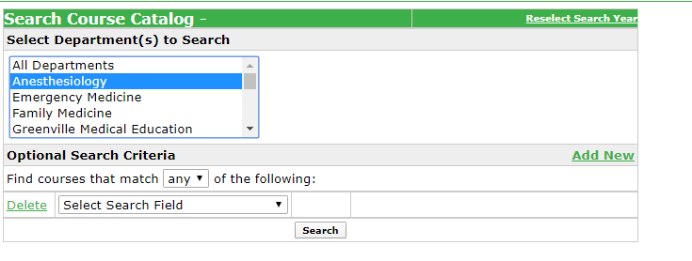
module/clerkship level objectives
Become familiar with the module level objectives for the M1 and M2 year
For all objectives, refer to our public course catalog in OASIS
Module level objectives are also listed in the module syllabus
Select the Department and click Search
Click on the Course Name to view all Course Objectives

Slide 15
Formative feedback
All biomedical science modules in the M1 and M2 years provide formative feedback to students through feedback reports upon completion of weekly formative exams, excluding summative exam weeks.
EMT will use field assessments as formative feedback.
The Integrated Practice of Medicine (IPM) modules in the M1 and M2 years provide formative feedback to students through weekly case resolution small group sessions and weekly skills sessions with IPM faculty and during regularly scheduled feedback sessions 4-5 times/year.
See the Formative Feedback policy for more details.

Slide 16
Grading system
BMS modules are graded on a satisfactory/unsatisfactory basis.
  A student will earn a Satisfactory (S) grade if a total percentage of points earned ≥ 69.45.
  A student will earn an Unsatisfactory (U) or Incomplete_Pass/Fail (I_PF) grade if a total percentage of points earned ≤ 69.44 at the discretion of the module director.
  Refer to the module syllabus for details on each component contributing to the final grade. Some modules may require students to pass multiple/all components to receive a satisfactory grade.
  For EMT and IPM, refer to the module syllabus for details on earning Pass with Honors.
For details, see the Grading System policy

Slide 17
Timeliness of grade reporting
For M1 and M2 modules, the Module Director will enter the official final grade (S, I_PF, or U) in Banner within 1 week of completion of the course. Students should be directed to log in Self Service Carolina to view their final grade one week after the completion of the course.
For details, see the Timeliness of Grade Reporting policy

Slide 18
Narrative assessment
Narrative assessment: Written comments from faculty that assess student performance and achievement in meeting specific objectives of a course or clerkship, such as professionalism, clinical reasoning.
Opportunities for Narrative Assessment in M1 and M2 are available in IPM.
See the Narrative Assessment policy for details.

Slide 19
Challenge and appeal policies
During summative exams for M1 and M2 basic science modules, students are allowed to challenge up to 10% of the exam via ExamSoft assessment software. For details on this process, see the Student Challenge of Summative Exam Questions policy.
Students have the right to be graded in an equitable manner, free from arbitrary bias or capriciousness on the part of faculty members. The Grade Appeal policy was created to ensure a fair and equitable appeal process that allows a medical student to appeal a grade when they can demonstrate that the grade inaccurately reflects their performance in a module, clerkship, or elective.

Slide 20
Promotion and technical standards
The Student Evaluation, Remediation, Requirements for Promotion and Appeal policy outlines the conditions that constitute promotion, remediation of unsatisfactory academic progress and professional conduct, and dismissal.
The UofSC School of Medicine Greenville has adopted the following Technical Standards for Admission, Retention and Graduation

Slide 21
Academic workload
UofSC School of Medicine Greenville recommends an average of 28 hours of required educational activity per week in the M1/M2 years.
It is the responsibility of the Module Directors to ensure that academic workload is not exceeded in the M1/M2 academic years.
Moving forward, academic workload in the M1/M2 years, including hours spent in class and hours required outside of class will be reported in the MDT and reviewed at M1/M2 sub-committee
Link to Academic Workload policy

Slide 22
faculty Evaluations completed by Students
In order to continuously improve the educational experience, students must complete module and faculty evaluations upon the completion of each module per the Course and Faculty/Resident Evaluation policy.

Slide 23
Equity Diversity and inclusion

Slide 24
Equity, Diversity and inclusion
Equity
Diversity*
Fair opportunities to attain one’s optimal health and hopes to the extent possible
Personal and professional histories that frame how we see the world, collaborate, and serve communities
Inclusion
Definitions adapted from CommonHealth Action
Intentional policies and practices that promote the full participation and sense of belonging of every student
Notes:
Definitions (Adapted from CommonHealth Action)
Health equity:
Providing all people with fair opportunities to attain their optimal health to the extent possible
Diversity:
The collective mixture of differences and similarities that includes individual and organizational characteristics, values, beliefs, experiences, backgrounds, and behaviors.
It encompasses our personal and professional histories that frame how we see the world, collaborative with colleagues and stakeholders, and serve communities (CommonHealth Action);
[includes INHERENT diversity and ACQUIRED diversity (adding exposure to diverse experiences)] (Harvard Business Review, December 2013, Hewlitt, Marshall, and Sherbin; McKinsey&Company, Diversity Matters, February 2015: Hunt, Layton, & Prince)
Inclusion:
Intentional policies and practices that promote the full participation and sense of belonging of every student

Slide 25
Anti-Discrimination policy
The UofSC School of Medicine Greenville does not discriminate in educational opportunities for qualified persons on the basis of race, ethnicity, religion, creed, sex, gender identity, national origin, age, disability, sexual orientation or veteran status.
Equal Education Opportunity and Anti-Discrimination policy

Slide 26
Our commitment
The University of South Carolina School of Medicine Greenville is deeply committed to fostering a culture of fairness, equity and inclusion among its diverse students, faculty, staff and other key stakeholders.
  Diversity and cultural competence is intentionally embedded into the curriculum
  Opportunities for mentoring are available
  Student organizations that foster diversity are available
For more details, visit our website

Slide 27
Policies and Other Important Information

Slide 28
Attendance Policy
Enrollment in the UofSC School of Medicine Greenville obligates students to complete all assigned course work promptly. Students are encouraged to attend all regular class sessions. Absences do not absolve the student of these responsibilities. Individual modules may have specific attendance requirements. Refer to the course syllabi for these specific requirements.
The Module Director will determine if the absence should be excused. Reasons for an excused absence include a scheduled healthcare appointment, presentation of original work at national meetings, family wedding or participation in a wedding party, religious holidays, death in the family, personal or immediate family illness, graduation ceremony for immediate family member or significant other.
M1 and M2 Attendance policy
IPM Attendance policy

Slide 29
Conflict of interest
A clinician who has provided medical or psychological services for a medical student will not serve in an evaluative capacity for the student or supervise educational activities that result in evaluation or assessment.
In addition, if an assigned assessor cannot provide an objective assessment of a student due to a personal or familial relationship, then they will not serve in an evaluative capacity for the student or supervise educational activities that result in evaluation or assessment.
Conflict of Interest in Student Assessment policy

Slide 30
The Family and Educational Rights and Privacy Act (FERPA)
FERPA pertains to school records, including grades, student ID numbers, course schedule, records of disciplinary actions, and so forth. Exempt from FERPA regulations is information considered “directory information” by the University (e.g., name, email address, “Class of ___” status, photo, etc.).
Information maintained by an individual faculty member is not considered school records unless it overlaps with official school records (e.g., grades, disciplinary actions). So, records of personal observations or opinions that are not shared with others, as well as communications with students that do not include protected information, are not regulated by FERPA.
Unless the student provides written permission, access to FERPA-protected information is only allowed to those (employees) who have a “legitimate educational interest” in the specific information being shared.

Slide 31
Conduct in educator/learner relationship
The UofSC School of Medicine Greenville is committed to fostering an environment that promotes academic and professional success in learners and medical educators at all levels. An atmosphere of mutual respect, collegiality, fairness, and trust is essential to achieve this success.
  Identifies responsibility of teachers and learners
  Describes inappropriate and unacceptable behaviors as those which demonstrate disrespect for others or lack of professionalism in interpersonal conduct
Link to Guidelines for Conduct in Medical Educator/Learner Relationship policy

Slide 32
Responsibilities of Medical Educators
Treat all learners with respect and fairness
Treat all learners equally regardless of age, gender, race, ethnicity, national origin, religion, disability, or sexual orientation.
Provide current material in an effective format for learning.
Be prepared and punctual for didactic, investigational, and clinical encounters and prompt in responding to requests and questions from students.
Provide timely feedback with constructive suggestions and opportunities for improvement/remediation when needed.
Practice insightful (Socratic) questioning, which stimulates learning and self-discovery and avoid overly aggressive questioning which may be perceived as hurtful, humiliating, degrading or punitive.
Encourage students who experience mistreatment or who witness unprofessional behavior to report the facts immediately.
Demonstrate respect and professionalism toward other members of the faculty in developing and delivering an integrated curriculum.

Slide 33
Student Mistreatment
Mistreatment can be defined in eight general domains:
  Public belittlement or humiliation
  Threats of physical harm or actual physical punishment
  Requirements to perform personal services, such as shopping
  Being subjected to unwanted sexual advances
  Being asked for sexual favors in exchange for grades
  Being denied opportunities for training because of gender, race, ethnicity or sexual orientation
  Being subjected to offensive remarks/name based on age, gender, race, ethnicity, religion or sexual orientation
  Receiving lower grades or evaluation based on race, ethnicity, religion, creed, sex, gender identity, national origin, age, disability, sexual orientation or veteran status.
Link to Student Mistreatment policy

Slide 34
Reporting student Mistreatment
Ombudsperson at (864) 455-3754
Online Mistreatment Report Form (may be submitted anonymously
Health System Compliance Hotline 1-888-243-3611 (English) or 1-800-297-8592 (Spanish)
Report to School Administration
Retaliation for reporting mistreatment is unacceptable and is not tolerated

Slide 35
professionalism
Violations of the Honor Code, Professionalism or Student Code of Conduct standards include, but are not limited to:
Lying - including any form of dishonesty or misrepresentation, omission, fabrication or falsification of documents or clinical reports
Cheating - using or attempting to use any unauthorized materials, devices or study aids in or prior to an examination, OSCE or any other academic work. Giving or receiving any unauthorized assistance in the completion of any examination, OSCE or other academic work as well as preventing or attempting to prevent others from using authorized materials
Plagiarism or copyright violation
Stealing
Violations of the Chemical Dependency policy
Unprofessional behavior, including but not limited to, any breach of patient confidentiality
Inappropriate conduct on campus, in the community or via social media
Repeated lack of accountability
Link to Honor and Professionalism System policy

Slide 36
Reporting students on Professionalism
Violations can be reported online anonymously:
Honor Code and Professionalism Violation Report From
Commendations can be reported online here:
Professionalism Commendation Form

Slide 37
Exposure policies
Exposure to Blood Borne Pathogens policy
  In the event of an exposure, contact Greenville Memorial Hospital (GMH) Exposure Control Office (864-455-4209). Do not leave a voice message regarding exposures. Instead, page the Exposure Control Nurse, 864-345-6133. After hours exposures must be reported to Infection Prevention & Control pager number 864-345-6133 (the area code must be dialed to page the Infection Preventionist).
Radiation Safety policy
  Outlines methods to reduce expose and distribution of monitoring devices

Slide 38
Emergency action plan
The Emergency Action Plan outlines responses for
  Inclement weather, active shooter, medical and fire emergencies

Slide 39
important medical school Policies
All UofSC School of Medicine policies are located on our website.
https://www.sc.edu/study/colleges_schools/medicine_greenville/internal/policies/index.php

Slide 40
Faculty handbook
The faculty handbook is on the Medical School website and describes
  Responsibilities of faculty members
  Responsibilities of the dean and other administrative officers
  Standing committees
  Appointment and promotion procedures and criteria
  Annual evaluation
  Resources for education
  Resources for research

Slide 41
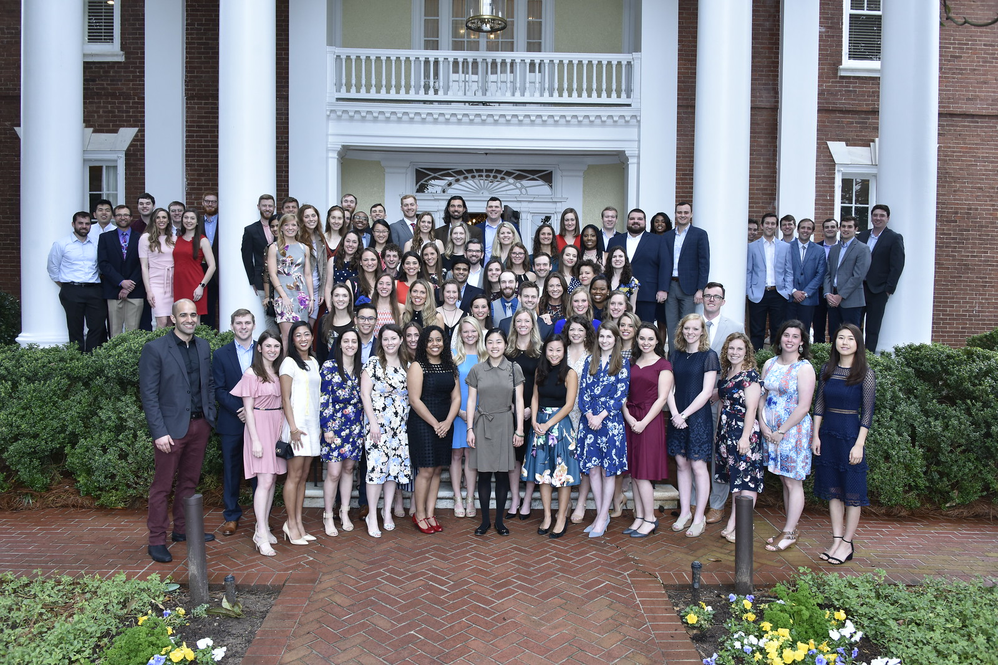

Slide 42
questions
Senior Associate Dean for Academic Affairs–Angela Sharkey, MD
Associate Dean for Curriculum–April Buchanan, MD
Biomedical Sciences Chair (interim)–Bill Roudebush, PhD
M1 and M2 Contact List

