Slide 1


Student Affairs
Travel Instructions

Slide 2
Overview of Travel Procedures
At least 2 weeks in advance of your trip, request time off from work for travel in your Department
When time off is approved, create and file a Travel Authorization in PeopleSoft
Within 2 weeks of return from trip, create and file an Expense Report

Slide 3
Important Notes
TO AVOID SOME OUT-OF-POCKET EXPENSES:
Registration can be paid by the University through a check request. Please request registration payment through Priscilla Kendrick (kendripg@greenvillemed.sc.edu) as soon as possible to avoid processing delays.
Flights can be booked through Donald Cockrell at Forest Lake Travel in Columbia (Donald@forestlaketravel.com). Arrangements made through Forest Lake Travel are paid directly by the University and will be charged to your professional funds account.
Note that if you opt to pay for your registration and/or flight, you will have to wait until you return from your trip to be reimbursed.

Slide 4
Important Notes
Hotel room costs cannot exceed $300/night (not including taxes and fees)
Meals are paid as a per diem. The current meal policy can be found on Slide 13. It is not necessary to submit food and beverage receipts.
Both the Travel Authorization and Expense Report require that a Signature Form be attached. The Signature Form is shown on Slide 9 with instructions on where to obtain a blank form.
If you are not requesting any professional funds, you do not need to complete a Travel Authorization. Be sure to note this on Leave Scheduler.
If you are traveling on grant funds housed at the USC Foundation, you do not need to complete a Travel Authorization. Be sure to note this on Leave Scheduler.

Slide 5
Create a Travel Authorization
You must log into your virtual USC desktop or use a USC computer in order to access PeopleSoft and process your travel.
After receiving approval of time off, log in to PeopleSoft at http://finance.ps.sc.edu.
Select Main Menu, Employee Self-Service, Travel and Expenses, Travel Authorization, Create/Modify
Click the orange Add button.
If you don’t have a USC ID number showing in the box, you will need to enter your bank account information into the system first. Directions on how to add a bank account are located on the next slide (Slide 6).
In the Description box, enter abbreviation of the organization, city, and dates away (e.g., “AAMC Orlando 6/5-6/9/18”)
In the Default Location box, click on the magnifying glass, then click on one of the 4 choices in blue.
6. Enter dates of travel in the Date From and Date To boxes.

Slide 6
How to Add Bank Account
Reimbursement for travel expenses is done through direct deposit. Please put your bank account information into PeopleSoft.
Log in to PeopleSoft using this link: finance.ps.sc.edu.
Authenticate your account with Duo.
Select Main Menu, Employee Self-Service, Travel and Expenses, Review/Edit Profile.
Review the information on the Employee Data tab for accuracy and add your bank account information to the USC Bank Accounts tab.
On the USC Bank Accounts tab, complete the following fields and save:
Bank Name
Account Type
Digital Routing Number
Bank Account Number

Slide 7
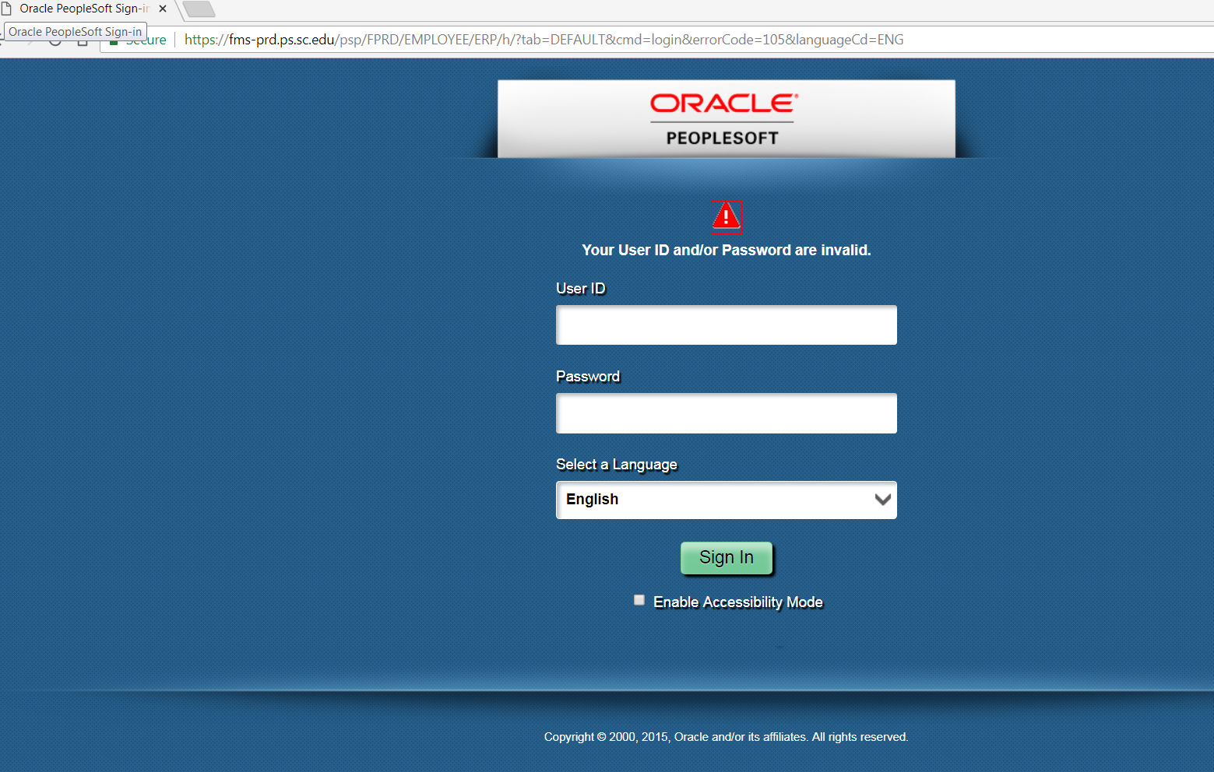
Travel Authorization (cont.)
If this screen appears as you attempt to log in to PeopleSoft, please type the following into the browser’s address line: finance.ps.sc.edu
Do not try to log in on this screen.

Slide 8
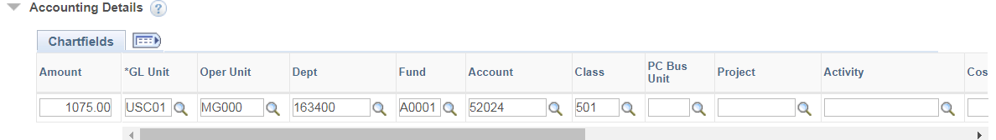
Travel Authorization (cont.)
Enter estimated expenses (please overestimate). Add more lines by using the + and – boxes on the right side of the screen. Note that on Flight information, you will need to enter a preliminary ticket number, such as “TBD” or “0000.”
After you enter the first estimated expense and save the screen (click Save for Later at the top right of the screen), and Accounting Details will pop up underneath the first line item.
Now go to the Actions box in the upper right of the screen, click on the down arrow, and select Default Accounting, then click the orange GO button.
Fill in Accounting Summary information as shown below, then click OK. Only the Oper Unit, Dept, Fund, and Class need to be filled out (arrows). Leave the other boxes as they are. This information will be automatically added for each expense. The Account number shown is for domestic travel. If you are traveling outside the US, use account number 52025.
Save your work and do not submit it yet. You will need to attach a signed Signature Form.

Slide 9
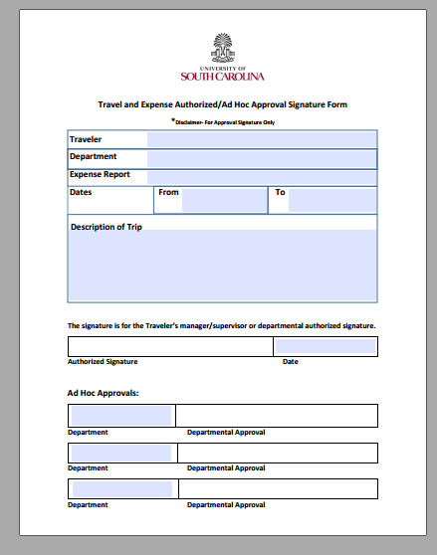
Complete Signature Form
Now complete the Signature Form. You can obtain it from the M Drive/Travel and Vacation/Forms and Policies, then search for “ad hoc.” This form will come up.
Enter TA number and later, Expense Report number here.

Slide 10
Travel Authorization (cont.)
When you complete the Signature Form, enter the TA number in the Expense Report box, leaving space on the right to also later enter the Expense Report number. You do not need to sign the form.
Email the completed form to Priscilla Kendrick at kendripg@greenvillemed.sc.edu. She will request the Chair’s approval and signature. Once signed, she will return the form to you so that the TA can be completed. SAVE this form on your computer; you will need it later.
On receipt of the signed Signature Form, go back into PeopleSoft and the Travel Authorization you created will come up. Attach the Signature Form in the Attachments area at the top center of the screen under the dates and put “Signature Form” into the Description box.
Save your work, then click Summary and Submit. Check the box indicating that the information is correct, then click Submit. A Verification box will pop up. Click Submit again.
The status of your TA can be viewed on PeopleSoft via this path: Main Menu, Employee Self-Service, Travel and Expenses, Travel Authorizations/View. Click on Approval History at the bottom of the screen. You are the first approver, followed by Min Zhang and Kristin Lacey, then by one of several approvers in Columbia. Note that additional documents may be uploaded through the View utility but other changes cannot be made.
When your TA has been fully approved, you will receive a system-generated e-mail notice.

Slide 11
Create an Expense Report
You must log into your USC desktop or use a USC computer in order to access PeopleSoft.
Within two weeks of your return from your trip, create and submit a travel expense report.
Prior to creating the report, gather all receipts.
Group receipts as follows, and save them all as PDF’s:
  Hotel
  Flight, if applicable
  Registration, if applicable
  Mileage—create a Google map directions document to prove mileage.
  Ground Transportation—includes taxis, shuttles, buses, trains
  Miscellaneous—parking, baggage fees
Meals are paid per diem, so food and beverage receipts are not needed.

Slide 12
Expense Report (cont.)
Log into your PeopleSoft account at http://finance.ps.sc.edu. Be sure to use your USC virtual desktop or USC computer.
Select Main Menu, Employee Self-Service, Travel and Expenses, Expense Report, Create/Modify.
Click the orange Add button.
In the Quick Start box at top right of screen, click on the Arrow and select “A Travel Authorization.” This function will populate your expense report from your TA.
Enter the actual amounts spent into each line item on the TA. Attach each receipt on the line where the expense is listed by clicking on the paper clip symbol.
As you enter your expenses, enter the name of the hotel in the Description box for that item and the name of the airline in the Description box on the flight line item. In the flight entry, enter your ticket number if available or your flight identifier (usually a 6 digit combination of letters and numbers) in the Ticket Number box. In the other description boxes, enter simple explanations such as “Baggage Receipt(s)” and “Taxi Receipts,” as appropriate.
NOTE: If you used the University’s travel agency to book your flight and/or your registration was paid in advance, you will need to attach those receipts at the top of the screen beneath the dates and add a note in the Notes area (to the right of Attachments at the top of the screen) that these were pre-paid and do not need reimbursed.

Slide 13
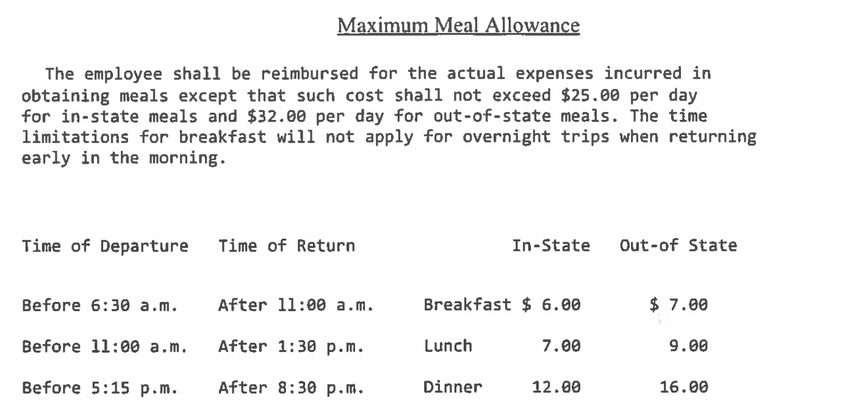
Expense Report (cont.)
If there is an expense that was not needed, you can delete that line with the minus (-) sign on right side of line. If additional lines are needed, add them with plus (+) sign.
Meal expenses are reimbursed based on when you departed and arrived at home at beginning and end of trip. The current meal policy is posted below. It is also available on the USCSOMG website using Search box (top right of screen) for “meal policy.” You will need multiple entries for meal reimbursement, including departure date, the middle days, and return date. The dates must be correct. Departure date entry should indicate “Departed Greenville at _____” (fill in the blank). Return date entry should indicate “Arrived Greenville at _____” (fill in the blank). Use the time that you left and returned to your home.

Slide 14
Expense Report (cont.)
For mileage expense, enter the total number of miles for the round-trip mileage, then save the document. The amount of reimbursement for mileage will populate. Also upload a Google map showing the mileage from your home to the airport and back using the paper clip icon on the mileage line item.
Pull up the Signature Form that you submitted on the Travel Authorization. Add the Expense Report number in the Report blank next to the TA number on the form. Example: TA 1000004567/Report 3000002398. Save the form on your computer and also attach it to the Expense Report in the Attachments area at the top of the screen below the dates. If you do not see a Report number at the top of the screen, save the document and it should populate.
Save the document and submit it. Be sure to check the box certifying that the information is correct and click Submit on the summary that pops up.
The status of your expense report can be viewed on PeopleSoft via this path: Main Menu, Employee Self-Service, Travel and Expenses, Expense Reports/View. Click on Approval History at the bottom of the screen. You are the first approver, followed by Min Zhang and Kristin Lacey, then by one of several approvers in Columbia. Note that additional documents may be uploaded through the View utility but other changes cannot be made.
When your expense report is approved, you’ll get an email notification.

Slide 15

DONE!

