Slide 1
Food- Problem, Solution, or Both?: Creating Food Systems Change
Mary Wilson, MPH
Sonya Jones, PhD
Carrie Draper, MSW
Holly Pope, PhD

Slide 2
Food is the problem and the solution!
http://www.ted.com/talks/ron_finley_a_guerilla_gardener_in_south_central_la
Notes:
Ted Talk: Begin and end at 1:54
http://www.ted.com/talks/ron_finley_a_guerilla_gardener_in_south_central_la
Download through media player

Slide 3
What is a Food System?
A food system includes all processes and infrastructure involved in feeding a population: production, processing, distribution, retail, consumption, and disposal of food and food-related items.

Slide 4
Activity
Think about your favorite fruit and ask yourself the following questions:
Who grew it?
Who harvested it?
Who processed it?
Who transported it?
Who packaged it?
Who sold it?
Who prepared it?
When is the last time you consumed it?
How did you dispose of it?
Is there anything that you wish you knew?
Is there anything that you wish you did not know?

Slide 5
What does our current food system look like?
Notes:
Our food system is failing us- we are growing most of our food using methods that poison and undermine our soil, water and air with unsustainable quantities of chemical fertilizers and pesticides.
Unhealthy Food Policy- The current system of agricultural subsidies mostly benefits large-scale growers of commodity crops such as corn and soybeans—crops that are primarily used to feed livestock and produce processed food. Our diet is dominated by high-calorie foods made from these subsidized crops, and a growing body of research connects this diet to increases in obesity and the diseases that go with it.
Industrial Agriculture
The late 20th century saw a major transformation in U.S. agriculture. Farms grew to enormous sizes, becoming more focused on a few crops and increasingly dependent on synthetic fertilizers and pesticides.
Animal production also changed. Most of our meat and poultry now comes from CAFOs—confined animal feeding operations—where large numbers of animals are fattened for slaughter in highly crowded conditions, their diet supplemented with copious amounts of antibiotics.
These methods of producing food leave a host of problems in their wake. Runoff from chemical inputs and CAFO waste pollutes our water and contributes to global warming; monoculture—the practice of planting a single crop over a large area—depletes soil and reduces biodiversity; reliance on antibiotics in animal production threatens our ability to use these drugs to fight human disease.
Genetic Engineering
Genetic engineering (GE), which manipulates an organism's genes to produce desired traits—most often by introducing genes from other species—has become a key component of the industrial food system.
GE technology does offer some potential benefits, but it also poses risks to human health and the environment that current regulations have not addressed effectively. And so far, GE solutions to food production problems haven't performed well in real-world applications, especially in comparison with less costly crop breeding and farming methods.
But the agribusiness giants who make GE products dominate the marketplace, leaving farmers with fewer and fewer non-GE options to choose from. And they have used their large lobbying budgets to help remove the teeth from what needs to be a careful, rigorous regulatory process.
http://www.ucsusa.org/food_and_agriculture/our-failing-food-system/

Slide 6
Global Food System
Currently, we have primarily a global food system versus a regional or local system.
http://www.youtube.com/watch?v=eHDxy04QPqM&feature=related
Notes:
Cut at 35 seconds?
Before the video is shown…
On Feb 14th, what are most people likely enjoying?
Chocolate is an $83 billion a year business
The US consumes approximately 20% of the world’s chocolate
In the U.S. alone, more than 58 million pounds of chocolate candy are sold during Valentine’s week.
That's $345 million in sales in just one week and it makes up more than 5 percent of chocolate candy’s sales for the year
Where is the chocolate coming from?

Slide 7
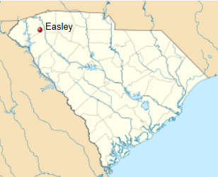
Not in South Carolina…?
Uncompensated workers at Dixie Bell Peaches, Inc.
http://www.change.org/petitions/say-no-to-free-and-uncompensated-american-labor
Notes:
The reality is that these types of situations aren’t just happening globally, they are also happening in SC. 2011
Talk about photos and the injustice for this situation. What are we looking at and how does it relate to the chocolate situation?

Slide 8
Feeling like maybe you can’t eat …ever again…

Slide 9
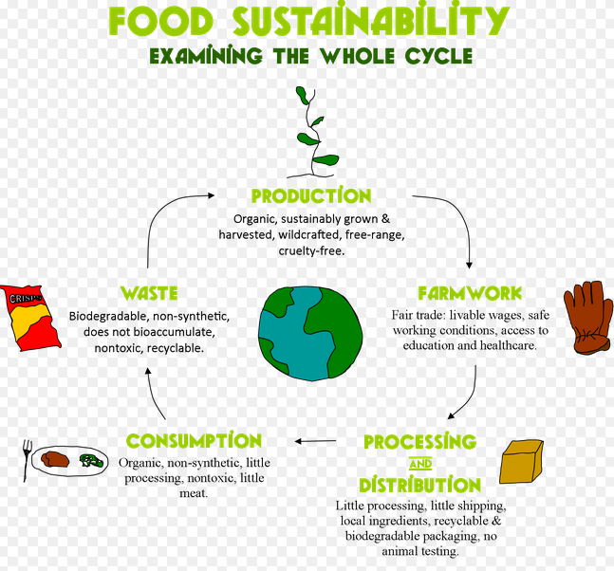
What do we want our food system to look like?
Notes:
We agree that we don’t want things like to happen, so what do we want our food system to be like
Sustainable Agriculture
In simplest terms, sustainable agriculture is the production of food, fiber, or other plant or animal products using farming techniques that protect the environment, public health, human communities, and animal welfare. This form of agriculture enables us to produce healthful food without compromising future generations' ability to do the same.
The primary benefits of sustainable agriculture are:
Environmental Preservation
Sustainable farms produce crops and raise animals without relying on toxic chemical pesticides, synthetic fertilizers, genetically modified seeds, ^{G} or practices that degrade soil, water, or other natural resources. By growing a variety of plants and using techniques such as crop rotation, conservation tillage, and pasture-based livestock husbandry ^{G}, sustainable farms protect biodiversity and foster the development and maintenance of healthy ecosystems.
Protection of Public Health
Food production should never come at the expense of human health. Since sustainable crop farms avoid hazardous pesticides, they're able to grow fruits and vegetables that are safer for consumers, workers, and surrounding communities. Likewise, sustainable livestock farmers and ranchers raise animals without dangerous practices like use of nontherapeutic antibiotics ^{G} or arsenic-based growth promoters. Through careful, responsible management of livestock waste, sustainable farmers also protect humans from exposure to pathogens, toxins, and other hazardous pollutants.
Sustaining Vibrant Communities
A critical component of sustainable agriculture is its ability to remain economically viable, providing farmers, farmworkers, food processors, and others employed in the food system with a livable wage and safe, fair working conditions. Sustainable farms also bolster local and regional economies, creating good jobs and building strong communities.
Upholding Animal Welfare
Sustainable farmers and ranchers treat animals with care and respect, implementing livestock husbandry practices that protect animals' health and wellbeing. By raising livestock on pasture, these farmers enable their animals to move freely, engage in instinctive behaviors, consume a natural diet, and avoid the stress and illness associated with confinement.

Slide 10
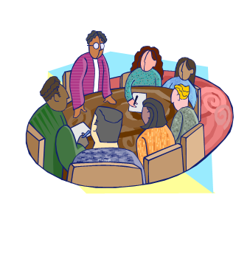
What can be done?
Notes:
What kinds of things beyond the nutritional content need to be analyzed when “eating healthy”?
What alternatives are available to us as consumers?
What should we do?
Eating healthy needs to be a wholistic concept. We need to think about the benefits to us, to all living creatures, and to our planet.
Fair trade, local, avoidance of whole product categories, advocacy for change
Public health professionals have obligations beyond educating the public, we have a role creating the change we want to see in the world. The solutions to most of the problems we are working on lie in thinking differently about how we do public health:
We need to ask different questions with our science.
We need to really understand and engage in policy development
We need to work closely with our communities
And, our evaluations need to consider benefits and consequences beyond “reduction in BMI”

Slide 11
The power of organizing!
Childhood Obesity Prevention in SC Communities (COPASCities)
5 year project funded by the USDA- Agriculture and Food Research Initiative in the Childhood Obesity Challenge area in 2011
Partner Communities
Chester, SC
Eastover, SC
Midlands Local Food Collaborative
Eat Smart, Move More South Carolina
Long-term goals:
Increase the capacity of SC community leaders and USC faculty and students to develop practice based evidence for community-based childhood obesity prevention.
Catalyze and describe the process through which community-based teams develop practice-based evidence for childhood obesity prevention.
Notes:
Through this project, we are empowering communities to create changes in their local food system using a community organizing approach. Through this approach community members take collective action and shift power to implement and promote policy, systems, and environmental change. Strategies used include door knocking, petition signing, phone banking, one-on-ones, and neighborhood/house meetings.
Working with 4 communities across the state:
*Chester- group of concerned citizens in Chester has developed into a community-based organization that now has a mission, vision, and 3 projects they’ve committed to support: community kitchen, farmer’s market, and community garden.
*Eastover- working with a team of young adults, the library, and the town to build the community’s support for a community garden
*Midlands Local Food Collaborative- organizing small scale growers to create a food hub
*ESMM SC, the statewide obesity prevention coalition- building the capacity of local coalitions to work together with SNAP recipients, and other food system stakeholders to create food systems change

Slide 12
Food for Thought
What we eat essentially determines
how the world is used.

Slide 13
The time for change is now! How will you and your community support the cause?

