Slide 1
Through community collaboration centered on experiential sustainability education, interns, staff and students from the University of South Carolina developed and enhanced their leadership skills and have built important relationships to help advance sustainability initiatives among elementary students and youth in the juvenile justice system .
Elementary School Outreach

Slide 2
Multiple Goals
Increase the leadership skills within the student-interns, advocates and course participants
Increase the amount of resources focused on nutrition, gardening and sustainability to use as outreach for K-12 students
Increase relationships with organizations that serve marginalized youth* to further their exposure to programs that promote nutrition, gardening and sustainability
(*Youth in the criminal justice system, ethnic minorities and students at struggling schools)

Slide 3
Projects with Adjudicated Youth

Slide 4
Nutrition & Sustainability Education
University student-interns, Green-quad staff, students of our environmental service learning courses and volunteers, both graduate and undergraduate, developed sustainability-focused education modules that were then delivered in local schools.
These schools range from incarcerated youth within the Department of Juvenile Justice, to 2nd-5th graders at local elementary schools in Richland County

Slide 6
Farm to School/ Gardening/ Nutrition with DJJ Campuses
Through their participation in this program, student-interns and student-advocates are developing leadership skills and ability to teach sustainable practices, therefore increasing their potential to serve as beacons of sustainability upon graduation.
Additionally they are promoting sustainability to the next generation- providing a deeper since of engagement on behalf of the K-12 students & incarcerated youth

Slide 7
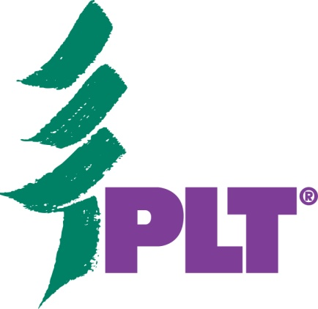
Engaging USC Students & Advocates

Slide 8
Advocate Training @ Sustainable Carolina
Project Teams- K-12 Curriculum Outreach, Food Justice & Garden teams
Students of our service learning courses- Green Politics, Politics of Local Food,
Service learning projects
Community Collaboration with Project Learning Tree/ Richland County Conservation

Slide 9
Sustainable Carolina/ Green Quad Educational Programs to date –
Collaboration with summer camp through the College of Public Health “Columbia’s Cooking” – two months during the summer of 2013
# of k-12 Students reached:110
# of university students reached: 6
# of university staff/faculty engaged: 3

Slide 10
Green Quad Based Summer Camp- GLEA*
Two weeks of summer day camp focused on sustainability, photography and literacy delivered during the summer of 2013
# of K-12 students reached: 15
# of University students reached: 2
# of University staff/faculty: 4

Slide 11
Educator & Advocate Training
Full day training of Project Learning Tree Curriculum and vermi-compost training by community collaborators from Richland Soil and Water Conservation
# of educators/advocates engaged: 18
# of University faculty engaged: 2
# of Community Collaborators engaged: 2

Slide 12
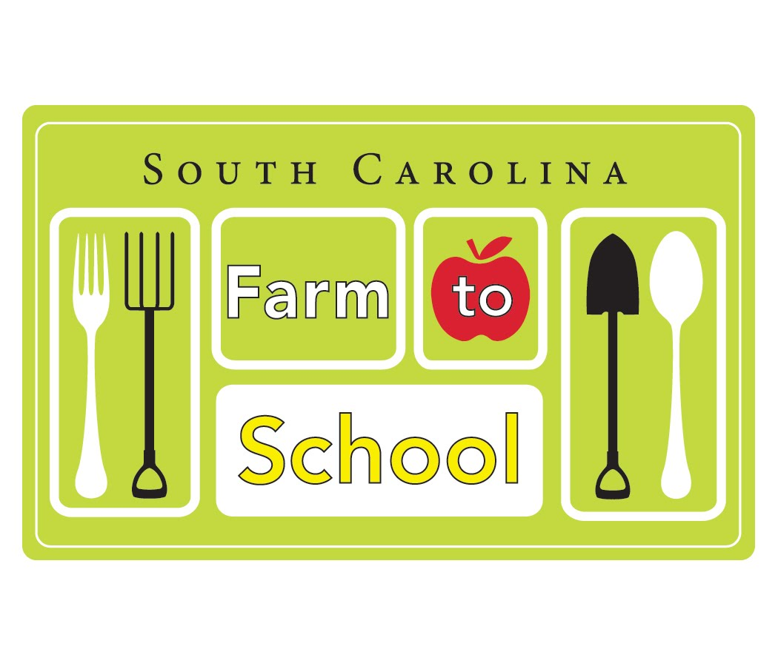
Green Job Skills- DJJ Students
# of K-12 students reached: 75
# of University students reached: 5
# of University staff engaged: 1
# of educational professionals engaged: 6
Curriculum provided as part of Farm to School Grant- Birchwood Campus

Slide 13
Elementary School outreach:
4 local elementary schools host programs developed by university interns, advocate volunteers including gardening, composting and habitat-protection activities
# of K-12 students reached: 93
# of university students reached: 10
# of teachers engaged: 10

Slide 14
Program Benefits
Contributions
From the teachers:
The contributions of the university-students to the learning communities at participating schools is also evident on behalf of the participating school-based educators and collaborators that have worked with our interns.
“By inviting university students into the classroom, we gain an injection of new ideas, passions, abilities, and knowledge.”
“By participating in this program, I can better engage my students about the environment, sustainability and health in a hands-on way”

Slide 15
USC Intern/Advocate Experiences
One participating university undergraduate detailed that these K-12 sustainability outreach programs to be a “fun way to learn about gardening, to work with kids, and to learn about qualitative research methods”
A second student involved with elementary students details that “we learn how difficult it is to make a curriculum and we see/learn hands on how kids learn things and how to properly present the material for the kids to best understand it and use it.”

Slide 16
Thanks for your attention
Autumn Perkins
K-12 Curriculum Outreach
Sustainable Carolina
AutumnPerkins@gmail.com

