Slide 1

Overview of Health Disparities in Aging And Alzheimer’s Disease and Related Dementias
Carolina Center on Alzheimer’s Disease and Minority Research (CCARMR) Seminar Series
April 19, 2019
Mindi Spencer, PhD
Office for the Study of Aging

Slide 2
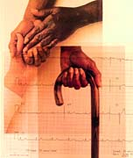
Presentation Overview
On the language of health disparities
Epidemiology of Alzheimer’s disease and related dementias (ADRD)
Aging and ADRD from a social determinants perspective
Culture and Caregiving

Slide 3
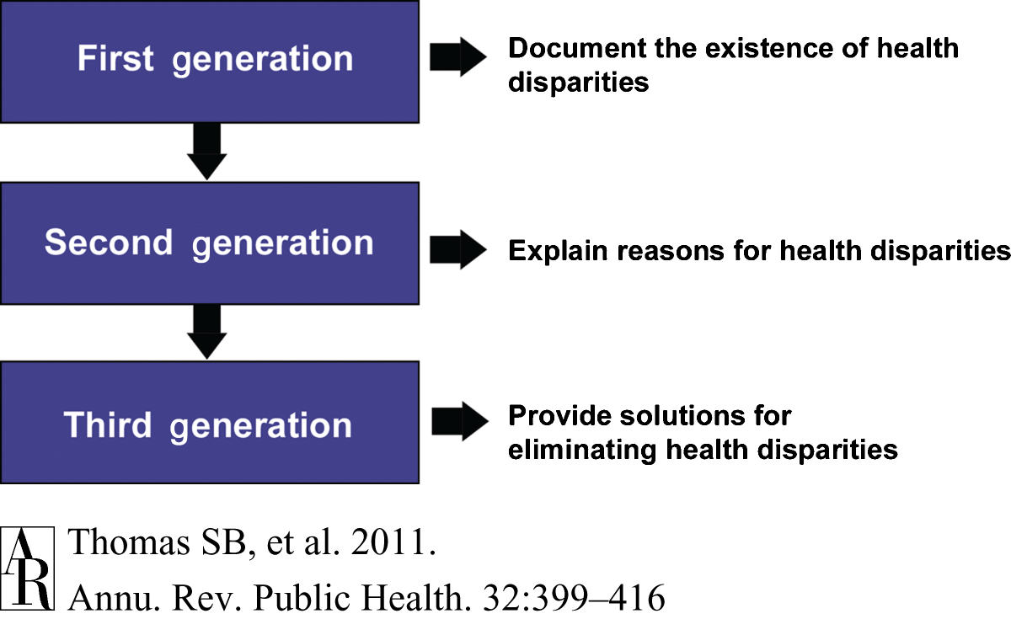
The Different “Generations” of Health Disparities Research and Practice

Slide 4
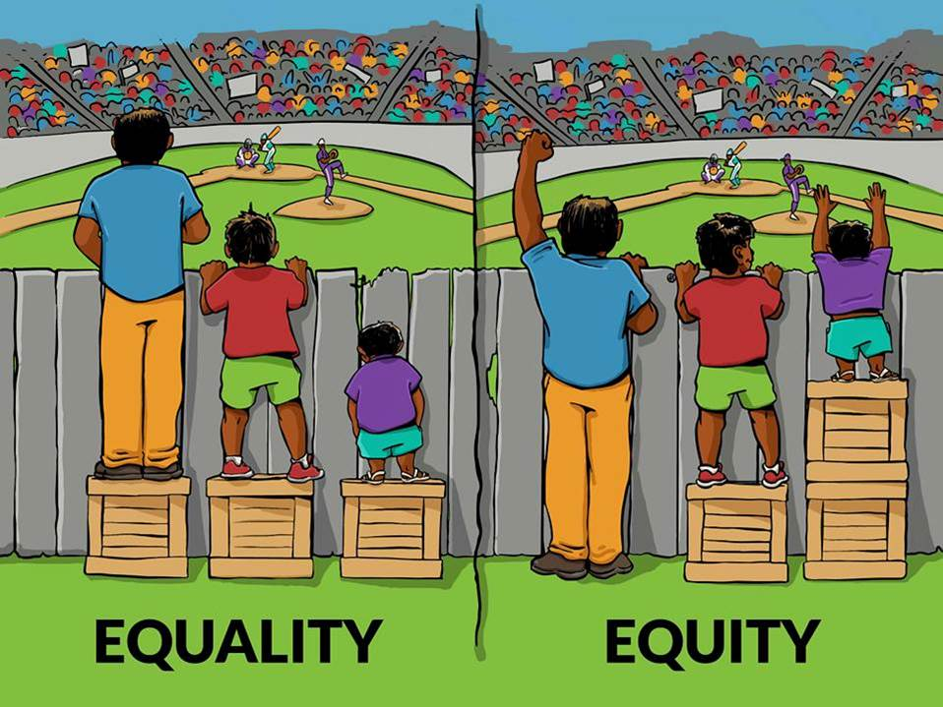
Health Equality vs. Health Equity

Slide 5
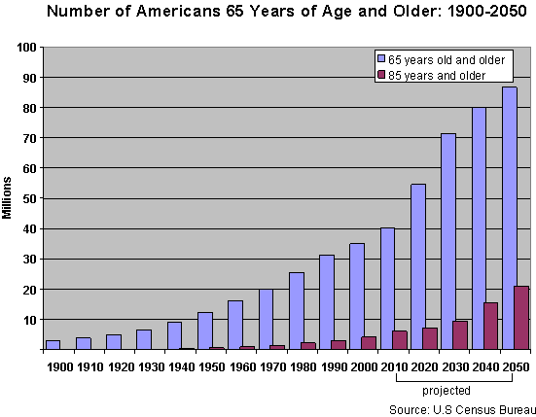
Population Aging in the United States

Slide 6
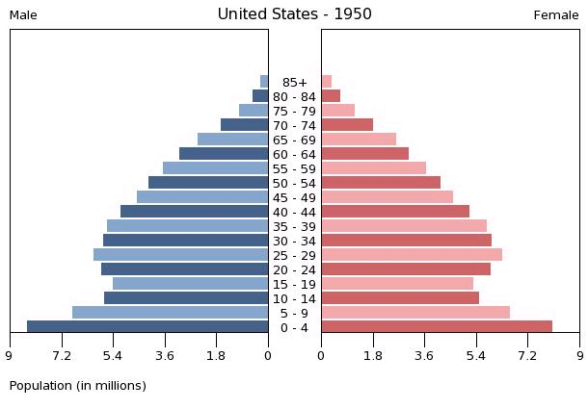
Population Pyramid – 1950
Source: U. S. Census Bureau International Data Base (http://www.census.gov/ipc/www/idb/country.php )
Notes:
Provides a way to visualize demographic trends over time
Shows how the Baby Boomers (born between 1946-1964) are a “demographic shockwave” or “pig in the python”
Demonstrates how the U.S. will experience an inevitable squaring of the pyramid in the future

Slide 7
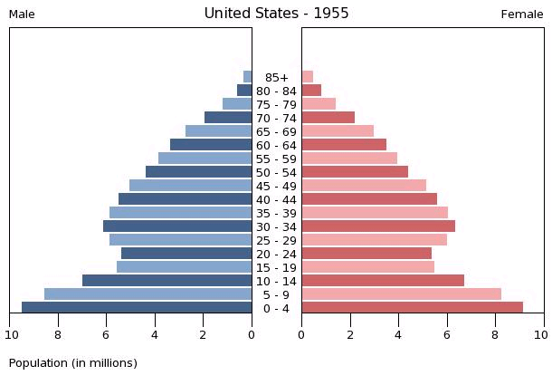
Population Pyramid – 1955
Source: U. S. Census Bureau International Data Base (http://www.census.gov/ipc/www/idb/country.php )

Slide 8
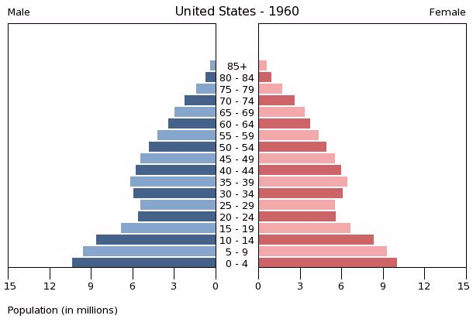
Population Pyramid – 1960
Source: U. S. Census Bureau International Data Base (http://www.census.gov/ipc/www/idb/country.php )

Slide 9
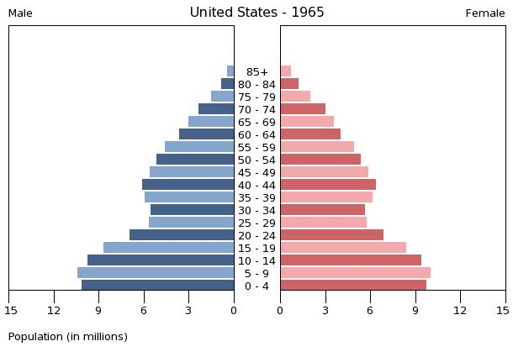
Population Pyramid – 1965
Source: U. S. Census Bureau International Data Base (http://www.census.gov/ipc/www/idb/country.php )

Slide 10
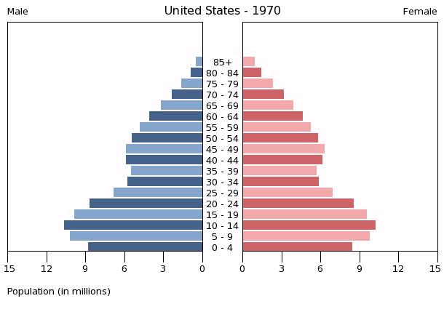
Population Pyramid – 1970
Source: U. S. Census Bureau International Data Base (http://www.census.gov/ipc/www/idb/country.php )

Slide 11
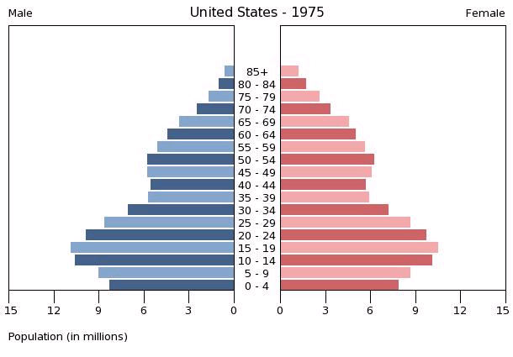
Population Pyramid – 1975
Source: U. S. Census Bureau International Data Base (http://www.census.gov/ipc/www/idb/country.php )

Slide 12
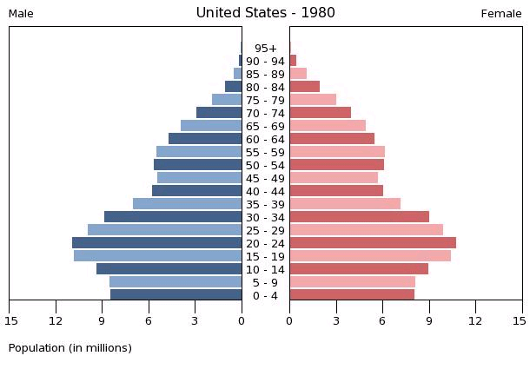
Population Pyramid – 1980
Source: U. S. Census Bureau International Data Base (http://www.census.gov/ipc/www/idb/country.php )

Slide 13
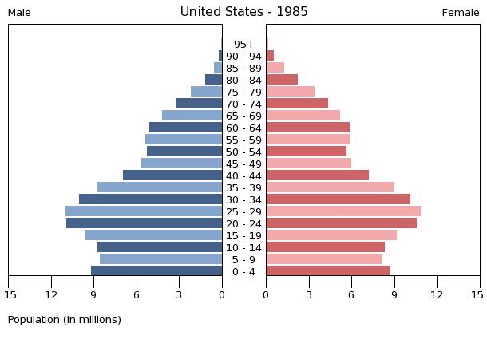
Population Pyramid – 1985
Source: U. S. Census Bureau International Data Base (http://www.census.gov/ipc/www/idb/country.php )

Slide 14
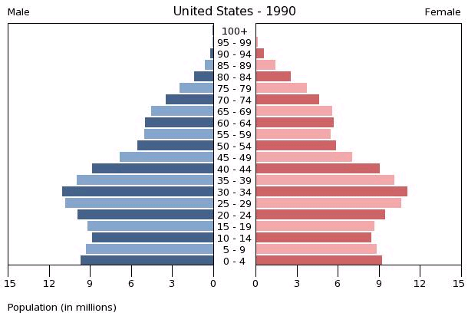
Population Pyramid – 1990
Source: U. S. Census Bureau International Data Base (http://www.census.gov/ipc/www/idb/country.php )

Slide 15
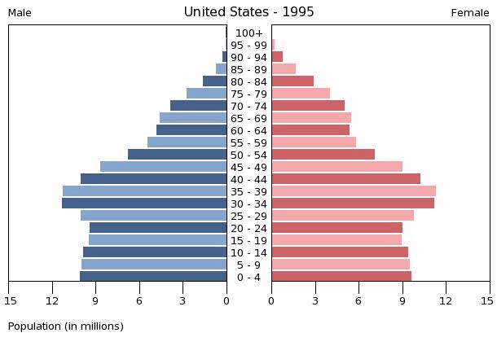
Population Pyramid – 1995
Source: U. S. Census Bureau International Data Base (http://www.census.gov/ipc/www/idb/country.php )

Slide 16
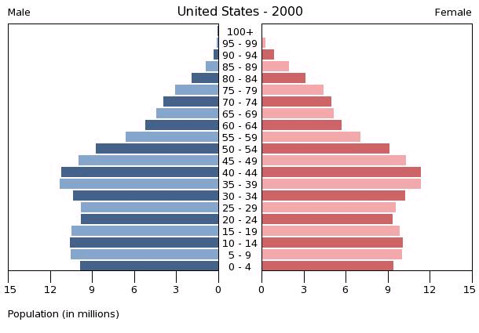
Population Pyramid – 2000
Source: U. S. Census Bureau International Data Base (http://www.census.gov/ipc/www/idb/country.php )

Slide 17
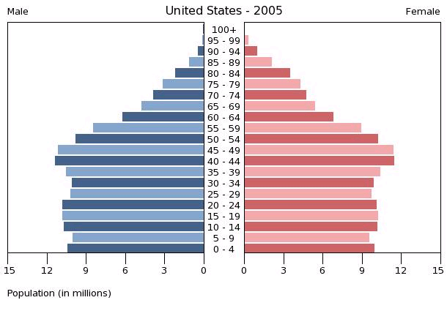
Population Pyramid – 2005
Source: U. S. Census Bureau International Data Base (http://www.census.gov/ipc/www/idb/country.php )

Slide 18
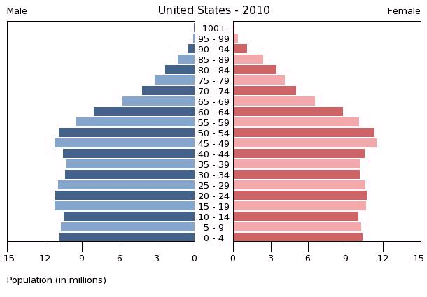
Population Pyramid – 2010
Source: U. S. Census Bureau International Data Base (http://www.census.gov/ipc/www/idb/country.php )

Slide 19
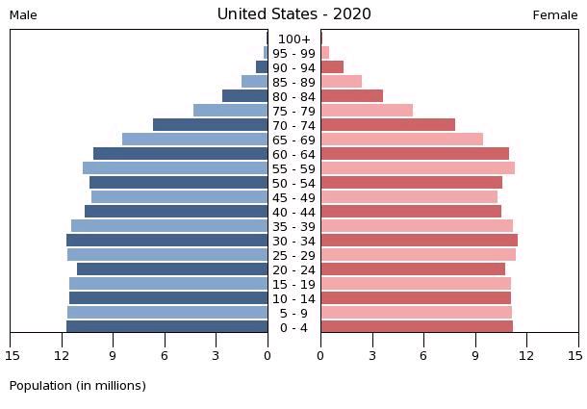
Population Pyramid – 2020
Source: U. S. Census Bureau International Data Base (http://www.census.gov/ipc/www/idb/country.php )

Slide 20
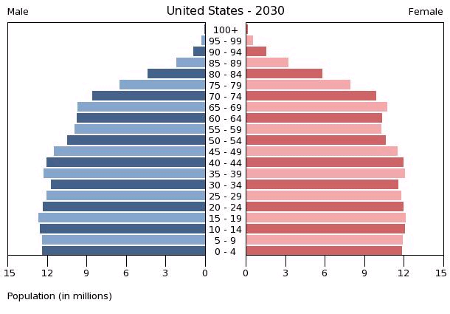
Population Pyramid – 2030
Source: U. S. Census Bureau International Data Base (http://www.census.gov/ipc/www/idb/country.php )

Slide 21
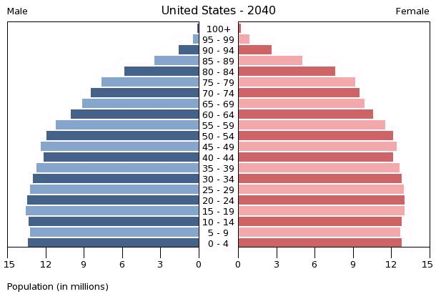
Population Pyramid – 2040
Source: U. S. Census Bureau International Data Base (http://www.census.gov/ipc/www/idb/country.php )

Slide 22
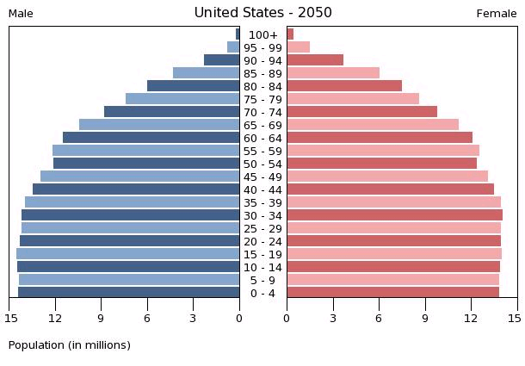
Population Pyramid – 2050
Source: U. S. Census Bureau International Data Base (http://www.census.gov/ipc/www/idb/country.php )

Slide 23
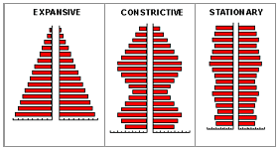
Three Types of Population Pyramids
Source: http://vcampus.uom.ac.mu/soci1101/643types_of_population_pyramids.html

Slide 24
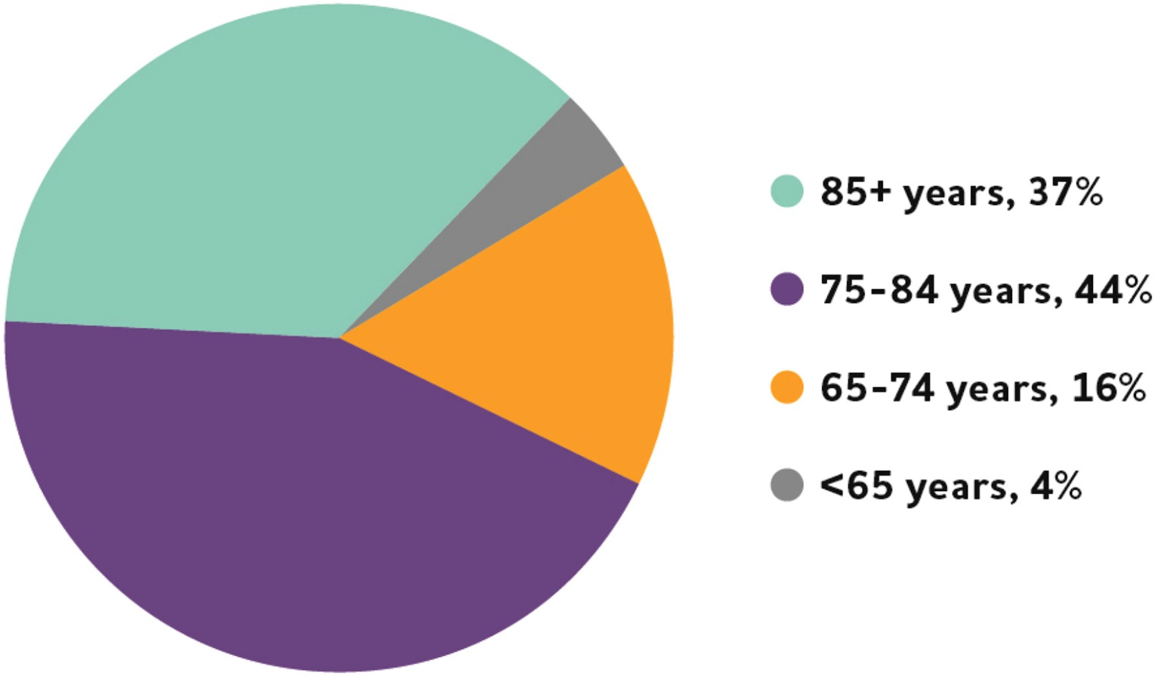

Fig. 1
Alzheimer’s Dementia by Age (2018)
Alzheimer's & Dementia: The Journal of the Alzheimer's Association 2018 14, 367-429 DOI: (10.1016/j.jalz.2018.02.001)
Copyright © 2018 Terms and Conditions
Notes:
Ages of people with Alzheimer's dementia in the United States, 2018. Percentages do not total 100 because of rounding. Created from data from Hebert and colleagues [30].^{A3}

Slide 25
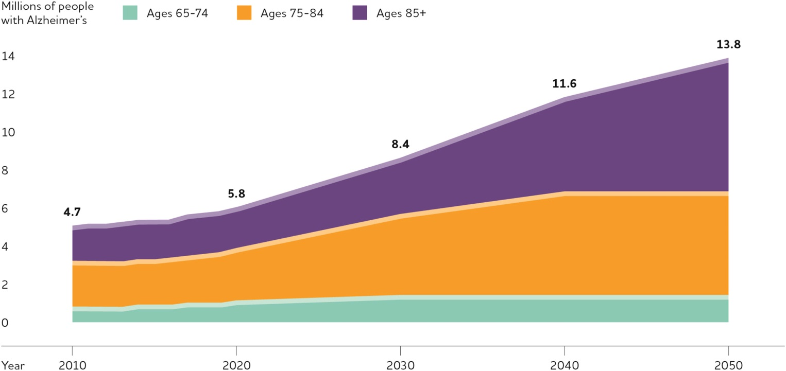
Fig. 4
Projected Number of People Age 65+ with Alzheimer’s Dementia, 2010-2050
Alzheimer's & Dementia: The Journal of the Alzheimer's Association 2018 14, 367-429 DOI: (10.1016/j.jalz.2018.02.001)
Copyright © 2018 Terms and Conditions
Notes:
Projected number of people age 65 and older (total and by age) in the U.S. population with Alzheimer's dementia, 2010 to 2050. Created from data from Hebert and colleagues [30].^{A11}

Slide 26
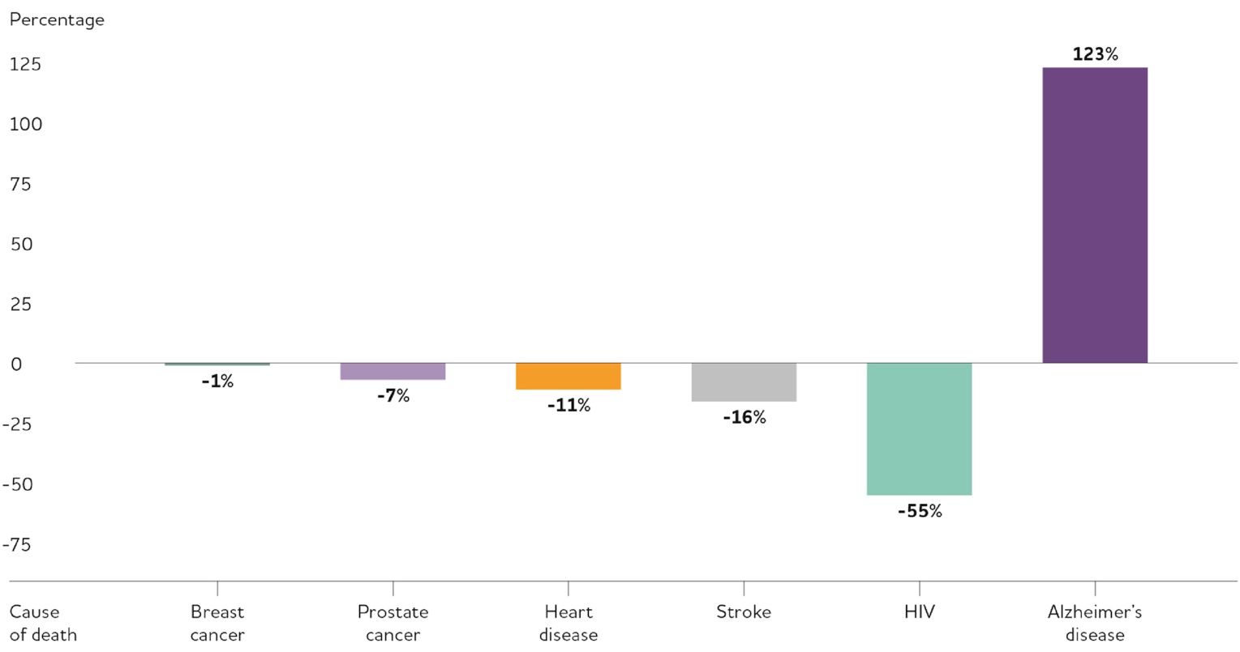
Changes in Causes of Death for all Ages between 2000 and 2015
Alzheimer's & Dementia: The Journal of the Alzheimer's Association 2018 14, 367-429 DOI: (10.1016/j.jalz.2018.02.001)
Copyright © 2018 Terms and Conditions
Notes:
Percentage changes in selected causes of death (all ages) between 2000 and 2015. Created from data from the National Center for Health Statistics [232,243].

Slide 27
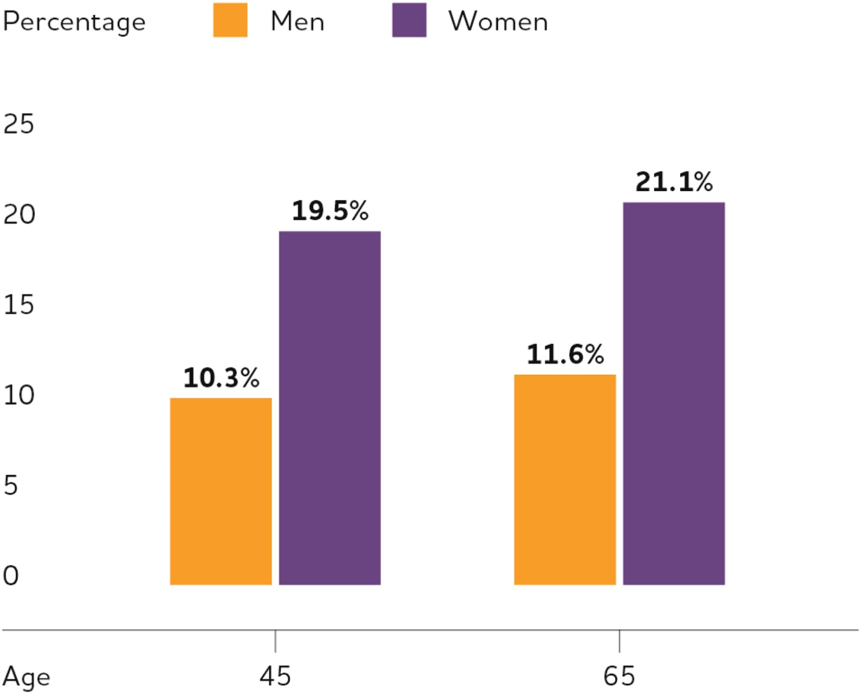
Fig. 3
Estimated Lifetime Risk for Alzheimer’s Dementia by Sex at Age 45 and 65
Alzheimer's & Dementia: The Journal of the Alzheimer's Association 2018 14, 367-429 DOI: (10.1016/j.jalz.2018.02.001)
Copyright © 2018 Terms and Conditions
Notes:
Estimated lifetime risk for Alzheimer's dementia, by sex, at age 45 and age 65. Created from data from Chene and colleagues [173].

Slide 28
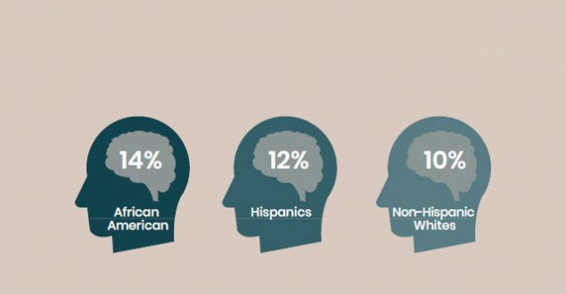
Percentage of Adults Aged 65+ with Alzheimer’s Disease by Race/Ethnicity
  Source: Centers for Medicare and Medicaid Services, 2014
  www.cdc.gov/aging

Slide 29
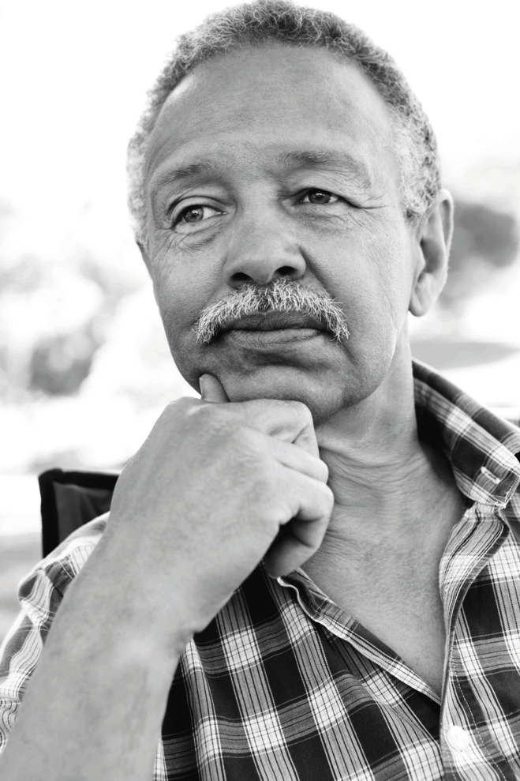
Race/Ethnicity is a Rick Factor for Alzheimer’s Dementia
African Americans: 2 times greater risk
Hispanics: 1.5 times greater risk
Potential explanations
  Cardiovascular risk factors are more common
  Lower levels of education and SES
  Others???
  Source: Alzheimer’s Association (2016) Alzheimer’s Disease Facts and Figures
Notes:
Race and ethnicity may also contribute to increased risk of developing Alzheimer’s and other dementias.
In the U.S., older African-Americans are about two times more likely than older whites to have Alzheimer’s disease. First-degree relatives of African-Americans with Alzheimer’s disease have a 43% chance of developing dementia.
Older Hispanics are about one and one-half times more likely than older whites to have Alzheimer’s disease.
Variations in health, lifestyle and socioeconomic circumstances across racial groups likely account for most of the difference in risk of Alzheimer’s and other dementias by race. African-American and Hispanic communities have a higher incidence of certain Alzheimer’s risk factors:
Conditions such as high blood pressure and diabetes which are risk factors for Alzheimer’s disease, are more common in African-Americans and Hispanic populations than in whites.
Lower levels of education and other socioeconomic characteristics (such as lower income, access to quality care) among older racial and ethnic minorities may also contribute to increased risk.
Some studies suggest that differences based on race and ethnicity do not persist in rigorous analyses that account for such risk factors.
The higher prevalence of Alzheimer’s dementia in minorities compared with whites appears to be due to a higher incidence of dementia in these groups.203,208 Variations in health, lifestyle and socioeconomic risk factors across racial groups likely account for most of the differences in risk of Alzheimer’s and other dementias.209 Despite some evidence that the influence of genetic risk factors on Alzheimer’s and other dementias may differ by race,68,70,210 genetic factors do not appear to account for the large differences in prevalence or incidence among racial groups.209,211 Instead, health conditions such as cardiovascular disease and diabetes, which are associated with an increased risk for Alzheimer’s and other dementias, are believed to account for these differences, as they are more prevalent in black/African American and Hispanic people.212-213 Socioeconomic characteristics, including lower levels of education, higher rates of poverty, and greater exposure to adversity and discrimination, may also increase risk in black/African American and Hispanic communities.68,212-214 Some studies suggest that differences based on race and ethnicity do not persist in rigorous analyses that account for such factors.120,160,209

Slide 30
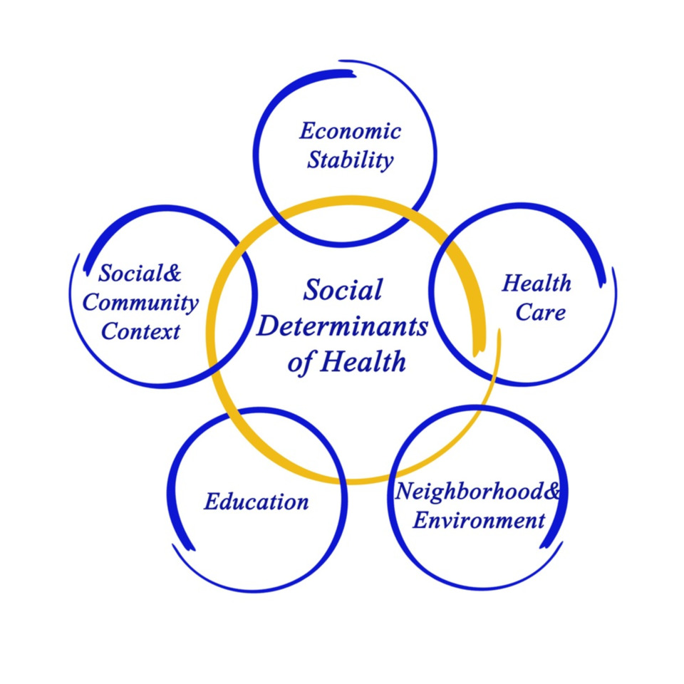
Social Determinants of Health and Aging
How might the social determinants of health become even more influential as a person grows older?

Slide 31
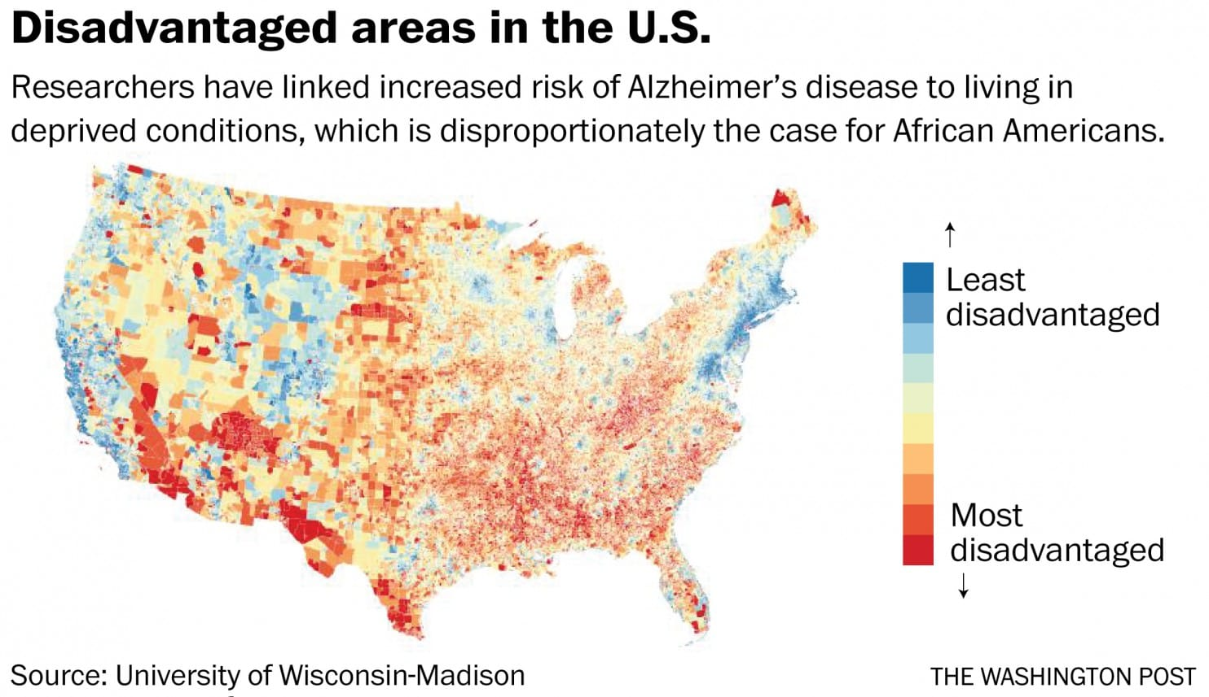
Notes:
A new group of studies into racial disparities among people with Alzheimer’s disease suggests that social conditions, including the stress of poverty and racism, substantially raise the risks of dementia for African Americans.
In four separate studies, researchers found that conditions that affect blacks disproportionately compared with other groups — such as poor living conditions and stressful events such as the loss of a sibling, the divorce of one’s parents or chronic unemployment — have severe consequences for brain health later on.

Slide 32

Caregiving in the United States
Caregiving in the U.S. will become even more important in the future due to:
  Population aging
  Changes in the age distribution
  Increasing diversity
48% of all caregivers who provide help to older adults do so for someone with ADRD
Image Credit. http://roguehealthandfitness.com/preventing-alzheimers-disease-rapamycin/

Slide 33
Alzheimer’s & Dementia Caregivers (Alzheimer’s Association, 2018)
83% of the care provided to older adults come from family members, friends or other unpaid caregivers
60% of people with Alzheimer’s live in home settings
Over 15 million informal caregivers in the U.S.
18 billion hours of unpaid care annually
Unpaid care valued at $221 billion (2015)
Notes:
In the US, 83% of the care provided to older adults come from family members, friends or other unpaid caregivers.
About 60% of people with Alzheimer’s disease live in home settings with the vast majority of their care provided by family and friends.
Currently in the U.S., it is estimated that over 15 million family and friends provide nearly 18 billion hours of unpaid care annually.
In 2015, this care was valued at $221 billion. This is approximately 46% of the net value of Walmart annual sales which was $473.1 billion in 2014 and nearly eight times the total annual revenue of McDonald’s which was $27.4 billion in 2014.

Slide 34
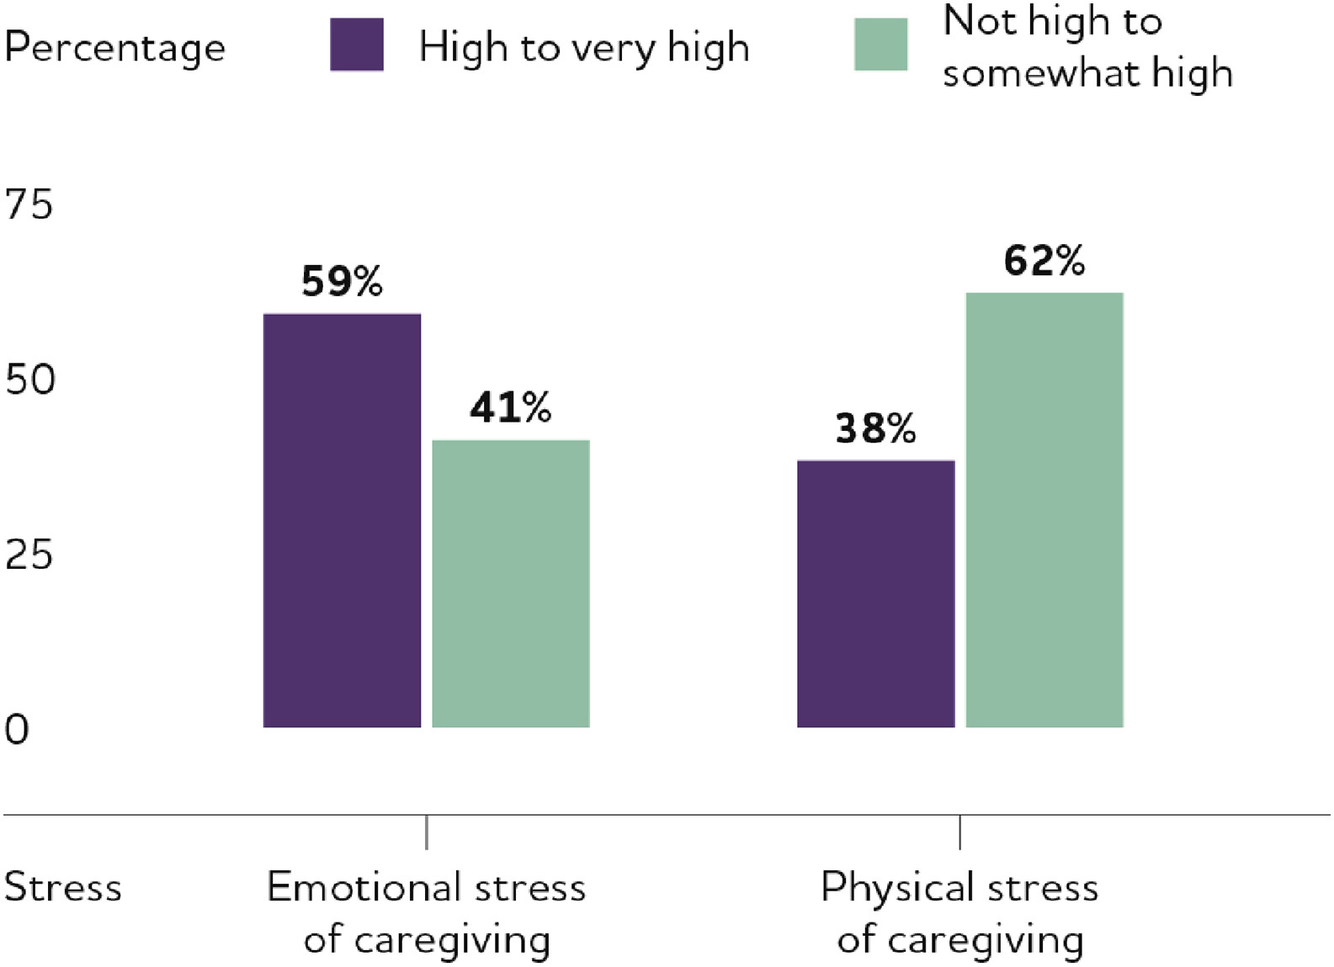
Percentage of Caregivers of People with ADRD who Report Caregiver Stress
Alzheimer's & Dementia: The Journal of the Alzheimer's Association 2018 14, 367-429 DOI: (10.1016/j.jalz.2018.02.001)
Copyright © 2018 Terms and Conditions
Notes:
Proportion of caregivers of people with Alzheimer's or other dementias who report high to very high emotional and physical stress due to caregiving. Created from data from the Alzheimer's Association.^{A15}

Slide 35
Need to Consider Racial/Ethnic Differences in Caregiving

Slide 36
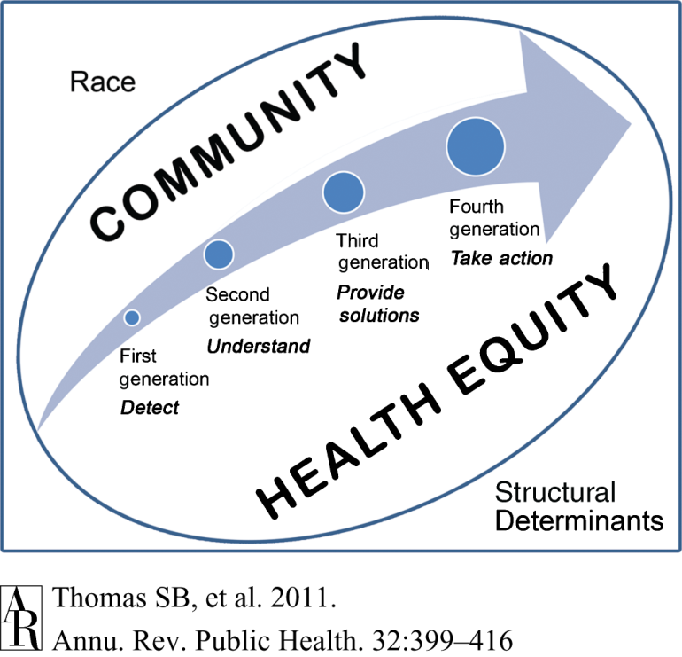
The “Next Generation” of Health Disparities Research and Practice

Slide 37


Questions/Comments
Contact Information
Email: mspencer@sc.edu
Phone: 803-777-4371

