Slide 1



Diverse Communities’ Perceptions of and Messaging about Cognitive Health and Impairment
Daniela B. Friedman, PhD
Department of Health Promotion, Education, and Behavior
dbfriedman@sc.edu
This presentation was supported by Cooperative Agreement Number U48/DP005000-01S7 from the Centers for Disease Control and Prevention. The findings and conclusions in this presentation are those of the author(s) and do not necessarily represent the official position of the Centers for Disease Control and Prevention.

Slide 2
Today’s Presentation
Introduce national reports guiding our work
Introduce the CDC-funded Healthy Brain Research Network (HBRN)
Review research on communities’ perceptions and quality of media resources about cognitive health and impairment
Discuss implications of findings

Slide 3
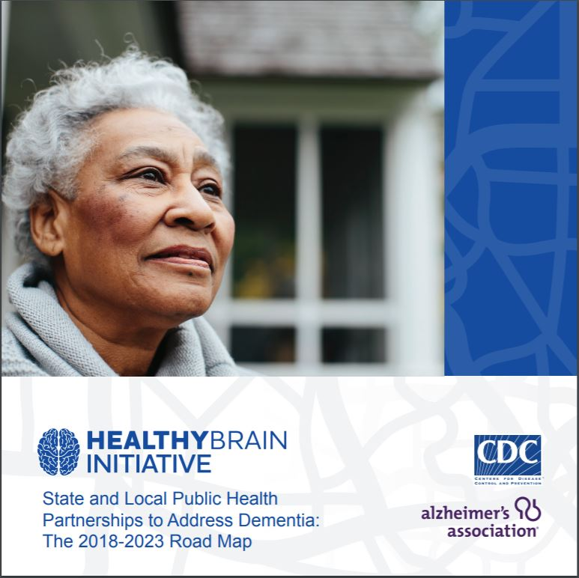
The Healthy Brain Initiative: The Public Health Road Map for State and National Partnerships, 2018–2023
Outlines how state and local public health agencies and their partners can continue to promote cognitive health, address cognitive impairment for people living in the community, and help meet the needs of caregivers
25 specific actions organized into 4 public health domains:
Educate and empower
Develop policies and mobilize partnerships
Assure a competent workforce
Monitor and evaluate
Released December 2018

Slide 4
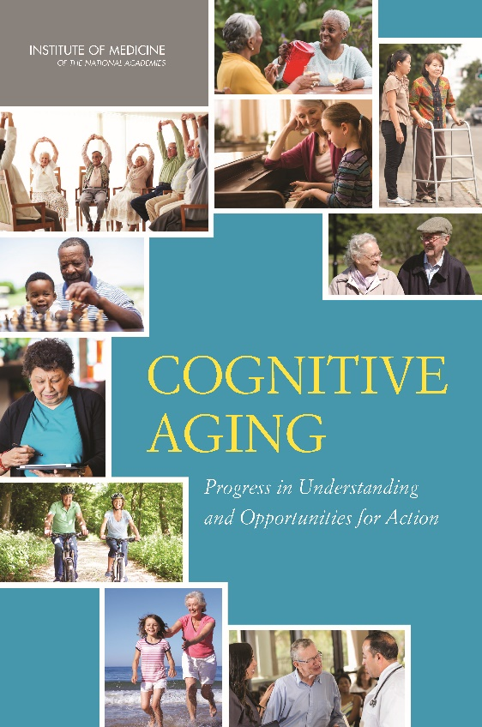
Cognitive Aging: Progress in Understanding and Opportunities for Action
www/iom.edu/cognitiveaging
Action Guide for Health Care Providers
Online Resources Related to Safe Medication Use in Older Adults
Online Resources Related to Elder Financial Abuse
Online Resources Related to Older Adult Driving
Action Guide for Individuals and Families
Report Brief
Una Guía de Acción para Individuos y Familias
Action Guide for Communities
IOM (Institute of Medicine). 2015. Cognitive aging: Progress in understanding and opportunities for action. Washington, DC: The National Academies Press.
Notes:
The network also aims to build upon the April release of the IOM report on cognitive aging. This report examines the current state of the evidence and speaks to the “public health dimensions of cognitive aging with an emphasis on definitions and terminology, epidemiology and surveillance, prevention and intervention, education of health professionals, and public awareness and education.”

Slide 5
Healthy Brain Research Network
Advance the public health research and translation agenda for cognitive health and healthy aging.

Slide 6
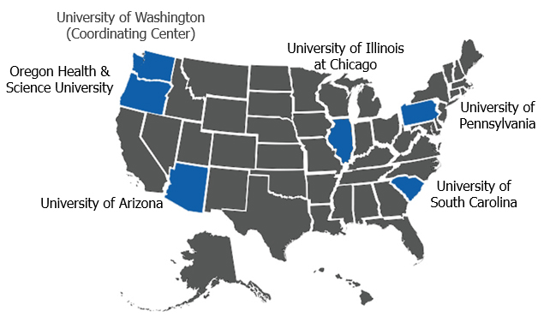

Healthy Brain Research Network (2014-2019)
Notes:
The network is comprised of funded sites (prevention research centers) at OHSU, University of Arizona, University of Pennsylvania, and University of South Carolina.
All activities are conducted in collaboration with program partners at the CDC Healthy Aging Program – Healthy Brain Initiative.
We also work with partners in the community such as the Alz Association and others.

Slide 7
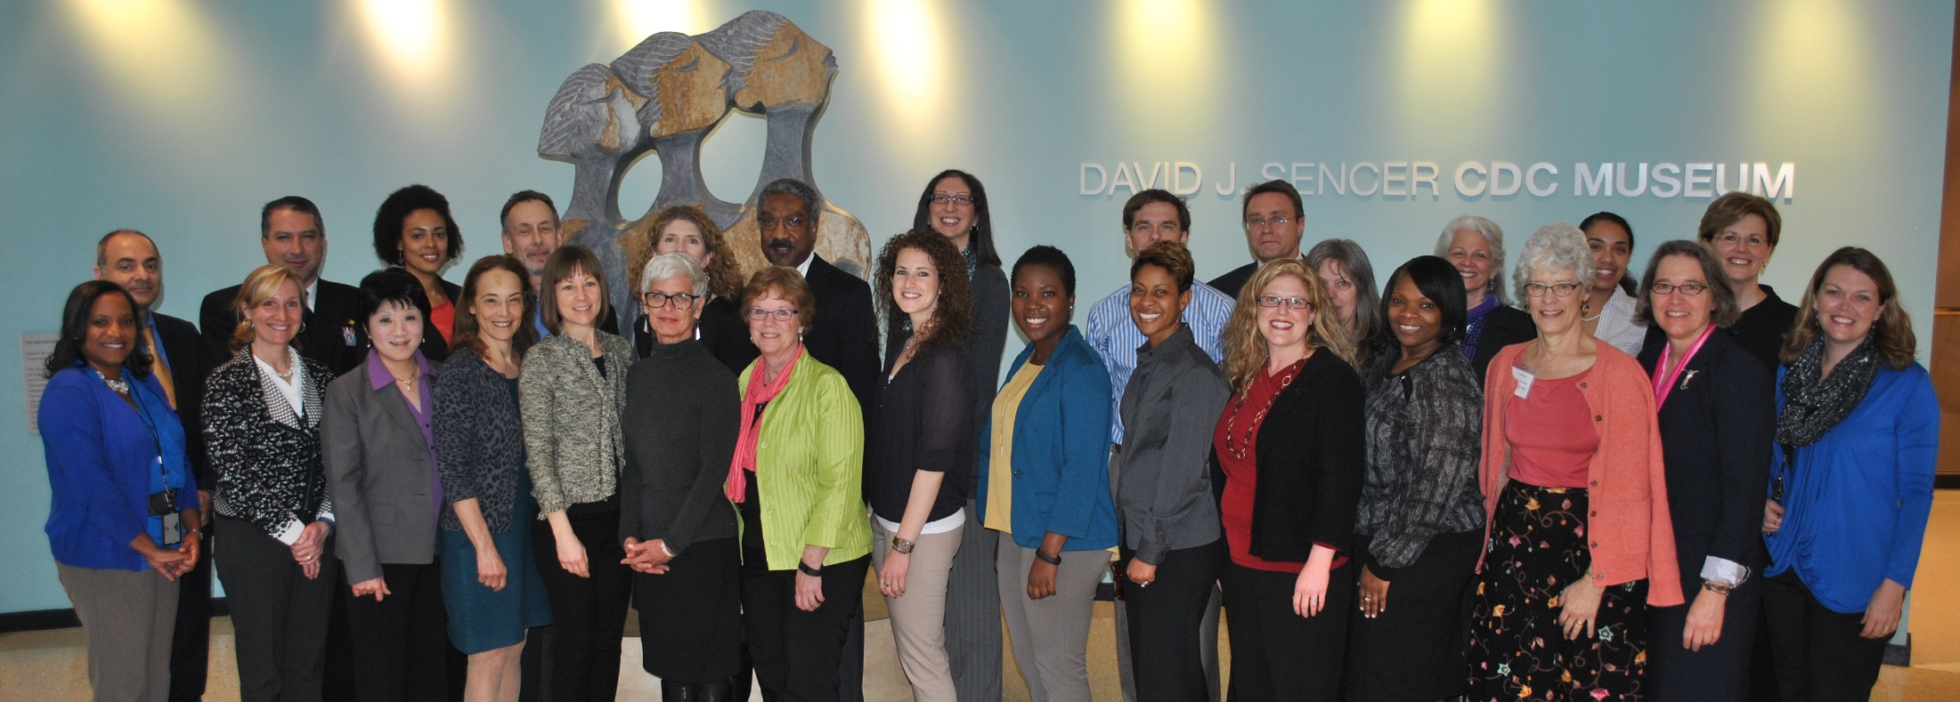
I love working in teams!

Slide 8
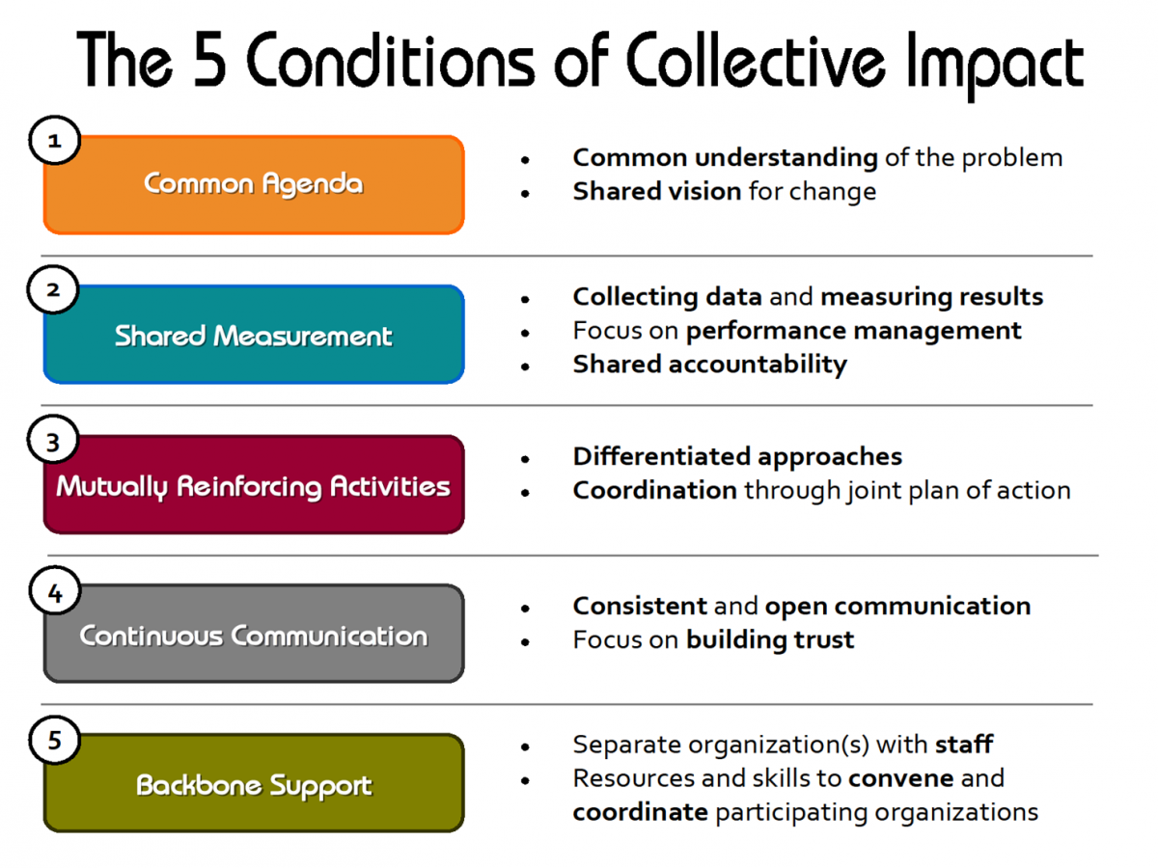
How We Do Our Work
Developed by FSG: http://www.fsg.org
Notes:
Guided by the work of FSG, we use a collective impact approach.

Slide 9
HBRN Logic Model Workgroup Final 5-21-15
Inputs
Activities
Outputs
Outcomes
Early Late Distal
Evaluation
Funding
Congressionally supported funding through CDC’s Healthy Brain Initiative (HBI) and possible funding opportunities (e.g., PRC Special Interest Projects)
Establish and advance a public health research agenda consist with HBI Road Map actions:
Implement and/or facilitate applied research in key areas consistent with established agenda
Conduct/lead systematic reviews and secondary data analysis
Developed HBRN research agenda
Public health and partner organizations
Are engaged and motivated to take action
Are aware of and carry out best practices and interventions
Use consistent framework, terms, and measures
Public health organizations and partners have increased understanding of cognitive health and care partners issues
Increased number of scholarly publications and presentation in priority areas of the HBRN research agenda
Select actions related to the Educate and Empower domain of the HBI Road Map are implemented
CDC Support
Healthy Aging Program (HAP) Scientific Coordinator and team member involvement
Train HBRN scholars and students as well as the public health workforce
Increased pool of HBRN scholars and others conducting research in areas of HBRN research agenda
Public health scholars and workforce, organizations and partners have increased capacity and ability to take action
Contributes to
Policy makers provide leadership regarding cognition and issues that affect care partners
HBRN Network
Coordinating center and funded member centers, including leveraging additional resources
Disseminate information and evidence and promote innovative approaches to public health and aging service professionals
Increased knowledge among multiple audiences about evidence-based strategies and enhanced beliefs and attitudes regarding actions to optimize cognitive health and reduce risks of cognitive decline
Translate evidence and findings into public health practice
Member center and partner organization mission and planning documents have an increased integration of cognitive issues
Select needs of care partners are met
Health care providers are more knowledgeable about cognitive health and decline and skilled in communicating with people and their families
Organizational & Individual Partners
TBD by Healthy Brain Research Network (HBRN) members
Inform the public about evidence-based strategies and actions to optimize cognitive health and reduce risks of cognitive decline
Prevention Research Centers
CDC Prevention Research Center Program (PRC)
PRC thematic networks
Special Interest Projects
Continued or new development of state AD Plans and/or implementation of actions through service on workgroups and provision of other technical assistance
Recommendations of state AD plans are implemented and/or evaluated
Consumers discuss cognitive health and concerns about decline with health care providers
Provide technical assistance on select areas regarding State Alzheimer’s Disease (AD) Plans
Create and optimize collaborative relationships with Member Centers, Affiliates, Partners, and Funders
Contextual Conditions (e.g., resources, competing priorities, policy environment)

Slide 10
South Carolina Healthy Brain Research Network (SC-HBRN)
Primary goal: to participate in collaborative activities and evaluation of the national HBRN to advance the public health research and translation agenda for cognitive health and healthy aging.
Specific aims are to:
Pursue a cognitive health and healthy aging research agenda
Advance collaborative and applied research in the areas of cognitive health and healthy aging
Support fellowship training of student scholars

Slide 11
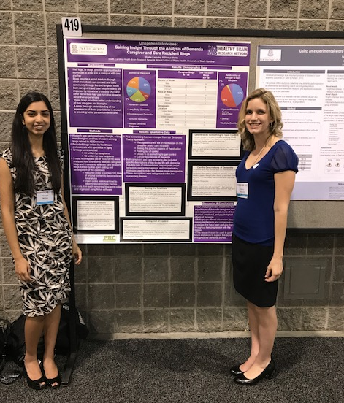
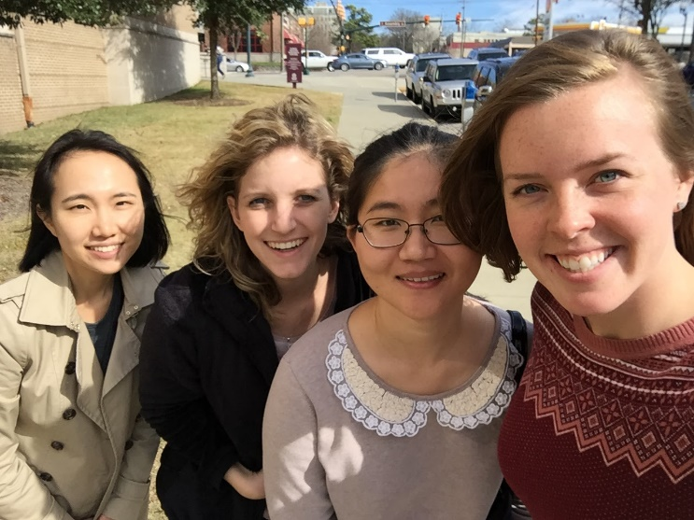
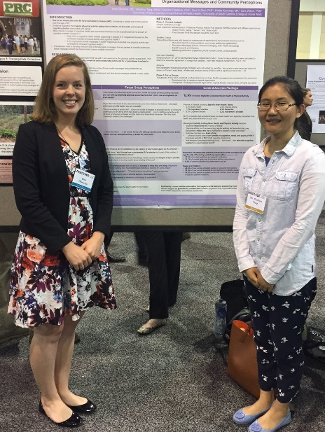
South Carolina HBRN Scholars
Undergraduate to postdoctoral levels
Represent multiple departments
Participate in multi-sites HBRN projects

Slide 12
A Pot-Pourri of Research Studies
Qualitative “Healthy Brain Study” (perspectives of older adults, caregivers, and providers)
National Survey Research (health care providers’ perceptions and practices)
Scoping Review Study
Media Analysis (magazines, YouTube, mobile App)
Social Media Campaign Study (Puerto Rico partners)

Slide 13
Qualitative “Healthy Brain Study”
Conducted 80+ focus groups with 616+ participants across 9 CDC-funded Healthy Aging Research Network sites (2005-2009)
Focus groups were with:
rural and urban older adults
diverse racial/ethnic groups
caregivers
healthcare providers

Slide 14
Perspectives of Older Adults
Concerned about cognitive decline
Believe physical activity, healthy diet, social activity, mental activity, and spirituality help you “stay sharp” and be “right in the mind”
Different cultures emphasized different aspects of cognition
Mixed media messages
“I don’t know if there’s anything left that really they [media] know that is healthy for you.”

Slide 16
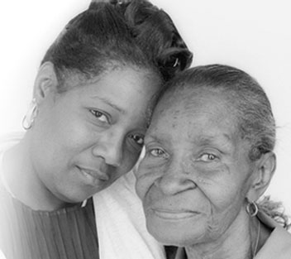
Caregivers’ Perspectives
Focused on care recipients’ symptoms associated with dementia
Described their own coping strategies:
“The main thing is staying active. Exercise the brain whenever you can because the brain goes idle if you don’t use it.”
Notes:
Caregivers focused on the challenges of care recipient symptoms associated with dementia, including severe memory loss and behavioral changes, and described strategies that helped them cope with these challenges.

Slide 17
Providers’ Perspectives
Conversations with patients about cognition were unusual
Physicians recognized cognitive benefits of their health recommendations
Healthcare system, clinical, & patient barriers limited discussions unless prompted by patients, families, or signs of cognitive dysfunction
“I have never initiated it [conversation] when the patient did not ask or when there was obvious family dementia or something that would bring it in closer. It’s not something I normally initiate in part because I don’t feel that we have that much to offer for it, aside from what I’m trying to do with their health in general.”
Notes:
17

Slide 18
National Survey Research Porter Novelli DocStyles (n=1,250) & HealthStyles (n=4,728)
Providers reported advising patients about reducing risks of cognitive impairment
Consumers reported receiving this information from other sources
Need to understand potential discrepancies in communications between patients and providers and improve communications about cognitive health and impairment
Notes:
First studies to examine health care providers’ perceptions and practices regarding cognitive functioning and to compare the beliefs and communication practices of consumers and primary care providers.
DocStyles 2008 – 972 providers
DocStyles 2009 – 1250 providers (physicians and nurse practitioners)
HealthStyles 2009 – 4,728 18+

Slide 19
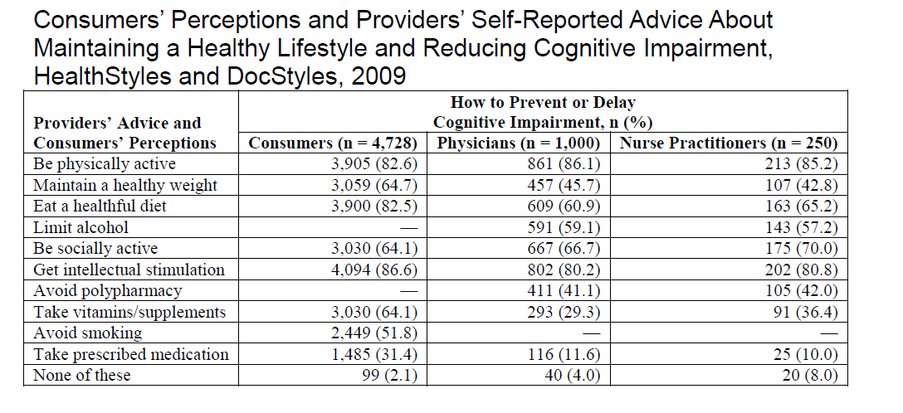
Friedman, D. B., Rose, I. D., Anderson, L. A., et al. (2013). Beliefs and communication practices regarding cognitive functioning among consumers and primary care providers in the United States, 2009. Preventing Chronic Disease,10, E58-quiz.

Slide 20
Scoping Review Study
Review helped inform actions of the 2013 Road Map to better understand perceptions about cognition
Reviewed 1,000+ research abstracts; 34 studies addressed our topic
Studies conducted in 8 countries
Participant numbers ranged from 9 (personal interviews) to 4,500 (national surveys)
Most studies looked at dementia or AD
Top 2 risk factors people mentioned across 34 studies were:
Genetics/heredity (14 studies)
Older age (8)
Top 3 protective factors people mentioned were:
Intellectual stimulation/mental activity (13)
Physical activity (12)
Healthy diet (10)
Friedman, D. B., Becofsky, K., Anderson, L. A., et al. (2015). Public perceptions about risk and protective factors for cognitive health and impairment: a review of the literature. International Psychogeriatrics, 27(8), 1263-1275.

Slide 21

Scoping Review Findings
General public, regardless of nationality, race/ethnicity, or gender, identified well-established risk factors for cognitive impairment and factors that may reduce risk of Alzheimer’s disease and other dementias
"If you stay indoors and don’t get out, then your mind will slow down. When you have time, even if you just chat with your friends, you will be more open, and able to keep your mind sharp."

Slide 22
Scoping Review Findings
Investigators did not identify a consistent set of risk or protective factors across studies
Future research should use uniform set of factors across studies to better track changes in perceptions over time and across locations and cultures

Slide 23


Media Analysis
Media analysis of 178 articles in 20 top-circulating magazines for:
General audiences
Women
Men
African Americans
Health conscious
Diet was discussed most & physical activity coverage limited
Risk factors such as hypertension rarely mentioned
Publications for African Americans had little content about cognition
Separate analysis of 63 English- and Spanish-language AARP magazine articles focused on physical activity revealed:
Only 3 English articles and no Spanish articles mentioned potential association of physical activity and risk reduction for ADRD
Assessment of 229 news items on three top cable news websites (MSNBC, CNN, FOX) found that stories intended for an aging audience more frequently focused on physical activity, diet, multiple lifestyle behaviors, and aging compared with news for general audiences
Friedman et al., 2011; Rose et al., 2013; Vandenberg et al., 2012

Slide 24
Media Portrayal of Protective Factors for Cognitive Health
Notes:
Figure 2. Main focus areas of 143 popular magazine articles
about cognitive health having a single primary health focus (2006-2007).
(Percentages do not total 100 because less frequently occurring
focus areas are not shown.)
Very little mention of physical activity – coverage not commensurate with state of the science

Slide 25

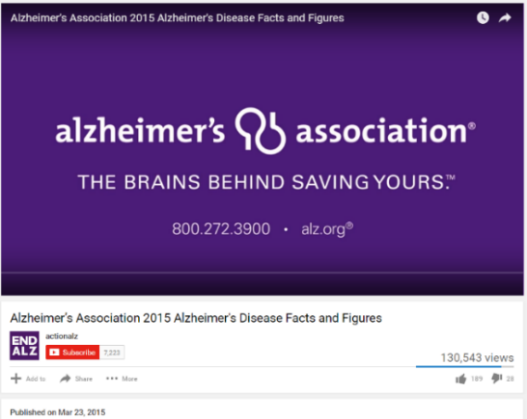
Alzheimer’s Disease Messaging on YouTube
Objective: To examine the content, format, and sources of AD-focused YouTube videos
Results:
- Final sample: 271 videos (over 3-year period)
- Most videos featured white speakers (89.8%), and adults ~20-60 yrs old (87.7%)
- Primary focus: symptoms, causes, and treatment of AD
- Authorship: non-profit organizations, layperson, for profit organizations or
companies
Limited content on high risk groups; limited attention to cultural aspects
Need to check quality and accuracy of YouTube videos about AD
Tang, W., Olscamp, K., Choi, S. K., & Friedman, D. B. (2017). Alzheimer’s disease in social media: content analysis of YouTube videos. Interactive Journal of Medical Research, 6(2), e19.
Notes:
Although AD symptoms (30.6%), causes of AD (29.5%), and treatment (28.0%) were commonly
addressed, quality of life of people with AD (12.5%) had more views than those more commonly
covered content areas.

Slide 26
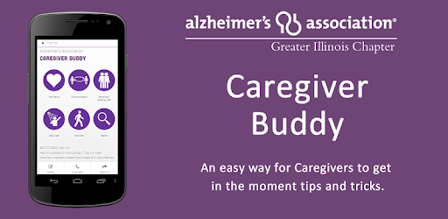
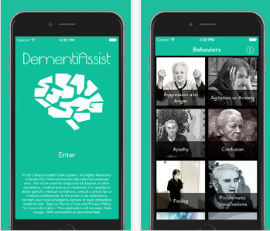
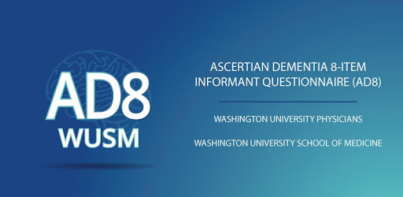
Mobile Applications About Alzheimer’s Disease and Related Dementias
Characteristics, content, and technical aspects of 36 apps in the U.S. Google Play Store and App Store were coded; Quality of the apps was evaluated using the Mobile Application Rating Scale.
Results:
- Most apps were designed for caregivers of individuals with ADRD or for the general
population
- Caregiving and disease management content was frequently provided
- Overall, quality of the apps was acceptable; apps by health care–related developers had
higher quality scores than those by non-health care–related developers
Future studies and those who plan to develop ADRD apps need to focus on:
- Users’ characteristics (e.g., demographics, level of health and technology literacy, etc.)
- Users’ needs and experience of apps
Choi, S. K., Yelton, B., Ezeanya, V. K., Kannaley, K., & Friedman, D. B. (2018). Review of the content and quality of mobile applications about Alzheimer’s disease and related dementias. Journal of Applied Gerontology, DOI: 10.1177/0733464818790187.

Slide 27
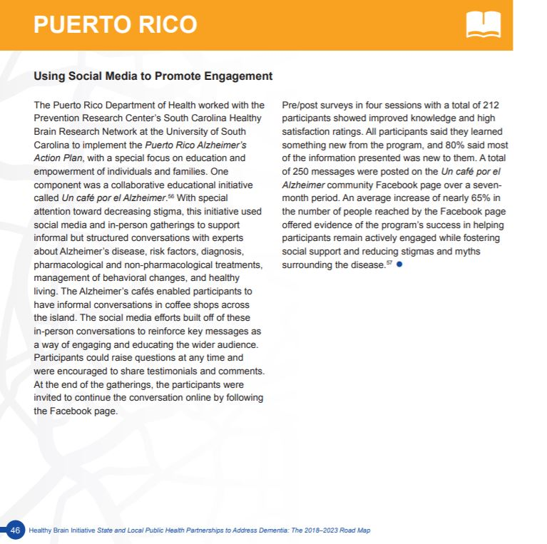
Social Media Campaign in Puerto Rico
Un Café por el Alzheimer
incorporates both an in person education component at coffee shops and other venues and a social media campaign using Facebook.
From The Healthy Brain Initiative: The Public Health Road Map for State and National Partnerships, 2018–2023
Notes:
Meeting people where they are – coffee shops!

Slide 28
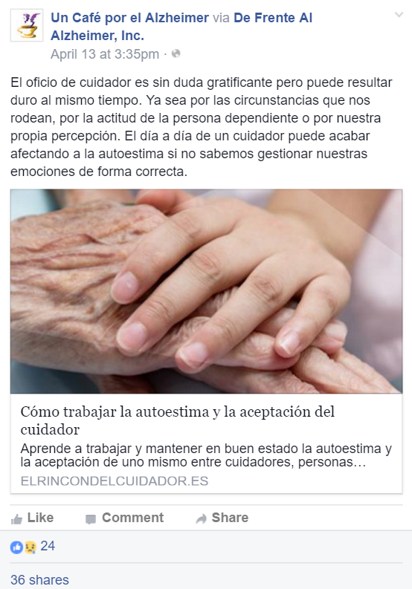

An Evaluation of the Puerto Rico Un Café por el Alzheimer Program
Objective: To analyze both an in-person education component and a social media campaign using Facebook for the Un Café por el Alzheimer education program
Friedman, D. B., Gibson, A., Torres, W., Irizarry, J., Rodriguez, J., Tang, W., & Kannaley, K. (2016). Increasing community awareness about Alzheimer’s disease in Puerto Rico through coffee shop education and social media. Journal of Community Health, 41(5), 1006-1012.

Slide 29
Puerto Rico Study Findings
4 education sessions (co-developed with community) were conducted with a total of 212 participants; 51 participants completed both pre- and post-surveys
Improved AD knowledge following in-person education; 96% reported they understood information presented and would recommend the program to others
Total of 250 posts on the Un Café por el Alzheimer community Facebook page with 168 posts related to AD
The Facebook page reached 294,109 people, with 9,963 page likes, 17,780 post clicks, and 3,632 shares; individuals made 610 comments related to the posts
Average increase of 64.8% in number of people reached by the Facebook page following the education sessions
60.6% of the posts announced upcoming events, meetings, or forums about AD

Slide 30
Summary/Implications of Findings
Findings informed national and state efforts to enhance awareness and increase programming for individuals with AD and caregivers
Need to continue to examine providers’ cognitive health perceptions, knowledge, and communication
Consider cultural perceptions and opinions about cognition in message development, format, and dissemination

Slide 31
Summary/Implications of Findings
Understanding public’s perceptions about cognitive health and impairment and partnering with communities upfront in message development help identify culturally appropriate strategies to increase public awareness and develop effective communication
Interdisciplinary dialogue is needed to enhance understanding between researchers and the media
Clarity needed in defining cognitive concepts and measurement for journalists’ reporting and public consumption

