Slide 1

K-Awards:
Guidelines for the Application and Submission Process
Monique J. Brown, PhD, MPH
Department of Epidemiology and Biostatistics
CCADMR Seminar
April 15, 2022

Slide 2
outline
What is a K-Award?
Types of K-Awards
Mentorship Team
Candidate Section
Environmental and Institutional Commitment to the Candidate
Research Strategy
Reference Letters
Summary

Slide 3

What is a K-award?
Research career development award granted by the NIH that provides individual and institutional research training opportunities

Slide 4
Types of k-awards
K01 - For support of a postdoctoral or early career research scientist committed to research, in need of both advanced research training and additional experience.
K02 - For support of an early to mid-career scientist with research funding, in need of additional protected time committed to research.
K05 - For the support of a senior research scientist with research funding, to pursue independent research, and to serve as a mentor to more junior research scientists

Slide 5
Types of k-award (cont.)
K07 - To support either a mentored or independent investigator to develop or enhance curricula, foster academic career development of promising young teacher-investigators, and to strengthen existing teaching programs
K12 - To provide support for newly trained clinicians appointed by an institution for development of independent research skills and experience in a fundamental science within the framework of an interdisciplinary research and development program.

Slide 6
Types of k-award (cont.)
K22 - To provide support to outstanding newly trained basic or clinical investigators to develop their independent research skills through a two- phase program; an initial mentored research experience, followed by a period of independent research.
K99/R00 - To support both an initial mentored research experience (K99) followed by independent research (R00) for highly qualified, postdoctoral researchers, to secure an independent research position. Award recipients are expected to compete successfully for independent R01 support during the R00 phase.

Slide 7
Types of k-award (cont.)
K23 - To provide support for the career development of clinically trained professionals who have made a commitment to patient-oriented research, and who have the potential to develop into productive, clinical investigators
K25 - To support the career development of investigators with quantitative scientific and engineering backgrounds outside of biology or medicine who have made a commitment to focus their research endeavors on basic or clinical biomedical research.

Slide 8
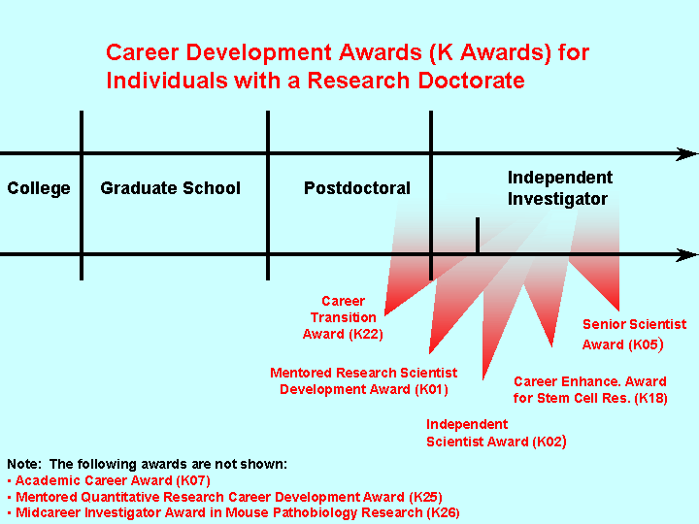

Slide 9
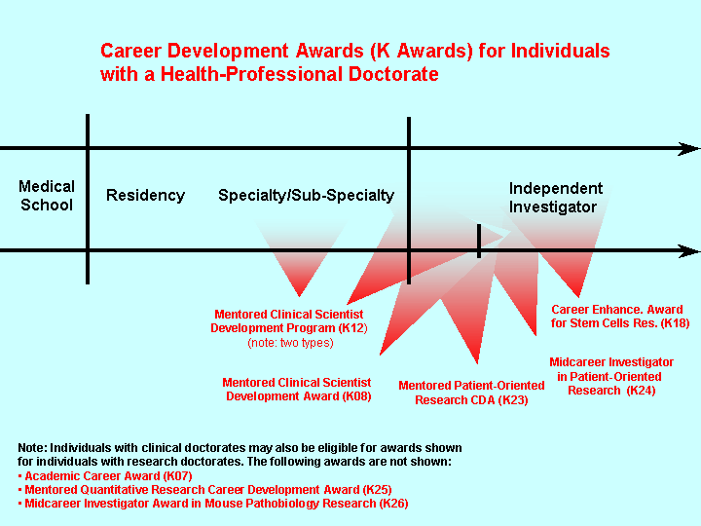

Slide 10
Mentorship team

Slide 11

Choosing a mentorship team
Mentors should be experts in areas where you seek mentorship
Avoid overlap of expertise
  Two mentors should not be mentoring you in one topic area

Slide 12
Choosing a mentorship team (Cont.)
Great if mentors are well-known in the field
  Double-edged sword?
  May not have time to be an involved and engaged mentor
Mixture of senior and mid-career experts
Should have a track-record of successfully mentoring candidates at your level
Biosketches should show these points

Slide 13

Plan and statement of primary mentor
Together with the candidate, is responsible for the proposed program:
  Planning
  Directing
  Monitoring
  Executing
The mentor should have sufficient independent research support to cover the costs of the proposed research project in excess of the allowable costs of this award.

Slide 14
Plan and statement of primary mentor
Information on his/her/their research qualifications and previous experience as a research supervisor
A plan that describes the nature of the supervision and mentoring that will occur during the proposed award period
A plan for career progression for the candidate to move from the mentored stage of his/her career to independent research investigator status during the project period of the award
A plan for monitoring the candidate’s research, publications, and progression towards independence

Slide 15

Plan and statement of primary mentor
The primary mentor must agree to provide annual evaluations of the candidate’s progress as required in the annual progress report.

Slide 16

CO-mentors
The candidate may also nominate co-mentors as appropriate to the goals of the program.
Similar information must be provided by any co-mentor.
If more than one co-mentor is proposed, the respective areas of expertise and responsibility of each should be described.
  Co-mentors should clearly describe how they will coordinate the mentoring of the candidate.
  If any co-mentor is not located at the sponsoring institution, a statement should be provided describing the mechanism(s) and frequency of communication with the candidate.

Slide 17
Co-mentors
If the applicant is proposing to gain experience in a clinical trial as part of his or her research career development, the mentor or a member of the mentoring team must include a statement to document leadership of the clinical trial, and appropriate expertise to guide the applicant in any proposed clinical trials research experience.

Slide 18
Collaborators, Contributors and Consultants
Signed statements must be provided by all collaborators and/or consultants confirming their participation in the project and describing their specific roles.
Information should be provided clearly documenting the appropriate expertise in the proposed areas of consulting/collaboration.

Slide 19
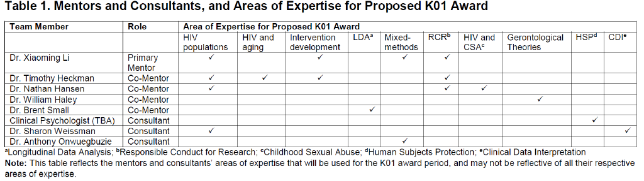

Slide 20
Candidate section

Slide 21
Candidate background
Describe the candidate's commitment to a health-related research career.
Describe all the candidate's professional responsibilities in the grantee institution and elsewhere and describe their relationship to the proposed activities on the career award.
Describe prior training and how it relates to the objectives and long-term career plans of the candidate.

Slide 22
Candidate background (cont.)
Describe the candidate's research efforts to this point in his/her research career, including any publications, prior research interests and experience.
Provide evidence of the candidate's potential to develop into an independent investigator.
  Usually this is evident from publications, prior research interests and experience, and reference letters.

Slide 23
Career goals and objectives
Describe a systematic plan that:
Shows a logical progression from prior research and training experiences to the research and career development experiences that will occur during the career award period and then to independent investigator status
Justifies the need for further career development to become an independent investigator.

Slide 24

Career goals and objectives (Cont.)
The candidate must demonstrate they have received training/will participate in courses:
Data management
Epidemiology
Study design (including statistics)
Hypothesis development
Legal and ethical issues associated with research on human subjects and clinical trials

Slide 25

Candidate’s Plan for Career Development
The candidate and the mentor are jointly responsible for the preparation of the career development plan.
A career development timeline is often helpful.
The mentor and any co-mentor may form a mentoring team to assist with the development of a program of study or to monitor the candidate's progress through the career development program.

Slide 26
Candidate’s Plan for Career Development
The didactic (if any) and the research aspects of the plan must be designed to develop the necessary knowledge and research skills in scientific areas relevant to the candidate's career goals.
Describe the professional responsibilities/activities including other research projects beyond the minimum time required.
  Explain how these responsibilities/activities will help ensure career progression to achieve independence as an investigator.

Slide 27
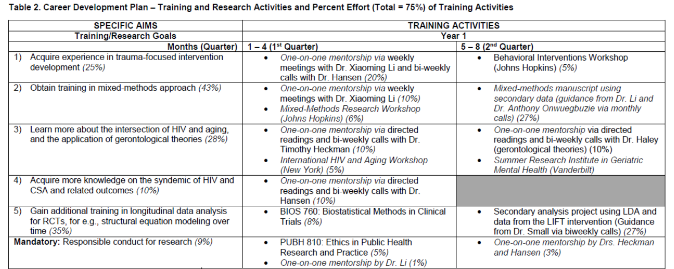
Career Development Plan Example

Slide 28

Environmental and Institutional Commitment to the Candidate

Slide 29
Description of Institutional Environment
The sponsoring institution must document a strong, well-established research and career development program related to the candidate's area of interest, including a high-quality research environment with key faculty members and other investigators capable of productive collaboration with the candidate
Describe:
  How the institutional research environment is particularly suited for the development of the candidate's research career and the pursuit of the proposed research plan
  The resources and facilities that will be available to the candidate

Slide 30
Institutional Commitment to the Candidate’s Research Career Development
The sponsoring institution must provide a statement of commitment to the candidate's development into a productive, independent investigator and to meeting the requirements of this award.
  It should be clear that the institutional commitment to the candidate is not contingent upon receipt of the award.
Provide assurance that the candidate will be able to do minimum time required to the development of his/her research program.
  The remaining effort should be devoted to activities related to the development of the candidate’s career as an independent scientist.

Slide 31
Institutional Commitment to the Candidate’s Research Career Development
Provide the candidate with appropriate office and laboratory space, equipment, and other resources and facilities (including access to clinical and/or other research populations) to carry out the proposed research plan.
Provide assurance that appropriate time and support will be available or any proposed mentor(s) and/or other staff consistent with the career development plan.

Slide 32
Research strategy

Slide 33
Research plan
A sound research project that is consistent with the candidate’s level of research development and objectives of his/her career development plan must be provided.
The research description should demonstrate the quality of the candidate’s research thus far and also the novelty, significance, creativity and approach, as well as the ability of the candidate to carry out the research.
Description of the relationship between the mentor’s research and the candidate’s proposed research plan

Slide 34
Research plan with clinical trials
If the applicant is proposing to gain experience in a clinical trial, ancillary clinical trial or a clinical trial feasibility study as part of his or her research career development, describe the relationship of the proposed research project to the clinical trial.

Slide 35
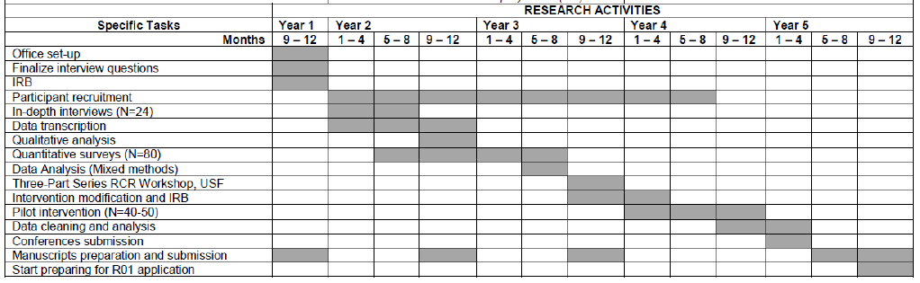
Research timeline

Slide 36
Responsible conduct of research
All applications must include a plan to fulfill NIH requirements for instruction in the Responsible Conduct of Research (RCR).
  Classes
  One-on-one meetings
  Seminars
  Workshops

Slide 37
Reference letters

Slide 38
Letters of recommendation
At least three, but no more than five, reference letters are required.
The letters should be from individuals not directly involved in the application, but who are familiar with the applicant’s qualifications, training, and interests.
The mentor or co-mentors of the application cannot be counted toward the three required references.

Slide 39
summary
K-awards are great opportunities to:
  Obtain additional training
  Protected time to conduct your research
However, a few may see the K as a “disadvantage”
  Teaching?
  Other research opportunities?
Nevertheless, a great “jumpstart” to your research trajectory.
  Provides data for future grant applications
  R01, R34, etc.

Slide 40
Thank you!!
Questions??
Monique J. Brown, PhD, MPH
brownm68@mailbox.sc.edu
803-777-5057
@DrMJBrown

