Slide 1



Aging and Sex in the Media
Lucy A. Ingram, PhD
Daniela B. Friedman, PhD

Slide 2

Ripped from the Headlines…
Forget Sudoku! If you REALLY want to improve brain power in old age regular sex is the key
RESEARCHERS have finally confirmed that frequent sex really is the key to staying sharp in old age.
Notes:
Periodical-- Express: Home of the Daily and Sunday Express
Source: https://www.express.co.uk/news/uk/820737/regular-sex-key-to-improved-brain-power-in-old-age

Slide 3




Slide 4
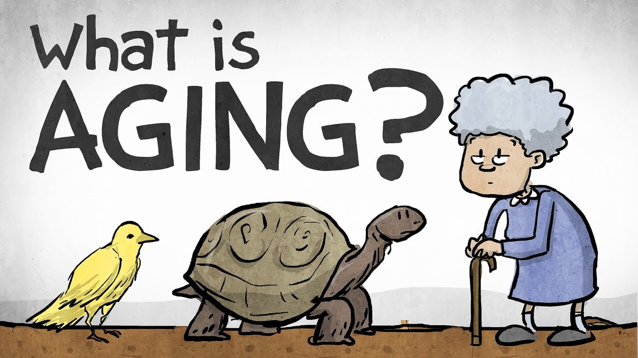
What is Aging? and
Perceptions of Aging

Slide 5
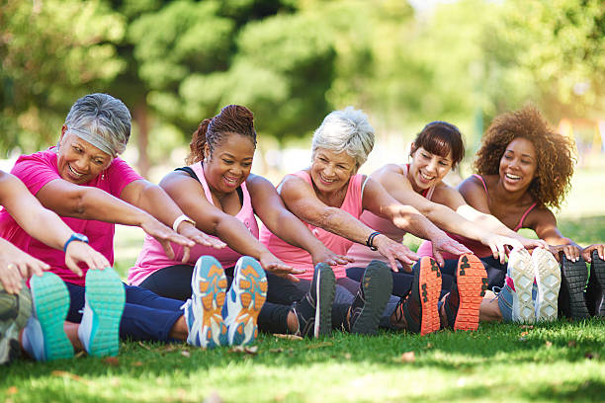
What is Healthy Aging?
Notes:
What is healthy aging?

Slide 6

“The development and maintenance of optimal physical, mental, and social well-being and function in older adults. It is most easily achieved when physical environments and communities are safe and support the adoption and maintenance of attitudes and behaviors known to promote health and well-being and when health services and community programs are used effectively to
prevent or minimize the impact of acute and chronic disease on function.”
Lang JE, Anderson LA, LoGerfo J, et al. The Prevention Research Centers Healthy Aging Research Network. Prev Chronic Dis 2006;3(1):A17.
Notes:
The Centers for Disease Control and Prevention’s Healthy Aging Research Network defines healthy aging as:
“The development and maintenance of optimal physical, mental, and social well-being and function in older adults. It is most easily achieved when physical environments and communities are safe and support the adoption and maintenance of attitudes and behaviors known to promote health and well-being and when health services and community programs are used effectively to prevent or minimize the impact of acute and chronic disease on function. This definition reinforces a social–ecological view of the determinants of health.”

Slide 7
What and how do we think about older people?
encounter
with older person
recognition of
old age cues
negative
changes in
rigidity of cues
Multiple Environmental
Influences
stereotyped
expectations
loss
of personal control and
self esteem
lessened
psychological activity and
social interaction
modified
speech
behavior
toward the older person
reinforcement for age
stereotyped
behaviors
constrained
opportunities
for communication
Ryan, E. B., Giles, H., Bartolucci, G., & Henwood, K. (1986). Psycholinguistic and social psychological components of communication by and with the elderly. Language and Communication, 6, 1-24.
Notes:
So what do we think about older people? This figure represents The Communication Predicament Model developed by Ellen Ryan and colleagues. Let me walk you through it.
When you encounter an older person how do you know that they are older? What are some cues? They may have grey hair, wrinkles, walk more slowly or use an assistive device.
What are common stereotypes of how we think older people act and behave? They may have hearing issues, may talk a lot or not much at all (be passive). There may be others.
What are some ways in which we might modify our speech and behaviors when we interact with older people? We might be overly controlling, overly nurturing. We may speak loudly and slowly and repeat ourselves thinking that the person may not understand us.
This type of behavior on our part reinforces commonly held aging related stereotypes and really limits the communication encounter.
In turn this can lead to lowered self esteem and feelings of loss of control by the older person and leading to this cycle of poor communication as the older person plays into the stereotyped role and others behaving in a way that reinforces that stereotyped behavior.

Slide 8
Improving Our Communication
e
e
n
v
i
r
l
p
o
encounter
with older person
n
i
recognition
of cues
on an individual basis
m
t
maximized
communication
skills and opportunities
e
l
u
modified
communication
to accommodate individual needs
n
increased
effectiveness
and satisfaction of provider
optimized health
well-being
and competence of elder
t
m
a
individual
assessment
for multi-focused interventions
l
s
empowerment
of client and provider
e
c
i
n
e
u
l
f
n
Ryan, Meredith, MacLean, & Orange, 1995
Notes:
How can we improve our communication with older people? Once we recognize those cues we need to modify our communicate to accommodate their needs and not play into stereotypes. This will help empower the older individual to participate equally in the exchange and feel empowered. Hopefully this will result in improved opportunity for communication and will get us out of that cycle on the previous slide where communication opportunities became quite constrained and limited.

Slide 9

Notes:
To continue our discussion about perceptions and how we all perceive things in different ways – who do you see in this image? Some see a young fair maiden facing away from us. Some see an older women. Who do you see? Can you see both?

Slide 10
What is Cognitive/Brain Health?
“the development and preservation of the multidimensional cognitive structure that allows the older adult to maintain social connectedness, an ongoing sense of purpose, and the abilities to function independently, to permit functional recovery from illness or injury, and to cope with residual functional deficits.”
Hendrie HC, et al. The NIH cognitive and emotional health project. Report of the critical evaluation study committee. Alz Dement 2006; 2:12-32.
Notes:
Let’s move on to the definition of cognitive health or brain health? It is:
“the development and preservation of the multidimensional cognitive structure that allows the older adult to maintain social connectedness, an ongoing sense of purpose, and the abilities to function independently, to permit functional recovery from illness or injury, and to cope with residual functional deficits.”

Slide 11

Notes:
-According to the national Alzheimer’s Association in the United States, every 65 seconds someone in the U.S. develops Alzheimer’s disease. A 2020 report showed that an estimated 5.8 million Americans age 65 and older are living with Alzheimer’s dementia. Eighty percent are age 75 or older. By 2050, the number of people age 65 and older with Alzheimer’s is projected to reach 13.8 million.
-Since January 1, 1988, the South Carolina Alzheimer’s Disease Registry has identified 285,984 cases of Alzheimer’s Disease and Related Dementias in South Carolina. Currently, 106,223 individuals in this Registry are still living with the disease.

Slide 12
What are your perceptions of how aging is portrayed in the media?

Slide 13
How does Media Influence our Perceptions about Aging and the Brain?
Notes:
Let’s get back to perceptions and what people think of aging and brain health and/or Alzheimer’s disease risk. How does the media influence our perceptions about aging and the brain? This graph is from a study that examined 178 articles about brain health published across 20 top-circulating magazines in the United States. The graph shows the percent of articles on different topics, including potential protective factors such as diet and physical activity. What is interesting here is that diet was discussed most and physical activity media coverage was limited. But at the time, most of the scientific evidence regarding how to reduce cognitive decline was related to physical activity. For example, based on media coverage the average consumer may have the perception that vitamins and supplements may have more of an effect than physical activity given the attention paid to that topic in the magazines but there is no conclusive evidence supporting that connection.

Slide 14
What is Media?
Different methods of communication designed to reach large audiences
The means through which individuals/groups/ organizations can express themselves and the technology used for that expression
Each type of media involves both content, and also a device or object through which that content is delivered
Notes:
We’ve provided an example of how media might influence our perceptions about aging and the brain. So what is media? I will turn it over to Dr. Ingram to discuss media and media literacy.
Dr. Ingram: There are different methods of communication designed to reach large audiences
Media is the means through which individuals/groups/ organizations can express themselves and the technology used for that expression.

Slide 15
Forms of Media
Electronic
  radio, television, film, streaming music, videos, telephones, computers, Internet, etc.
Print
  newspapers, magazines, books, comics, advertising, etc.
Notes:
There are different types of media —film, tv, music, music videos, social media (e.g. SNS; SNS types—general (for example, Facebook, twitter, etc…)
There are different types of exposure to media – sometimes it is deliberate where we actively seek information. And sometimes it is unconscious exposure.

Slide 16
Forms of Media (con’t)
“New”
  User-driven interactive forms of communication; emphasis on shareability and interactivity
  Delivered digitally
  Text messaging, social networking, memes, podcasts, online videos, virtual worlds
Notes:
We also have “new media” which refers to: User-driven interactive forms of communication; emphasis on shareability and interactivity. This can include: text messaging, social networking, memes, websites, email, blogs, podcasts, chat rooms, online videos, wikis, virtual worlds
Meme definition:
a humorous image, video, piece of text, etc. that is copied (often with slight variations) and spread rapidly by Internet users.

Slide 17
Why Does Media Matter?
Chicken/Egg Debate
  Does media reflect reality?
  Does media create reality?
Media as a powerful socializing agent
  Can teach the values, beliefs, and norms of our culture as individuals develop identity
Notes:
Why does media matter? As we’ve already mentioned, media can influence our perceptions about health. We can envision it similar to that of the chicken and egg debate.
Does media reflect reality?
Does media create reality?
Media can be a powerful socializing agent. It can teach the values, beliefs, and norms of our culture as individuals develop identity
Reminds me of the Ted Talk by Chimamanda Ngozie Adichie “The Danger of a Single Story”

Slide 18
Media Literacy
Framework to access, analyze, evaluate and create messages in a variety of forms
Key media literacy questions—
  Who created this message?
  What creative techniques are used to attract my attention?
  How might different people perceive and understand this message differently from me?
  What lifestyles, values and points of view are represented in, or omitted from, this message?
  Why is this message being sent?
Notes:
Allows us to critically assess the messages and information provided in the media.
Having media literacy is being able to access, analyze, evaluate, and create messages in a variety of forms. As Dr. Friedman described, what is presented in the media may not be commensurate with the state of the science or representative of all populations and we need to ensure that communities know how to accurately interpret information in the media. So media literacy is really a framework for understanding messages and helping us to be intelligent consumers of media information.
Youth begin by defining media, then analyzing it using the five key media literacy questions, they must then evaluate it by relating it to their own personal experiences and judging it against their own values. Finally, youth participate in the creation of a media message which demonstrates their appreciation for the production aspect of media.
Media literacy involves basic critical thinking skills
Knowing how to identify key concepts; how to make connections between multiple ideas
How to ask pertinent questions; formulate responses
Identify fallacies (Center for Media Literacy, 2003)
Media literacy avoids “negating” media that many youth enjoy and highly respect

Slide 19
Sex in the Media
Notes:
Let’s talk about sex in the media.

Slide 20

Not a New Phenomenon
Suggestive versus overt
Sexual content in media is increasing
Much of the research has been conducted on adolescents
Notes:
Seeing evidence of sexual images in the media is not a new phenomenon.
We see examples, likely daily, that can be categorized as either suggestive or overt. “Suggestive” implies that the image or message is something that makes you think about sex, whereas “overt” images and messages are plainly and clearly about sex, sexuality, or sexual relationships.
Also, the amount of sexual content in the media has increased over time. In fact, some would say that the phenomenon is more acceptable as normative and as part of mainstream communication.
Of the extant research in this arena, most of the studies have been about youth rather than aging or older adults.
Talk about sex on TV can occur as often as 8–10 times per hour, and the amount of sexual content continues to rise. Remarkably, shows targeted at teens actually have more sexual content than adult shows (Kunkel, Eyal, Finnerty, Biely, & Donnerstein, 2005). Teen magazines devote an average of 2.5 pages per issue to sexual topics (Brown & Strasburger, 2007; Walsh-Childers, Gotthoffer, Lepre, 2002). A national study of 1560 Internet users ages 10–17 found that 1% of youth self-reported sending sexual images of themselves and 5.9% of youth reported that they had received sexual images (Mitchell, Finkelhor, Jones, & Wolak, 2011).
Abundant research documents that the media can exert a powerful influence on children and teenagers. Dozens of studies show that teenagers learn information and attitudes about sex and sexuality from the media, and that heavy consumers of media are more likely to think that real human behavior mimics behavior seen on TV and in movies (the “cultivation hypothesis”) (Fisher et al., 2009; Wright, Malamuth, Donnerstein, 2012).
Evidence indicates that frequent and involved exposure to sexually oriented genres (i.e., soap operas and music videos) is associated with greater acceptance of stereotypical and casual attitudes about sex, with higher expectations about the prevalence of sexual activity and of certain sexual outcomes, and, even occasionally, with greater levels of sexual experience (Ward, 2003).
Reference list:
-Kunkel D, Eyal K, Finnerty K, Biely E, Donnerstein E. Sex on TV 4: A Biennial Report to the Kaiser Family Foundation. Menlo Park, CA: Kaiser Family Foundation; 2005.
-Walsh-Childers K, Gotthoffer A, Lepre CR. From “just the facts” to “downright salacious:” teens’ and women’s magazines’ coverage of sex and sexual health. In: Brown JD, Steele JR, WalshChilders K, eds. Sexual Teens, Sexual Media. Hillsdale, NJ: Lawrence Erlbaum; 2002:153–171.
-Brown JD, Strasburger VC. From Calvin Klein to Paris Hilton and MySpace: adolescents, sex and the media. Adolesc Med State Art Rev. 2007;18:484–507.
-Mitchell K, Finkelhor D, Jones L, Wolak J. Youth sexting: past year prevalence and episode characteristics from a National Study of Youth. Manuscript under review, 2011.
-Wright PJ, Malamuth NM, Donnerstein E. Research on sex in the media: what do we know about effects on children and adolescents. In: Singer DG, Singer JL, eds. Handbook of Children and the Media. 2nd ed. Thousand Oaks, CA: Sage; 2012, pp. 273–302.
-Fisher DA, Hill DL, Grube JW, Bersamin MM, Walker S, Gruber EL. Televised sexual content and parental mediation: influences on adolescent sexuality. Media Psychol. 2009;12:121–147.
-Ward, L. Monique. "Understanding the role of entertainment media in the sexual socialization of American youth: A review of empirical research." Developmental Review 23.3 (2003): 347-388.

Slide 21
Sex, Media, and Youth
Media use may influence early sexual behavior
  adolescents who viewed more sexual content were more likely to initiate intercourse and progress to more advanced noncoital sexual activities
What is the content of the media? What is the length of time exposed to the media?
The widespread use of sexual media, can present opportunities for the delivery and evaluation of public health interventions
Notes:
Research has shown that media may influence early sexual behavior.
In a study conducted in 2013, researchers investigated whether sexual media content and/or contextual factors (like co-viewing and parental media restrictions) were associated with early sexual behaviour. They found that the likelihood of sexual intercourse was lower with parental restriction of sexual media and same-sex peer co-viewing; but higher with mixed-sex peer co-viewing.
Another study examined how levels of sexually explicit material (SEM) use during adolescence and young adulthood were associated with sexual preference, sexual behaviors, and sexual and relationship satisfaction. Results revealed that both the frequency of SEM use and number of SEM types viewed were uniquely associated with more sexual experience. Higher frequencies of SEM use were associated with less sexual and relationship satisfaction. SEM viewing may set up young adults to expect unrealistic sexual encounters (Morgan, 2011).
A study by Chandra et al. (2008) also reported a longitudinal association between watching sex on television as a teen (ages 12–17 years) and pregnancy before the age of 20.
Sexual media exposure among youth is concerning because we need to know what the youth are experiencing…what are they seeing, what are they hearing…how are they interpreting the images? Also, are these images presented at one point in time, or repeatedly over time? Also, we know that the content could be questionable, inaccurate, and as we’ve seen, likely to be associated with risk behavior.
All of this could present an opportunity in public health for delivering counter messaging and images that are of sexual health in nature or could serve as opportunities to evaluate current sexual content accessed by youth.

Slide 22
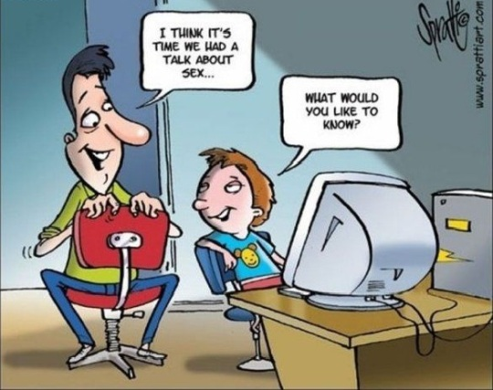
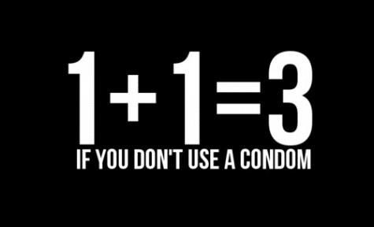
Examples
Notes:
So let’s examine a few images.
The first is a cartoon that illustrates an adult and child (possibly father and son) having the “sex talk”. Here the adult says, “I think it’s time we had a talk about sex.” The child responds with, “What would you like to know.” This image is ironic because typically the flow of information occurs from the adult to the child; however, as is becoming increasingly the case, the child is learning about and may even be able to inform the adult about sex. I think it no coincidence that the young person is sitting in front of a computer, a source of much more information about sex than most parents want to share with their youth.
As a health educator, I delight in the notion that 1+1=3, not the standard mathematical response of “2”, that is if a condom is not used when having sexual intercourse.

Slide 23
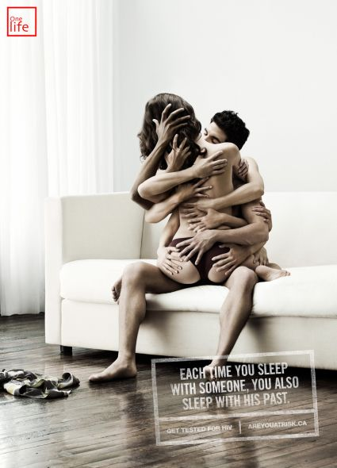
Notes:
Then there is this image. In sexual health education the notion of a person having sex with everyone their partner has had sex with is depicted here. I’ll ask the same question from the previous slide—
What are your thoughts about the necessity of this image to “sell” or communicate this idea?

Slide 24

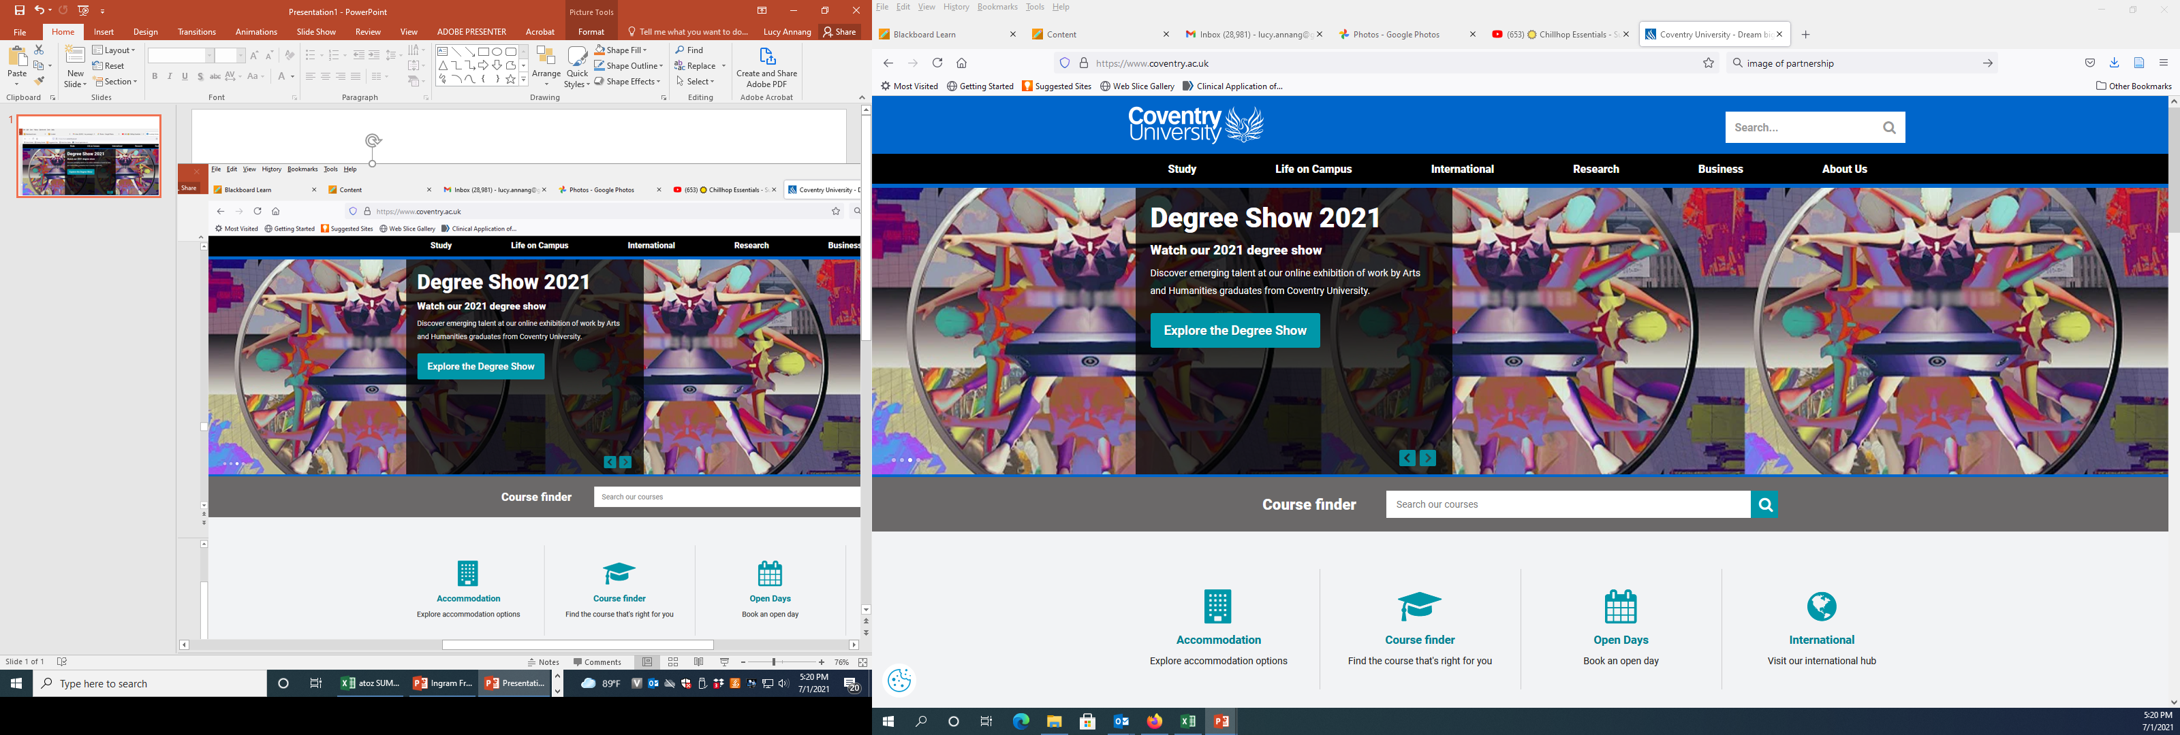

How does this translate to the other end of the age spectrum? What are the implications for aging and older populations?
Notes:
Coventry
No.1 Modern University in the Midlands
Guardian University Guide 2021
1st for Overseas Student Experiences
based on student trips abroad from HESA 2018/19 UK data
Top 30 in the World for International Students
QS World University Rankings 2021
University of the Year for Student Experience 2019
The Times and Sunday Times Good University Guide 2019

Slide 25
Coventry University
No.1 Modern University in the Midlands
1st for Overseas Student Experiences
Top 30 in the World for International Students
University of the Year for Student Experience 2019
Notes:
Coventry
No.1 Modern University in the Midlands
Guardian University Guide 2021
1st for Overseas Student Experiences
based on student trips abroad from HESA 2018/19 UK data
Top 30 in the World for International Students
QS World University Rankings 2021
University of the Year for Student Experience 2019
The Times and Sunday Times Good University Guide 2019

Slide 26



Slide 27

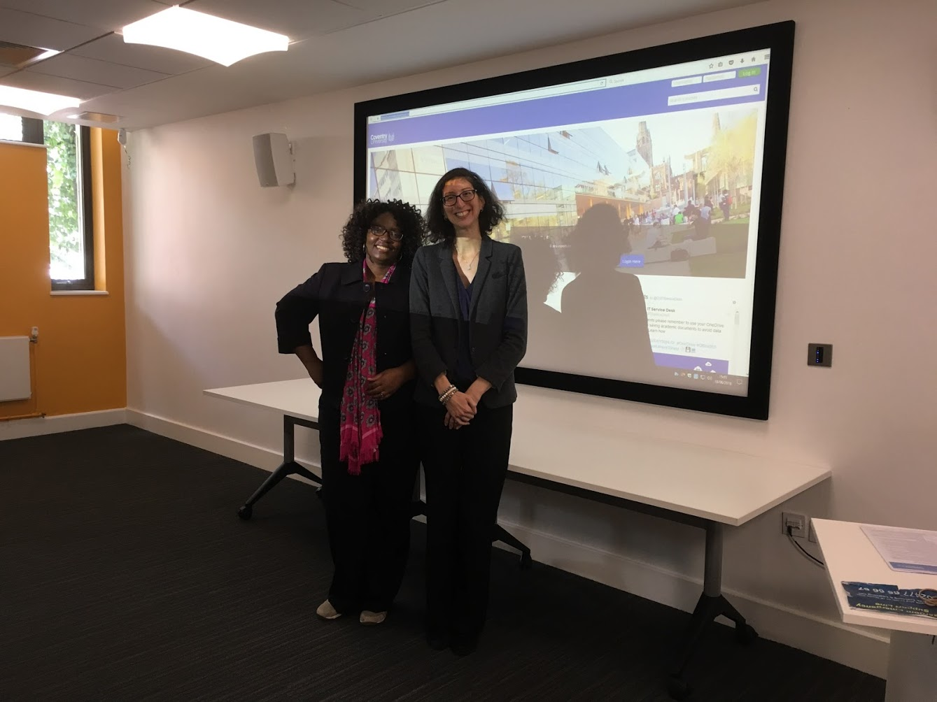

Slide 28
Ripped from the Headlines…
Forget Sudoku! If you REALLY want to improve brain power in old age regular sex is the key
RESEARCHERS have finally confirmed that frequent sex really is the key to staying sharp in old age.
Notes:
Periodical-- Express: Home of the Daily and Sunday Express
Source: https://www.express.co.uk/news/uk/820737/regular-sex-key-to-improved-brain-power-in-old-age

Slide 29
Sex on the Brain! Associations between Sexual Activity and Cognitive Function in Older Age
(Wright & Jenks, 2016)
The relationship between cognition and sexual activity in healthy older adults is under-researched
This study explored the associations between sexual activity and cognition in adults aged 50–89
Study findings have implications for the promotion of sexual counselling in healthcare settings, where maintaining a healthy sex life in older age could be instrumental in improving cognitive function and well-being
Notes:
Age Ageing. 2016 Mar; 45(2): 313–317.

Slide 30
Sexual Expression and Cognitive Function: Gender-Divergent Associations in Older Adults
(Wright et al., 2020)
This study explored the associations between the frequency of engaging in different types of sexual activities and cognitive function in older women and men.
Data source: Wave 6 of the English Longitudinal Study of Aging, 1915 women, 2195 men, ages 50-89 years.
Gendered links were found between sexual activity (masturbation-women vs. kissing-men) and cognitive function (word recall vs. number sequencing).
These gender-related divergences may reflect differences in biological/neurological mechanisms, or in cognitive factors that could influence cognitive reserve in later life.
Notes:
Published in Archives of Sexual Behavior
Prior research demonstrates a positive association between sexual activity and cognitive function in later life. However, the relationship between the type of sexual activity and cognitive function in older adulthood remains unclear.
About ELSA:
The English Longitudinal Study of Ageing (ELSA) is a unique and rich resource of information on the dynamics of health, social, wellbeing and economic circumstances in the English population aged 50 and older.
​
The original sample was drawn from households that had previously responded to the Health Survey for England (HSE) between 1998 and 2001. A pilot study was conducted in 2001 before main fieldwork began in March 2002. The same group of respondents have been interviewed at two-yearly interviews, known as ‘waves’, to measure changes in their health, economic and social circumstances. Younger age groups are replaced or refreshed to retain the panel. The sample has been refreshed using HSE participants in waves 3, 4, 6, 7 and 9.
For women, masturbation was linked to better word recall (p = .008), while for men, kissing/petting/fondling was associated with better number sequencing (p = .035). In women (p = .016) and men (p = .018), dissatisfaction with sex life was associated with better number sequencing.

Slide 31
Other Researchers:
Sexuality and Dementia
Notes:
Let’s talk about sex in the media.

Slide 32
Sexuality & Dementia: An eLearning Resource to Improve Knowledge and Attitudes of Aged-care Staff
(Jones & Moyle, 2016)
Expression of sexuality by older people, particularly those with dementia, can be challenging and confronting for aged-care staff
An eLearning resource was developed
the intervention significantly increased aged-care staff/nursing students’ knowledge about older people’s sexuality and improved staff attitudes and permissiveness towards late life sexuality and the expression of sexuality by people with dementia
Notes:
2nd article
Arch Sex Behav. 2016 Jan;45(1):133-44. doi: 10.1007/s10508-014-0465-1. Epub 2015 Jan 27.
Sexual Health and Well-being Among Older Men and Women in England: Findings from the English Longitudinal Study of Ageing.
Lee DM¹, Nazroo J², O'Connor DB³, Blake M⁴, Pendleton N⁵.
Author information
Abstract
We describe levels of sexual activity, problems with sexual functioning, and concerns about sexual health among older adults in the English Longitudinal Study of Ageing (ELSA), and associations with age, health, and partnership factors. Specifically, a total of 6,201 core ELSA participants (56 % women) aged 50 to >90 completed a comprehensive Sexual Relationships and Activities questionnaire (SRA-Q) included in ELSA Wave 6 (2012/13). The prevalence of reporting any sexual activity in the last year declined with age, with women less likely than men at all ages to report being sexually active. Poorer health was associated with lower levels of sexual activity and a higher prevalence of problems with sexual functioning, particularly among men. Difficulties most frequently reported by sexually active women related to becoming sexually aroused (32 %) and achieving orgasm (27 %), while for men it was erectile function (39 %). Sexual health concerns most commonly reported by women related to their level of sexual desire (11 %) and frequency of sexual activities (8 %). Among men it was level of sexual desire (15 %) and erectile difficulties (14 %). While the likelihood of reporting sexual health concerns tended to decrease with age in women, the opposite was seen in men. Poor sexual functioning and disagreements with a partner about initiating and/or feeling obligated to have sex were associated with greater concerns about and dissatisfaction with overall sex life. Levels of sexual activity decline with increasing age, although a sizable minority of men and women remain sexually active until the eighth and ninth decades of life. Problems with sexual functioning were relatively common, but overall levels of sexual health concerns were much lower. Sexually active men reported higher levels of concern with their sexual health and sexual dissatisfaction than women at all ages. Older peoples' sexual health should be managed, not just in the context of their age, gender, and general health, but also within their existing sexual relationship.
Curr Opin Psychiatry. 2017 Sep;30(5):358-368. doi: 10.1097/YCO.0000000000000354.
Factors associated with sexual health and well being in older adulthood.
Kleinstäuber M¹.
Author information
Abstract
PURPOSE OF REVIEW:
To provide an update of recent studies on factors associated with sexual well being in older people with a special focus on sexual activity, satisfaction and function.
RECENT FINDINGS:
Most recent studies confirmed the relationship between mental health status, especially negative affect and depressive symptoms, and sexual health in older adulthood. However, when this relationship is investigated more deeply, it seems that in fact positive psychological well being (positive affect and quality of life) accounts for sexual activity rather than the lack of depressive symptoms. Moreover, recent studies provided more insight into the relationship between marital characteristics, religion, cognitive functioning and sleeping difficulties and different dimensions of sexual health in older adulthood.
SUMMARY:
In summary, there is substantial previous research revealing associations between various psychosocial, health-related and demographic variables and sexual health in older adulthood. Most considered variables are, for example, age, sex, general physical and mental health. For future research, it is important to consider that relationships between specific variables and sexual health in higher age are usually more complex than they are expected to be and factors differ between different dimensions of sexual health. Communication about sexuality between health-care providers and older patients still implies a lot of barriers and lack of knowledge. Therefore, the provision of communication training for health-care providers to older people in which knowledge is gained about correlates of sexual health in older adulthood should be implemented.

Slide 33
Sexuality & Dementia: An eLearning Resource to Improve Knowledge and Attitudes of Aged-care Staff
(Jones & Moyle, 2016)
staff also reported the importance of existing workplace policy on the expression of sexuality and the need for guided discussions with family members
this can, in turn, improve quality of life, health, and wellbeing for people with dementia

Slide 34
Dementia, Women and Sexuality: How the Intersection of Aging, Gender and Sexuality Magnify Dementia Concerns
(Westwood, 2014)
There is an emergent awareness that dementia is a gendered issue, disproportionately affecting women compared with men
Little attention has been given as yet to the experiences of lesbian and bisexual women living with dementia
This article examined the significance of the intersection of ageing, gender and sexuality for lesbian and bisexual women with dementia

Slide 35
Dementia, Women and Sexuality: How the Intersection of Aging, Gender and Sexuality Magnify Dementia Concerns
(Westwood, 2014)
Findings suggest that stigma and social marginalisation associated with dementia and with ageing, gender and sexuality intersect to compound the social exclusion of lesbians and bisexual women
Community care policy, which is predicated on heterosexist norms, fails to account for older lesbians and bisexual women’s support networks and thus less likely to be attuned to their needs

Slide 36
Future Research Opportunities
Comparison of UK and US: What does it mean to age well?
  Quality of life and sexual health focus
  Diverse populations
Media analysis of sexuality and aging
  Coverage of growing STI rates?
  Is cognitive health considered?
Systematic reviews
Notes:
International journal of aging and human development
The gerontologist
Women and aging
Ageing and society
Sexual health journals?

Slide 37
Other Collaborative Opportunities
Collaborative Online Learning Module: “Sex, Lies, and Mediascape: Misrepresentations across the Lifespan”
  MOU established
  Over 500 students from ASPH and CU
  Over 80% of students enjoyed taking part in the experience and would do it again
Manuscript under review:
  Fostering distance education: Lessons from a United States-England partnered Collaborative Online International Learning (COIL) approach

Slide 38


Thank You!
Daniela B. Friedman, PhD
dbfriedman@sc.edu
Lucy A. Ingram, PhD
Lannang@sc.edu
Notes:
2nd image is of Ernestine Shepherd. She was in the Guinness Book of World Records in 2010 as the oldest female bodybuilder; She is now (as of 7/1/2021 85 years old).

